Slide 1
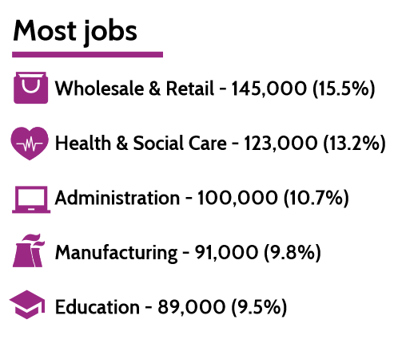
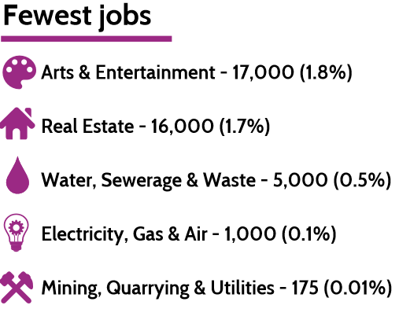
Stockland Green School: CAREERS BULLETIN 2
Post 16 Advice- Opportunities
The Queen Elizabeth Hospital has partnered with Medic Mentor, the UK’s largest medical family, to provide free live virtual work experience to any student in the UK wanting to become a doctor, dentist or vet. For more information please visit
https://medicmentor.co.uk/university-hospitals-birmingham-trust-virtual-work-experience/
Kennedys Virtual Apprenticeship Insight Event
Kennedy’s Law apprenticeships will be hosting a virtual insight event on Monday 26 October between 12pm - 1pm. This session will be a great way to gain a further insight into the Legal Apprenticeship we offer here at Kennedys. The event is for school and college students who have completed or are soon to complete their A Levels (or equivalent studies) and are interested in this alternative route to qualification as a solicitor. Parents can also access this information to gain a better insight.
Please visit:
https://fsr.cvmailuk.com/kennedys/main.cfm?page=jobSpecific&jobId=50962&rcd=1079832&queryString=groupType%5F105%3D3385%26groupType%5F8%3D%26groupType%5F21%3D%26srxksl%3D1&srxksl=1
General Information/ Notifications
Please see email sent to parent/carers email address about post 16 college open events.
Reminder for pathways event mentioned in Bulletin 1. To register and access the webinar follow the link:
Pathways 22nd October: https://www.eventbrite.co.uk/e/121227267019
Useful links
https://nationalcareers.service.gov.uk/
https://www.gov.uk/apply-apprenticeship
https://careerpilot.org.uk/
Information about Traineeships: https://amazingapprenticeships.com/app/uploads/2020/07/Traineeships-11-May-2020.pdf

