Slide 1
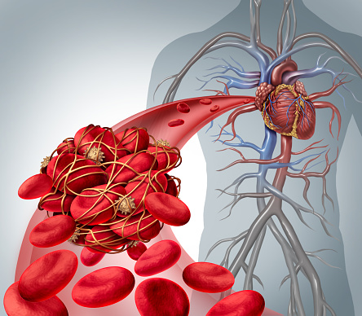
Overview
Organisation
Principles of organisation
Animal tissues, organs and
organ systems
  The human digestive system
  Enzymes
  The heart and blood vessels
  Blood
  Coronary heart disease: a non-communicable disease
  Health issues
  The effect of lifestyle on some non-communicable diseases
  Cancer
Plant tissues, organs and systems
  Plant tissues
  Plant organ system

Slide 2
  Principles of Organisation
organism | A group of organ systems working together. | e.g. human, frog, oak tree, orchid
organ system | A group of organs working together to perform a specific function. | e.g. digestive system, respiratory system, root system, shoot system
organ | A group of tissues working together to perform a specific function. | e.g. heart, stomach, leaf, flower
tissue | A group of similar cells with a similar structure and function. | e.g. muscle tissue, blood, xylem, phloem
cell | The smallest structural and functional unit of an organism. | e.g. nerve, epithelial, palisade, root hair
smallest largest
muscle cell
muscle tissue
heart
circulatory system
human
Video - Organisation in Plants
Notes:
http://www.bbc.co.uk/education/clips/zs2r87h

Slide 3
  Animal tissues, organs and organ systems Part 1 - The human digestive system
The digestive system is an example of an organ system where different organs work together to digest and absorb food.
Digestion is where large insoluble molecules are broken down into smaller soluble ones that can be absorbed into the bloodstream. Digestion occurs in the GUT (tube from the mouth to the anus) and it relies on ENZYMES (biological catalysts).
Activity - Digestive Enzymes
Digestive Enzyme | Where released? | Breakdown what?
Amylase | Salivary glands and pancreas | Carbohydrates into simple sugars
Protease | Stomach and pancreas | Proteins into amino acids
Lipase | Pancreas | Fats and oils (lipids) into fatty acids and glycerol
Video - Digestion and Enzymes
PiXL - Required Practical Guide Food Tests
Notes:
http://www.bbc.co.uk/education/clips/z6nwmp3
Activity
http://www.bbc.co.uk/education/guides/zwqycdm/activity

Slide 4
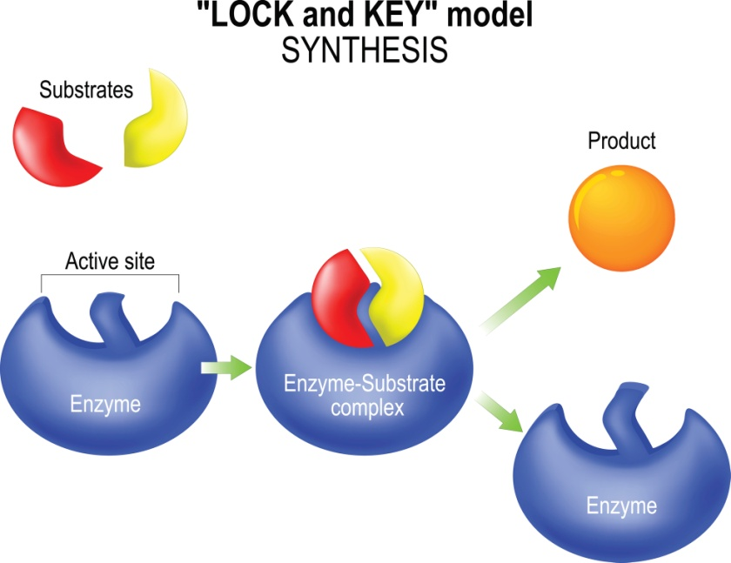
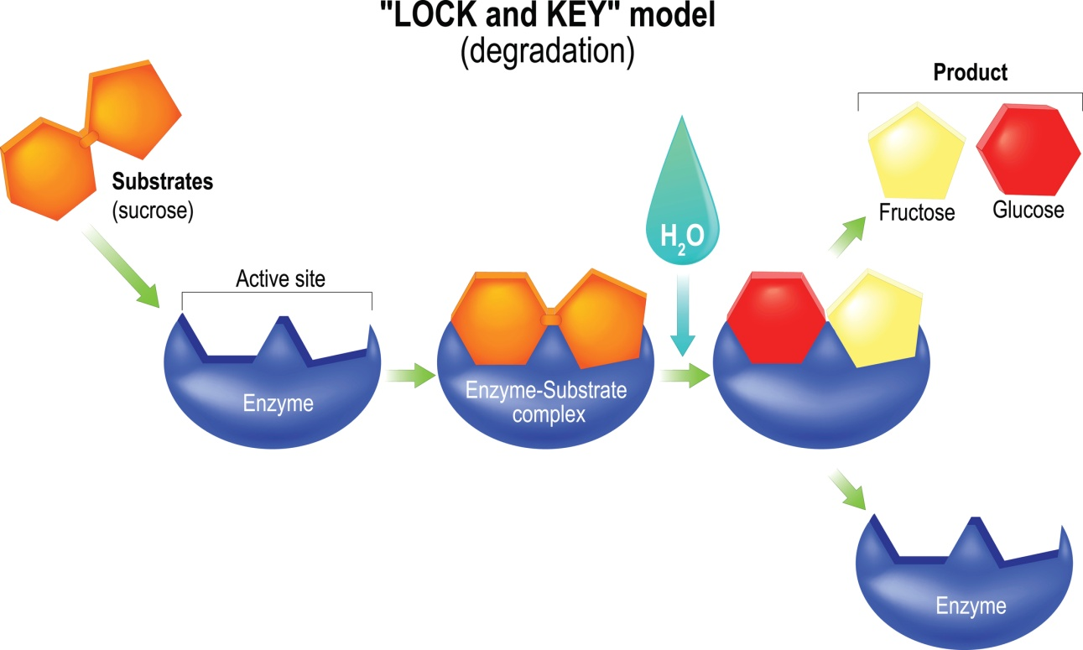
  Animal tissues, organs and organ systems Part 1 - The human digestive system
‘Lock and Key theory’ – is a model to explain enzyme action
Enzymes are made of proteins and are biological catalysts - substances that increase the rate of chemical reactions without being used up. The shape of the active site of the enzyme is specific for each substrate (substance the enzyme acts on).
Video - Enzymes
The products of digestion are used to build new carbohydrates, lipids and proteins in the body. Some glucose is used in respiration.
PiXL - Required Practical Guides - Enzymes
Notes:
http://www.bbc.co.uk/education/clips/zpk9wmn

Slide 5
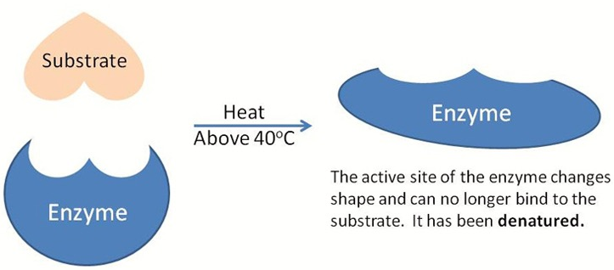
  Animal tissues, organs and organ systems Part 1 - The human digestive system
Enzyme activity is affected by temperature and by pH. Specific conditions are needed to keep enzymes working at their best. OPTIMUM CONDITIONS! Enzymes control the chemical reactions in the body this is known as metabolism.
DENATURED
In enzyme reactions, increasing the temperature will initially increase the rate of reaction due to increased collisions between the enzyme and substrates. BUT if the temperature is too high the enzyme will denature (NB: denature NOT die/killed)
The active site has changed shape so the substrate cannot fit
Digestion and pH. The stomach releases acid. The enzymes made in the stomach work best in acidic conditions. The enzymes made in the pancreas and small intestine work best in alkaline conditions.
Bile is made in the liver and stored in
the gall bladder. It is alkaline to
neutralise hydrochloric acid from
the stomach. It also emulsifies fat
to form small droplets which
increases the surface area.
The alkaline conditions and large surface area increase the rate of fat breakdown by lipase.

Slide 6
  Animal tissues, organs and organ systems Part 2 - The heart
Video - The heart
The heart is an organ that pumps blood around the body in a double circulatory system
1. The right ventricle pumps blood to the lungs where gas exchange takes place
2. The left ventricle pumps blood around the rest of
the body.
Coronary arteries supply oxygen rich blood to the heart muscle.
The natural resting heart rate is controlled by a group of cells in the right atrium (pacemaker). Artificial electrical pacemakers are used to correct irregularities in the heart rate.
Notes:
http://www.bbc.co.uk/education/clips/z627sbk

Slide 7
  Animal tissues, organs and organ systems Part 2 - The lungs and gas exchange
Video - Lungs
The heart pumps low oxygen/high carbon dioxide containing blood to the lungs.
In the lungs, oxygen and carbon dioxide are exchanged in the tiny air sacs (alveoli) at the end of the bronchial tubes. The alveoli are surrounded by capillaries.
Notes:
https://www.youtube.com/watch?v=8NUxvJS-_0k

Slide 8
  Animal tissues, organs and organ systems Part 2 – Blood vessels
Video - Blood Vessels
Arteries
Carry blood away from the heart
Thick muscular walls
Small lumen (internal hole)
Carry blood under high pressure
Veins
Carry blood to the heart
Thin walls
Large lumen (internal hole)
Carry blood under low pressure
Have valves
Capillaries
Connect arteries and veins
One cell thick
Carry blood under very low pressure
All arteries carry oxygenated blood except for the pulmonary artery.
All veins carry deoxygenated blood except for the pulmonary vein.
Notes:
https://www.youtube.com/watch?v=e29I6zIq79A

Slide 9
  Animal tissues, organs and organ systems Part 2 - Blood
Plasma – Pale yellow fluid part of blood, transports cells, CO₂, hormones and waste.
Red blood cells (erythrocytes)
- have no nucleus (more room to carry O₂)
- contain the red pigment haemoglobin which carries O₂
oxygen + haemoglobin → oxyhaemoglobin
- they have a large surface area to volume ratio for faster diffusion of oxygen
White blood cells - An important part of the immune system, some produce antibodies (proteins that bind to microbes and destroy them) and others surround and engulf foreign cells, all have a nucleus.
Platelets - Tiny fragments of cells (no nuclei), clump together to help form clots, protect the body by stopping/reducing bleeding.
Blood is a tissue consisting of plasma, in which the red blood cells, white blood cells and platelets are suspended.

Slide 10
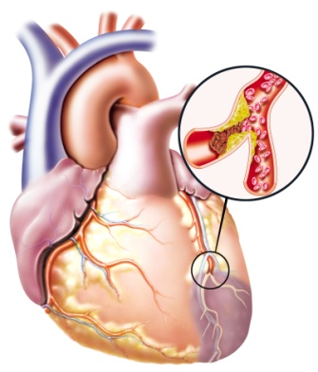
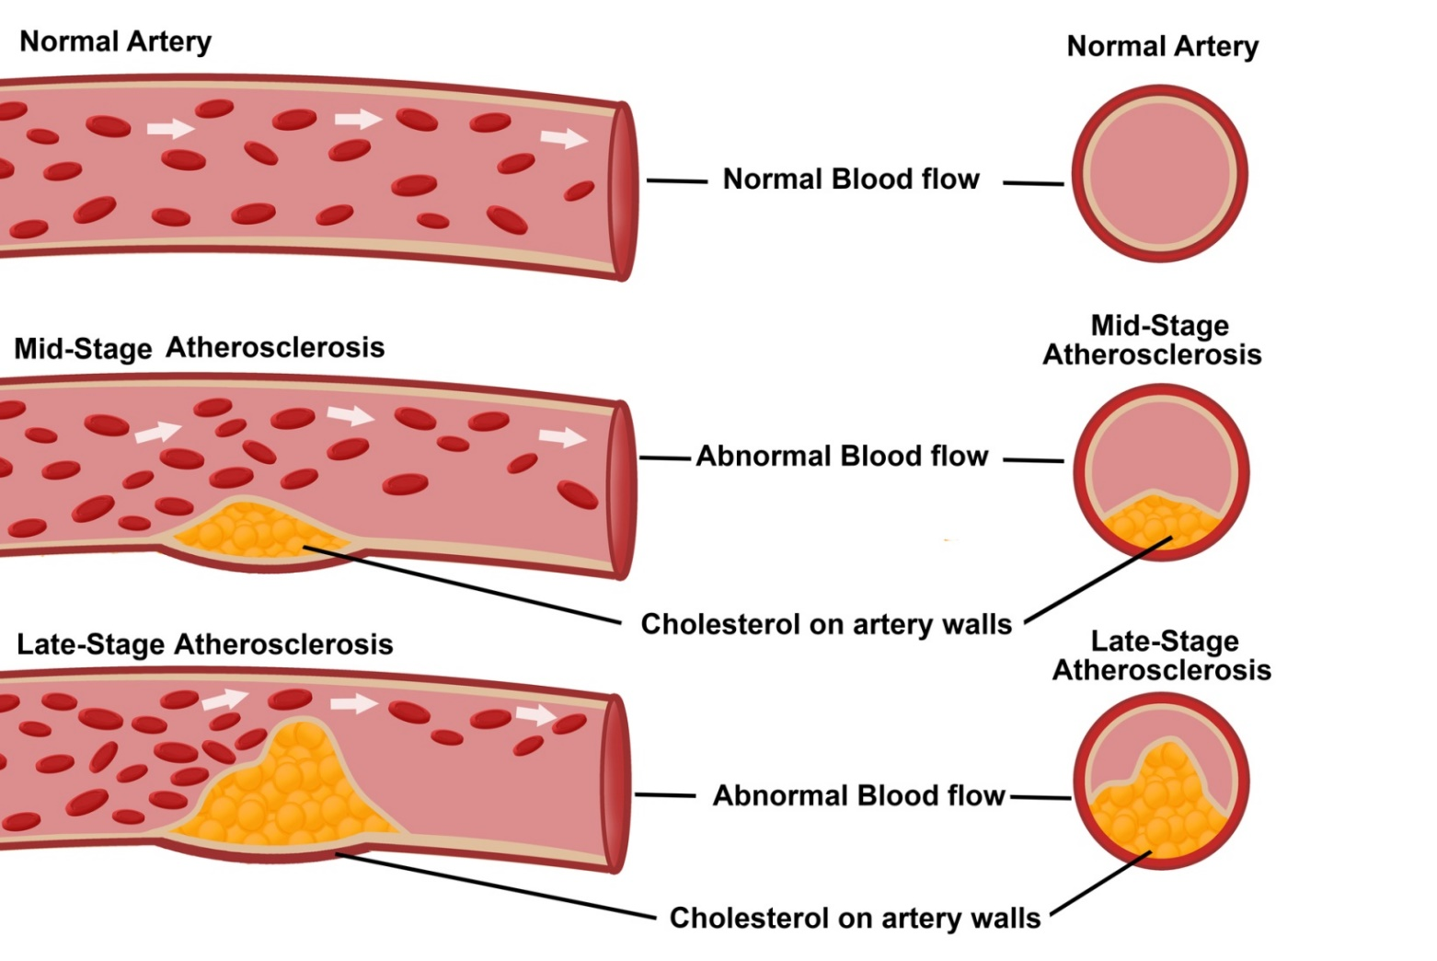
  Animal tissues, organs and organ systems Part 2 - Coronary heart disease
Atherosclerosis is a cause of coronary heart disease (CHD) where layers of fatty material build up inside the coronary arteries, narrowing them. This reduces the flow of blood through the coronary arteries, resulting in a lack of oxygen for the heart muscle.
coronary arteries
Risk factors for CHD:
Smoking and High Blood pressure: damages the lining of the artery, leading to a build up of fatty deposits.
High cholesterol: Cholesterol is a fatty substance that is carried in your blood by proteins.
Not enough exercise: Increases blood pressure and cholesterol in the blood.
Video - Coronary Heart Disease

Slide 11
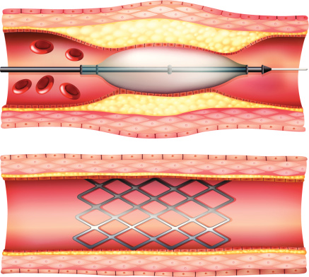
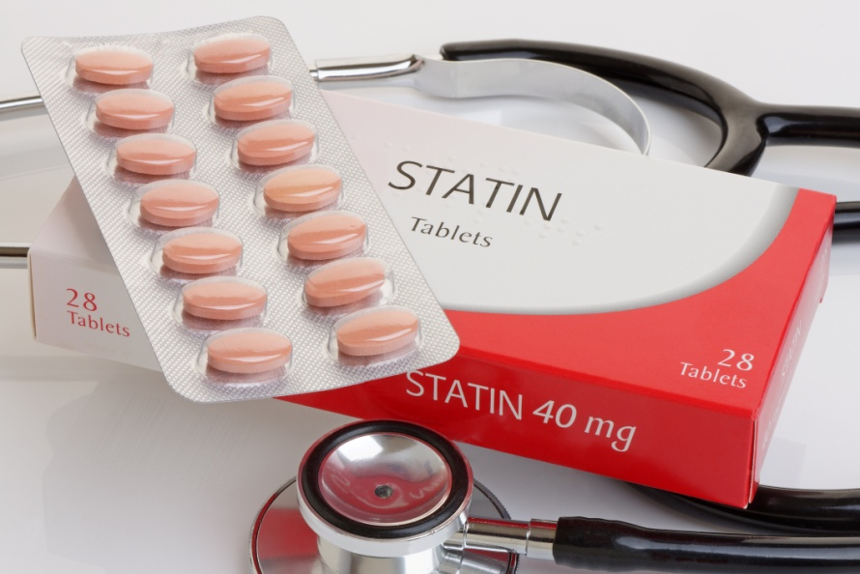
  Animal tissues, organs and organ systems Part 2 - Coronary heart disease
Atherosclerosis (coronary heart disease) can be treated in two main ways by placing a stent in the coronary artery and/or using drugs called statins.
Stents are metal cylinder grids which can be inserted into an artery to maintain blood flow by keeping the artery open so that the heart continues to receive enough oxygen to function effectively.
Statins are drugs that lower harmful cholesterol in the blood and stop the liver producing too much cholesterol and reduce the rate at which it is deposited. Patients should also have a healthy diet. This reduces the risk of heart disease.
Video - Stent Insertion Animation
Notes:
Heart stent animation https://www.youtube.com/watch?v=icAN3dglyLQ

Slide 12
  Animal tissues, organs and organ systems Part 2 – Faulty valves
Heart valves prevent the blood in the heart from flowing in the wrong direction. In some people heart valves may become faulty, preventing the valve from opening fully or the heart valve might develop a leak because it does not close fully.
Valves in the Heart
Symptoms can include:
Being short of breath
Swelling in the ankles and feet
Feeling unusually tired
Causes:
Being born with it (congenital heart disease)
Having had rheumatic fever
Cardiomyopathy - a disease of the heart muscle
Damage to the heart muscle from a heart attack
Getting older
Endocarditis a bacterial infection in the heart
Faulty heart valves can be replaced by biological or mechanical valves.
biological
mechanical
Video - Heart valve Replacement Animation
Notes:
Heart valve replacement animation https://www.youtube.com/watch?v=Te-JZftquOM

Slide 13
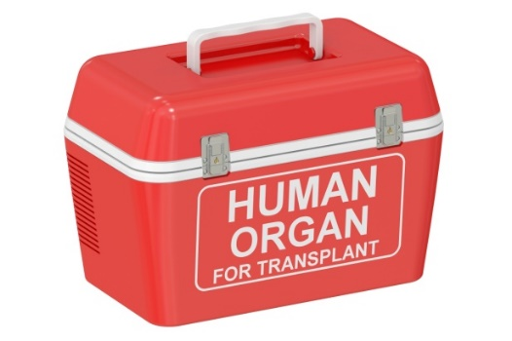
  Animal tissues, organs and organ systems Part 2 – Heart failure
Heart disease can lead to heart failure. Patients with heart failure can be given heart or heart and lung transplants. Donor hearts come from a person who has died. These only have a few hours to get to the person needing the heart. Often hearts and lungs are transplanted together. In this country you have to give consent for your organs to be donated.
Video - Heart Transplant (graphic)
Conditions that may require a heart transplant include:
Atherosclerosis (coronary heart disease) – a build-up of fatty substances in the arteries supplying the heart
Cardiomyopathy – where the walls of the heart have become stretched, thickened or stiff
Congenital heart disease – birth defects that affect the normal workings of the heart
Artificial hearts are occasionally used to keep patients alive whilst waiting for a heart transplant, or to allow the heart to rest as an aid to recovery. Artificial hearts can only be used as a short term measure.
Notes:
Sensitivity needed for video shows a real heart transplant https://www.youtube.com/watch?v=yDDpGpbJAlU

Slide 14
  Animal tissues, organs and organ systems Part 3 - Health issues
The World Health Organisation definition:
Health is a state of complete physical, mental and social well-being and not merely the absence of disease or infirmity.
Disease can be:
Communicable – these are infectious diseases caused by viruses, bacteria, protists and fungi and are spread in animals (and plants) e.g. malaria, measles, athletes foot
Non-communicable – these diseases are not caused by infection and cannot be spread e.g. heart disease, diabetes, Alzheimer's, asthma
Different types of disease may interact (work together) to make a person ill.
Defects in the immune system mean that an individual is more likely to suffer from infectious diseases
Viruses living in cells can be the trigger for cancers to form
Immune reactions initially caused by a pathogen can trigger allergies such as skin rashes and asthma
Severe physical ill health can lead to depression and other mental illness

Slide 15
  Animal tissues, organs and organ systems Part 3 - Non-communicable diseases, the human and financial costs
Non-communicable diseases (NCDs) can have a significant human and financial cost for individuals, local communities, nationally and globally.
Video - NCDs
WHO Factsheet data link
Non-communicable diseases (NCDs) kill 40 million people each year, equivalent to 70% of all deaths globally
Each year, 15 million people die from a NCD between the ages of 30 and 69 years; over 80% of these "premature" deaths occur in low- and middle-income countries
Cardiovascular diseases account for most NCD deaths, or 17.7 million people annually, followed by cancers (8.8 million), respiratory diseases (3.9million), and diabetes (1.6 million)
Human cost: lower quality of life, shorter lifespan and the families of the sufferer are also affected due to caring responsibilities, parental/partner death etc.
Financial cost: cost of health care, research into diseases, awareness campaigns. Reduced income due to inability to work, personal care costs, adaptations to the home and buying specialist equipment e.g. wheelchairs, mobility scooters etc.
Also if many people are unable to work due to NCDs the economy can be affected.
Notes:
https://www.youtube.com/watch?v=UTSf09Huz70&list=PL3FB3D1EAAD2DBE57
WHO factsheet last accessed 21/8/2107 http://www.who.int/mediacentre/factsheets/fs355/en/

Slide 16
  Animal tissues, organs and organ systems Part 3
  - The effect of lifestyle on some non-communicable diseases
There are other factors that can also affect health and increase the risk of getting a disease, these can be:
aspects of a persons lifestyle
  e.g. lack of exercise, stress levels, exposure to too much sunlight, exposure to ionising radiation (e.g. X-rays, gamma rays)
substances (chemicals) taken into:
  a persons body – e.g. high fat/sugar diet, cigarette smoke, alcohol
  in their environment - e.g. air/water pollution, asbestos, ionising radiation
  These are called RISK FACTORS
RISK FACTOR
HAZARD
HARM
The potential source of harm e.g. smoking, lack of exercise
The combination of the chances of the hazard causing harm and the severity of that harm
The damage to health or a disease that can occur
MANY DISEASES ARE CAUSED BY THE INTERACTION OF A NUMBER OF RISK FACTORS

Slide 17
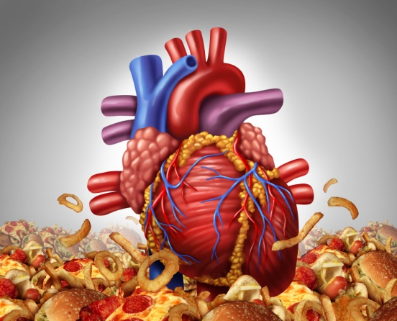
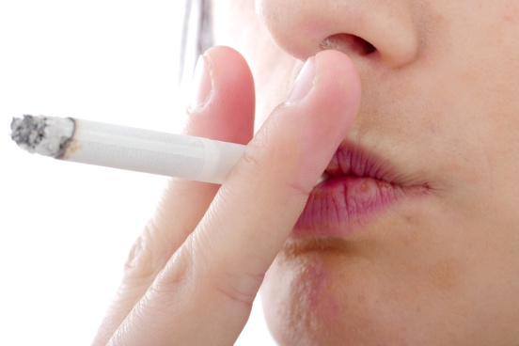

  Animal tissues, organs and organ systems Part 3 - Some causes of non-communicable diseases
Some RISK FACTORS have been found to directly cause disease.
CARDIOVASCULAR disease:
Diet – a diet high in saturated fats can increase the levels of LDL (low density lipoproteins – cholesterol plus a protein that can cause atherosclerosis)
Smoking – tobacco smoke damages the lining of the arteries leading to atherosclerosis, carbon monoxide in tobacco smoke reduces the amount of oxygen in the blood so the heart has to pump harder, the nicotine in tobacco smoke causes the heart to beat faster and raises blood pressure
Lack of exercise – exercising regularly lowers blood pressure and stress

Slide 18
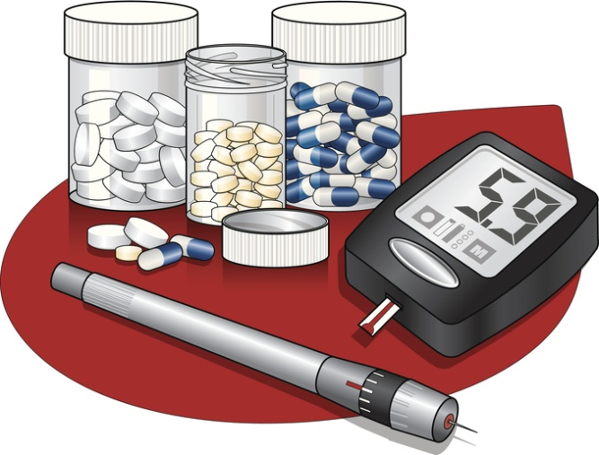
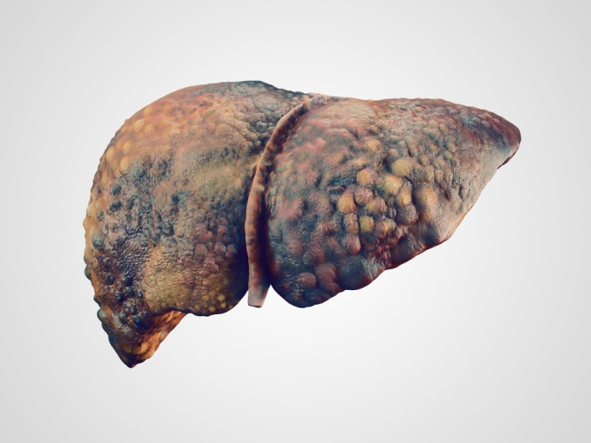
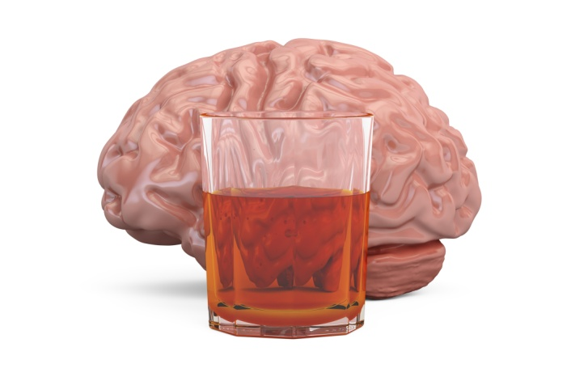
  Animal tissues, organs and organ systems Part 3
  - Some causes of non-communicable diseases
Some RISK FACTORS have been found to directly cause disease.
OBESITY is a risk factor for Type 2 diabetes:
Type 2 diabetes – is where the cells in the body are less sensitive or resistant to insulin so the body cannot control the concentration of glucose in the blood correctly Video - Type 2 Diabetes
Obesity increases the risk of developing type 2 diabetes, the more fat you have around your abdomen (tummy)
Alcohol is a risk factor for Liver disease and Brain damage:
Liver disease – the liver breaks down toxins in alcohol, if you have too much alcohol the first stage of liver disease is when the liver becomes fatty and eventually cirrhosis of the liver develops if you continue to drink too much alcohol
Brain function damage – alcohol affects the way the nerve cells in the brain work and the cells then become damaged. The brain mass may also shrink Video - Alcohol and the Body
Notes:
https://www.
https://www.youtube.com/watch?v=Sw9OGC7IJWwyoutube.com/watch?v=YoPyFGYcr7s
https://www.youtube.com/watch?v=V2Aj-iJ6p38

Slide 19
  Animal tissues, organs and organ systems Part 3 - Some causes of non-communicable diseases
Some RISK FACTORS have been found to directly cause disease.
SMOKING is a risk factor for Lung disease:
COPD – describes a group of lung diseases that make it difficult for people to move air in and out of the lungs
Two examples of these are:
  Bronchitis – the bronchi and bronchioles are inflamed (swollen) and excess mucus is produced
  Emphysema – this affects the alveoli, the walls are broken down and they then trap excess air
COPD narrows the airways and makes it difficult to get rid of CO₂ and get in the O₂ needed for respiration. Smoking is the main cause of COPD and is responsible for 9 out of 10 cases. Video - COPD
Notes:
https://www.youtube.com/watch?v=cQuARMhr9lo

Slide 20
  Animal tissues, organs and organ systems Part 3
  - Some causes of non-communicable diseases
Some RISK FACTORS have been found to directly cause disease.
SMOKING is a risk factor for Lung cancer:
Lung cancer - is one of the most common and serious types of cancer. Around 44,500 people are diagnosed with the condition every year in the UK (NHS)
Symptoms include:
  a persistent cough
  frequent chest infections
  coughing up blood
  breathlessness
Causes: most cases of lung cancer are linked to smoking 85% (NHS), tobacco smoke contains over 60 toxic chemicals and some of these substances are known to be carcinogenic (cancer causing)
If you smoke more than 25 cigarettes a day, you are 25 times more likely to get lung cancer than a non-smoker. Some people who have never smoked can get lung cancer too.
All cigarettes must now by law be sold in plain packaging and with graphic images and health warnings.

Slide 21
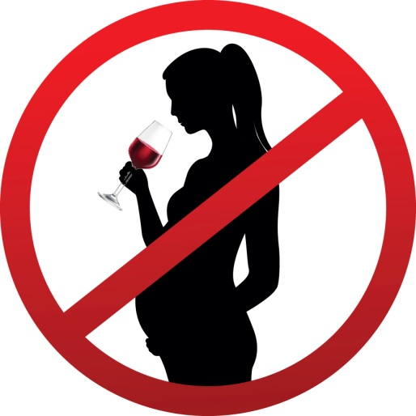
  Animal tissues, organs and organ systems Part 3 - Some causes of non-communicable diseases
Some RISK FACTORS have been found to directly cause disease.
Risks of SMOKING and ALCOHOL on unborn babies:
Smoking:
Tobacco smoke contains over 4000 chemicals one of these is carbon monoxide, it is a toxic gas that reduces the amount of oxygen available to the unborn baby.
Smoking while pregnant increases the risk of: miscarriage, premature births, sudden infant death syndrome (SIDS)
Alcohol:
Medical experts are still unsure how much alcohol is safe to drink while pregnant and advise pregnant woman not to drink any alcohol.
First 3 months of pregnancy: – can increase the risk of miscarriage and premature birth
Heavy drinking during pregnancy can lead to foetal alcohol syndrome (FAS) children with FAS have:
  poor growth
  facial abnormalities
  learning difficulties

Slide 22
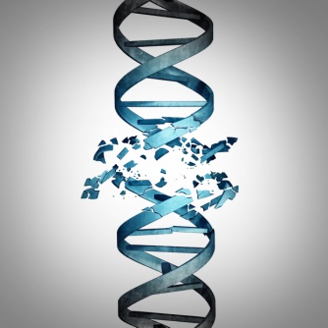
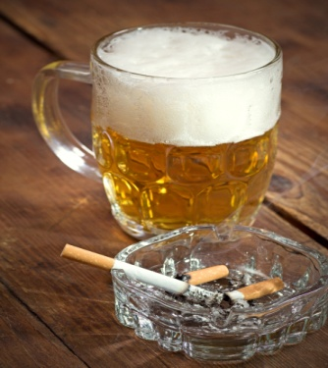
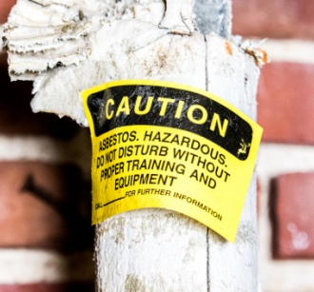

  Animal tissues, organs and organ systems Part 3 - Some causes of non-communicable diseases
Some RISK FACTORS have been found to directly cause disease.
CARCINOGENS as a risk for cancer:
Carcinogen - a substance or form of radiation that can cause cancer. Some carcinogens cause cancer by damaging the DNA directly, others can speed up cell division making mutations more likely
Tobacco - smoke can cause cancers in the lungs, oesophagus, larynx (voice box), mouth, throat, kidney, bladder, pancreas, stomach and cervix
Alcohol - is a risk factor in the following cancers - mouth, larynx, oesophagus, liver and breast
Occupational carcinogens – there are over 40 known carcinogens in the work environment and these need to be carefully controlled so that workers don’t get too exposed to them e.g. asbestos causes lung cancer
Ionising radiation – this type of radiation can knock electrons off the atoms in DNA causing changes that can lead to cancer e.g. UV, X-rays, radon gas, radiation in medical treatments Video - UV Radiation
Notes:
https://www.youtube.com/watch?v=gV4a_9Kh3ts

Slide 23
  Animal tissues, organs and organ systems Part 3 - Cancer
Uncontrolled cell division and growth results in the formation of a tumour (mass of cells), these can be BENIGN or MALIGNANT, not all tumours are cancerous.
Benign tumours:
  Growths of abnormal cells
  Contained in one area
  Usually within a membrane surrounding the cells
  They do not invade other parts of the body Video - Benign Brain Tumour
Malignant tumour (CANCER):
    Growths of abnormal cells
    These are cancerous
    Invade neighbouring tissues and spread to different parts of the body in the blood where they form secondary tumours
    Can be caused by lifestyle or genes
      Video - What is Cancer?
Notes:
https://www.youtube.com/watch?v=UopUxkeC4Ls

Slide 24
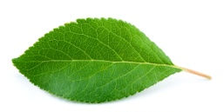
  Plant tissues, organs and systems - Plant tissues
Like animals, plants are organised into tissues made of similar cells that carry out a particular function.
Epidermal
Covers the surfaces of the plant
Palisade mesophyll
The cells are packed with chloroplasts it is the site of most of the photosynthesis
Spongy mesophyll
Photosynthesis also occurs in the cells here
Large air spaces for gas exchange
Xylem and phloem
Form vascular bundles and transport water and glucose around the plant
Meristem
Found at the tips of roots and shoots
Where cell differentiation occurs
organism | oak tree
organ system | root system
organ | leaf
tissue | palisade mesophyll
cell | palisade cell
smallest largest

Slide 25
  Plant tissues, organs and systems - Plant tissues
The leaf is a plant organ, it is the site of photosynthesis and respiration in plants.

Slide 26
  Plant tissues, organs and systems - Plant organ systems
The roots, stem and leaves form a plant organ system for transport of substances around the plant.
Most leaves (except for those on aquatic plants) have guard cells on their lower epidermis. These cells open and close depending on the water content of the cells. The stoma (stomata) open and close to let gases diffuse in and out and control water loss. If there is a lack of water in the guard cells they go ‘flacid’ and close, this prevents water vapour from leaving through the stomata
Root hair cell - Hair like projections to increase the surface area for uptake of water and mineral ions.

Slide 27
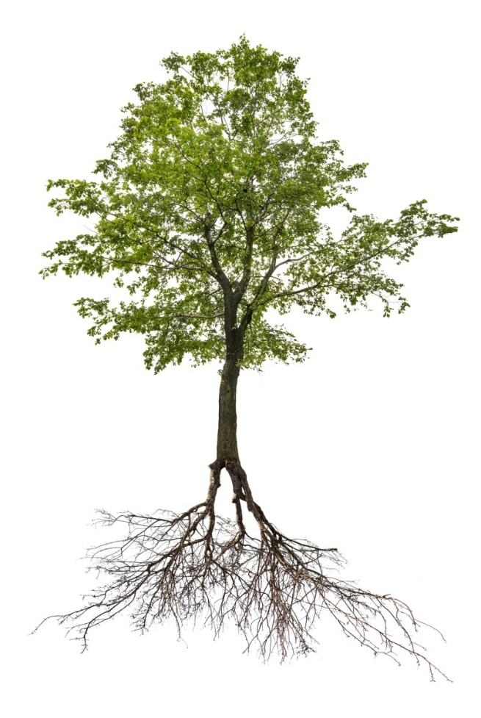
  Plant tissues, organs and systems - Plant organ systems
TRANSPIRATION
TRANSLOCATION
Xylem tissue transports
water and mineral ions from the roots to the stems and leaves. It is composed of hollow tubes strengthened by lignin adapted for the transport of water in the transpiration stream.
Phloem tissue transports dissolved sugars from the leaves to the rest of the plant for immediate use or storage. Phloem is composed of tubes of elongated cells with pores in the end walls.
xylem
phloem
The rate of transpiration is increased as the temperature, humidity, air movement and light intensity increase
Cell sap can move from one phloem cell to the next through pores in the end walls.

