Slide 1
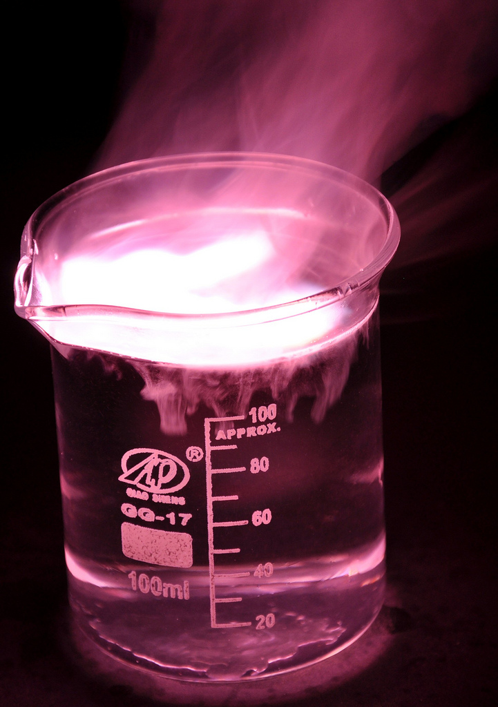
Overview Bonding, Structure and the properties of matter
Bonding
Chemical bonds
Ionic bonding
Ionic compounds
Covalent bonding
Metallic bonding
Properties of substances
States of matter
State symbols
Properties of ionic compounds
Properties of small molecules
Polymers
Giant covalent structures
Properties of metals and alloys
Structure and bonding of carbon
Diamond, graphite
Graphene and fullerenes
Nanoparticles (Chemistry ONLY)
Size of particles
Uses of nanoparticles
Notes:
https://c2.staticflickr.com/4/3178/4076380768_03994aed44_b.jpg

Slide 2
Chemical bonds
There are three types of strong chemical bonds:
Ionic
Covalent
Metallic
Ionic | Covalent | Metallic
Particles are oppositely charged ions | Particles are atoms which share pairs of electrons | Particles are atoms which share delocalised electrons
Between metals and non-metals | Most non-metallic elements Between non-metals and non-metals | In metallic elements and alloys
You need to be able to explain chemical bonding in terms of electrostatic forces and the transfer of electrons.

Slide 3
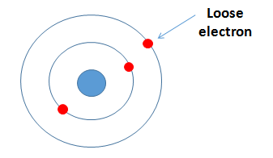
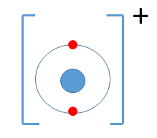
Ionic bonding
Ionic bonds form between metals and non-metals. Ionic bonding involves the transfer of electrons in the outer shells.
Metals lose electrons to become positively charged ions
and non-metals gain electrons to become negatively
charged ions.
The elements in Group 1 react with the elements in Group 7.
Groups 1 elements can each lose one electron.
This electron can be given to an atom from Group 7, they both achieve the stable electronic structure of a noble gas.
Notes:
https://examhints.files.wordpress.com/2014/10/ions-list.png

Slide 4
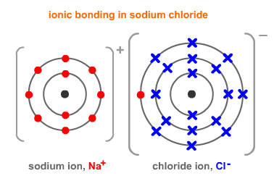
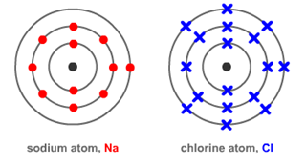
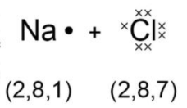
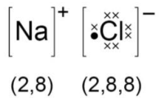
Ionic bonding
The electrostatic attraction between the oppositely charged Na⁺ ions and Cl⁻ ions is called ionic bonding. The electron transfer during the formation of an ionic compound can be represented by a dot and cross diagram:
The charge on the ions produced by metals in group 1 and 2 and by non-metals in group 6 and 7 relates to the group number of the element in the periodic table. For example group 1 form 1+ ions, group 3 form 3+ ions, group 6 form 2- ions and group 7 form 1- ions.
When completing diagrams always include:
The correct number of electrons on outer shells
The charge

Slide 5
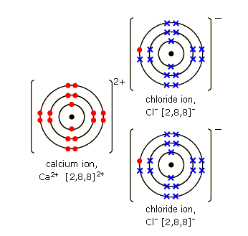
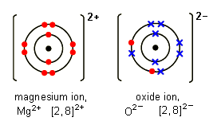
Ionic bonding
Magnesium oxide:
Sometimes the atoms reacting need to gain or lose two electrons to gain a stable noble gas structure. Each magnesium loses two electrons and each oxygen gains two electrons.
Magnesium ions have the formula Mg²⁺, while oxide ions have the formula O²⁻ .
This means that one magnesium atom reacts with one oxygen atom, giving the formula MgO
Calcium Chloride:
Each calcium atom (2, 8, 8, 2) needs to lose two electrons but each chlorine atom (2, 8, 7) needs to gain only one electron.
This means that two chlorine atoms
react with every one calcium atom, giving the formula CaCl₂
Notes:
https://www.google.co.uk/url?sa=i&rct=j&q=&esrc=s&source=images&cd=&cad=rja&uact=8&ved=0ahUKEwj83_7Kp7nVAhViDMAKHUa-BjEQjRwIBw&url=http%3A%2F%2Fwww.bbc.co.uk%2Feducation%2Fguides%2Fzccmn39%2Frevision&psig=AFQjCNEgBoTtwHYRcEQ-aOWdYS2_agBv1g&ust=1501789374706607

Slide 6
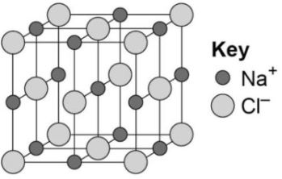
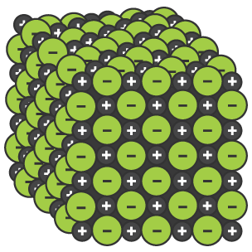
Ionic compounds
An ionic compound is a giant structure of ions.
Ionic compounds are held together by strong electrostatic forces of attraction between oppositely charges ions. These forces act in all directions in the lattice – this is called ionic bonding.
Empirical formula
The models can indicate the chemical formula of a compound by the simplest ratio of atoms or ions in models of their giant structure – this is called the empirical formula.
e.g. there is a 1:1 ratio of sodium to chlorine in sodium chloride, so the formula is NaCl.
The structure of sodium chloride can be represented in the following forms:
- The models never accurately reflect the many millions of atoms/ions bonded together in the giant lattices

Slide 7
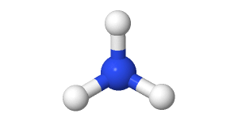
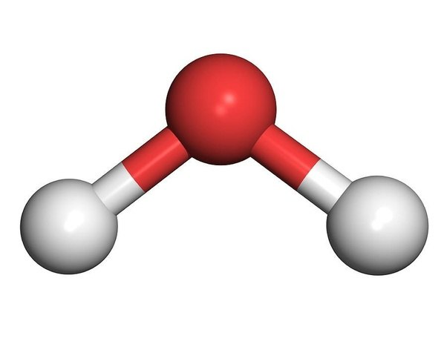
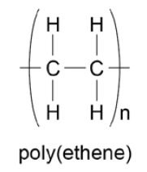
Covalent bonding - PART 1
When atoms share pairs of electrons, they form covalent bonds.
These are STRONG bonds.
Covalently bonded substances may be: Small molecules, very large molecules or giant covalent structures.
NH₃
H
H₂O
You can deduce the molecular formula of a substance from a given model or diagram showing the atoms and bonds in the molecule by counting the number of atoms.
O
N
H
H
H
H
Polymers are examples of very large covalent molecules, they can be represented in the form: where ‘n’ = a very large number!
Examples of covalently bonded substances with giant covalent structures are diamond and silicon dioxide.
Notes:
https://www.google.co.uk/url?sa=i&rct=j&q=&esrc=s&source=images&cd=&cad=rja&uact=8&ved=0ahUKEwiPu_Gf4bjVAhWpqVQKHT5nDzwQjRwIBw&url=http%3A%2F%2Fwww.historyoftheuniverse.com%2Findex.php%3Fp%3Dnitrogen.htm&psig=AFQjCNHbB72WgjFaiV6T9gpkLrR0o42JUQ&ust=1501770468520684
https://www.google.co.uk/url?sa=i&rct=j&q=&esrc=s&source=images&cd=&cad=rja&uact=8&ved=0ahUKEwjR96uG97jVAhXHK8AKHTJtCvkQjRwIBw&url=https%3A%2F%2Fwww.quora.com%2FBoth-H2O-and-CO2-are-covalently-bonded-particles-Which-experiences-stronger-forces-of-attraction-between-its-particles-H2O-or-CO2&psig=AFQjCNHgR7lQOEvAsLNkknh2W390tWdutQ&ust=1501776343501473

Slide 8
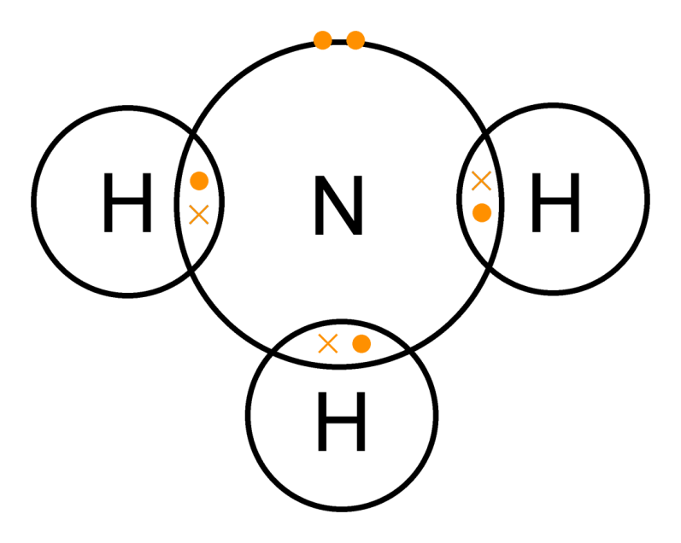
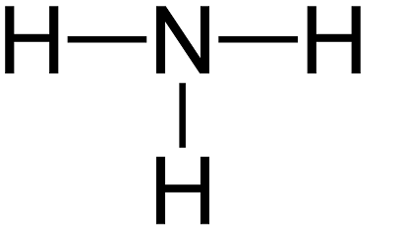
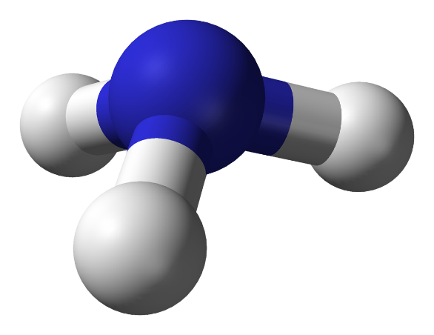
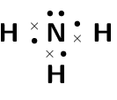
Covalent bonding - PART 1
Covalently bonded substances may consist of small molecules. The covalent bond in molecules can be represented in the following models. Like all models, each one is useful but has some limitations.
Ammonia NH₃
Dot and cross with outer shells as circles:
+ Show which atom the
electrons in the bonds come
from
- All electrons are identical
2D with bonds:
+ Show which atoms are bonded together
3D ball and stick model:
+ Attempts to show the correct H-N-H bond angle is 107.8°
+ Shows the impact of the lone pair
- It shows the H-N-H bond
incorrectly at 90°
Dot and cross with outer shells electrons:
Notes:
https://www.google.co.uk/url?sa=i&rct=j&q=&esrc=s&source=images&cd=&cad=rja&uact=8&ved=0ahUKEwiPu_Gf4bjVAhWpqVQKHT5nDzwQjRwIBw&url=http%3A%2F%2Fwww.historyoftheuniverse.com%2Findex.php%3Fp%3Dnitrogen.htm&psig=AFQjCNHbB72WgjFaiV6T9gpkLrR0o42JUQ&ust=1501770468520684

Slide 9
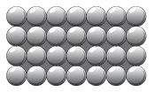
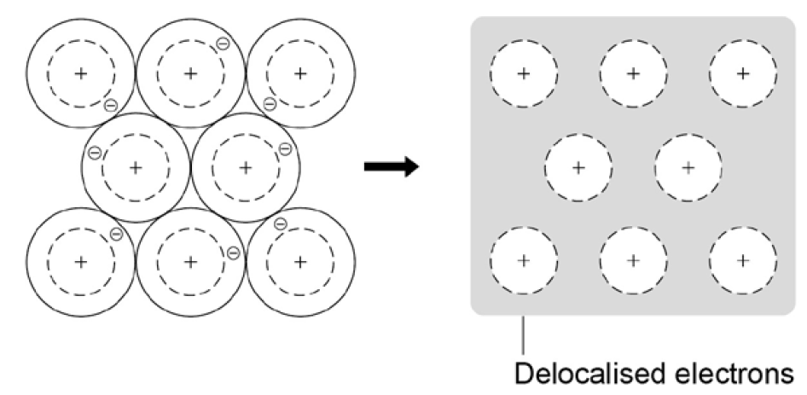
Metallic bonding
The atoms in metals are built up layer upon layer in a regular pattern. They are another example of a giant structure.
The electrons in the outer shell of metal atoms are delocalised and are free to move throughout the structure.
The sharing of delocalised electrons leads to strong metallic bonds.
Metallic bonding can be represented in the following form:

Slide 10
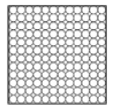
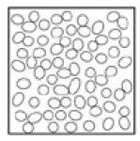
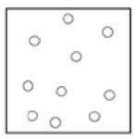
States of matter and state symbols
There are three states of matter – solid, liquid and gas. To explain the properties of the states, the particle theory is used. It is based on the fact that all matter is made up of tiny particles and describes the movement and distance between particles.
Solid | Liquid | Gas
Close together, regular pattern, vibrate on the spot. | Close together, random arrangement, move around each other. | Far apart, random arrangement, move quickly.
In chemical equations, the three states are shown as (s), (l), (g)
and (aq) for aqueous solutions.

Slide 11
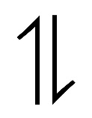
Changes of state
Melting and freezing take place at the melting point.
Boiling and condensing take place at the boiling point.
The amount of energy required to change the state depends on the strength of the forces between the particles of the substance.
The stronger the forces between the particles the higher the melting and boiling point of the substance.
The type of bonding and the structure of the substance depend on the particles involved.
Freezing
Melting
Condensing
Boiling
HT ONLY - There are limitations of the particle model of matter:
There are no forces
All particles are shown as spheres
The spheres are solid

Slide 12
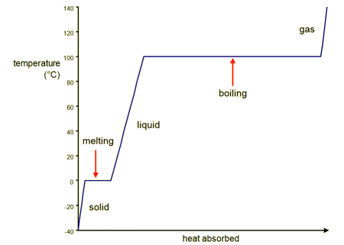
Changes of state
The graph shows a heating curve of a solid, which shows the temperature of a substance plotted against the amount of energy it has absorbed:
A substance must absorb heat energy so that it can melt or boil. The temperature of the substance does not change during melting, boiling or freezing, even though energy is still being transferred.

Slide 13
Properties of ionic compounds
Structure
Ionic compounds have regular structures called giant ionic lattices.
There is strong electrostatic forces of attraction in all directions between oppositely changed ions.
Properties
High melting and boiling points – large amounts of energy is needed to break the many strong bonds and overcome the electrostatic attraction.
Conduct electricity when molten or dissolved in water – ions are free to move and can carry charge.

Slide 14
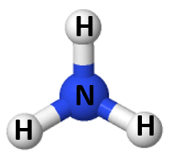
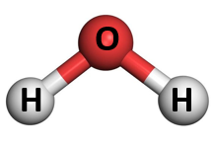
Properties of small molecules
Structure
They have weak forces between the molecules. These weak forces are overcome when they change state not the strong covalent bonds.
Properties
Low melting and boiling points – small amounts of energy is needed to break the intermolecular forces. Most are gases or liquids.
Do not conduct electricity – Particles do not have an overall electric charge.
Intermolecular forces increase with the size of the molecules. So larger molecules have higher melting and boiling points.

Slide 15
Polymers
Some covalently bonded substances have very large molecules, such as polymers.
Structure
Polymers are made up from many small reactive molecules that bond to each other to form long chains. The atoms in the polymer molecules are linked to other atoms by strong covalent bonds. The intermolecular forces between polymer molecules are relatively strong.
Properties
Solid at room temperature – Strong intermolecular forces.

Slide 16
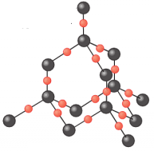
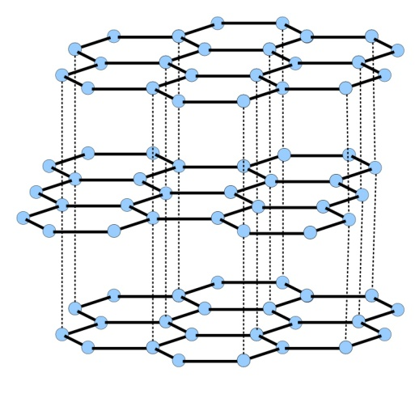
Giant covalent structures
Structure
All atoms within the structure are linked by strong covalent bonds. These bonds must be broken for a solid to melt or boil.
Properties
Very high melting and boiling points – very large amounts of energy is needed to break the covalent bonds.
Do not conduct electricity – Particles do not have an overall electric charge.

Slide 17
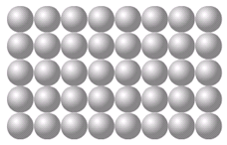
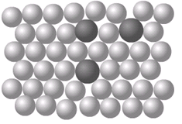
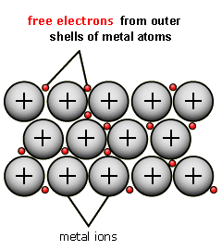
Properties of metals and alloys
The giant structure of atoms with strong metallic bonding gives most metals a high melting and boiling point.
Metals are malleable (can be hammered into shape) and ductile (can be drawn out into a wire) because the layers of atoms (or ions) in a giant metallic structure can slide over each other
Delocalised electrons in metals enable electricity and heat to pass through the metal easily.
A metal mixed with other elements is called an alloy. Alloys are harder than pure metals. Alloys are made from two or more different metals.
Pure metal Alloy
The different sized atoms of the metals distort the layers in the structure, making it more difficult for them to slide over each other, and so make the alloys harder than pure metals.
For example, gold is naturally soft but adding copper to make jewellery stronger and last longer.

Slide 18
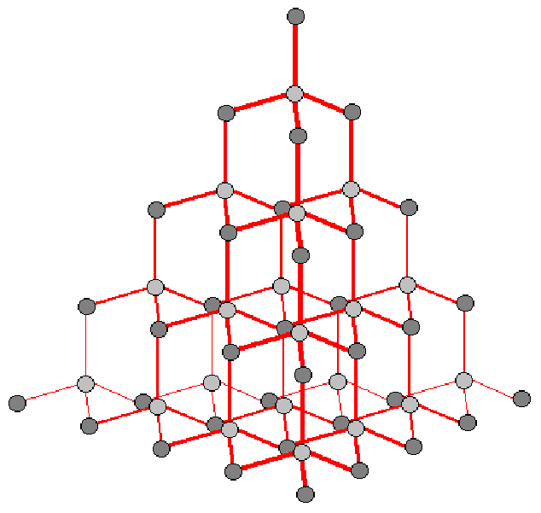
Diamond
Diamond:
In diamond, each carbon atom forms four covalent bonds with other carbon atoms in a giant covalent structure.
Diamond is very hard – it is the hardest natural substance, so it is often used to make jewellery and cutting tools.
Diamond has a very high melting and boiling point – a lot of energy is needed to break the covalent bonds.
Diamond cannot conduct electricity – there are no free electrons or ions to carry a charge.
Notes:
https://www.google.co.uk/url?sa=i&rct=j&q=&esrc=s&source=images&cd=&cad=rja&uact=8&ved=0ahUKEwjb_7i7gbnVAhUBohQKHTa6AYMQjRwIBw&url=http%3A%2F%2Fweknownyourdreamz.com%2Fsymbols%2Fsymbol-for-silicon-dioxide.html&psig=AFQjCNF6pkoi_opTPCYLPtR-tFf3ucWV1g&ust=1501779137465594

Slide 19
Graphite
Graphite:
In graphite, carbon atom forms three covalent bonds with three other carbon atoms, forming layers of hexagonal rings which have no covalent bonds between the layers.
Graphite is soft and slippery – layers can easily slide over each other because the weak forces of attraction between the layers are easily broken. This is why graphite is used as a lubricant.
Graphite conducts electricity – the only non-metal to do so. One electron from each carbon atom is delocalised.

Slide 20
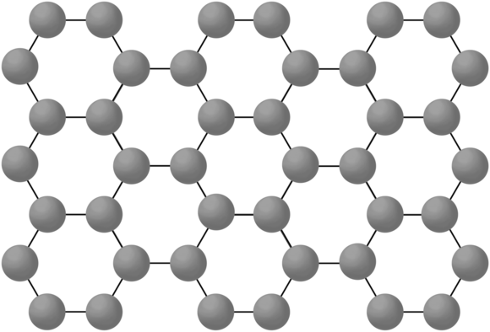
Graphene
Graphene:
This is a single layer of graphite – a layer of inter-locking hexagonal rings of carbon atoms one atom thick.
It is an excellent conductor of thermal energy and electricity (even better than graphite), has a very low density and is incredibly strong.
It has many uses in the electronics industry.
Notes:
https://images.techhive.com/images/article/2014/04/graphene_structure-100263091-orig.png

Slide 21
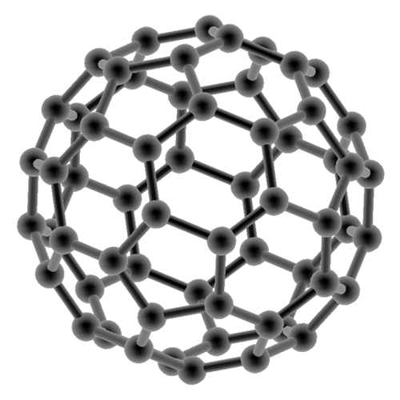
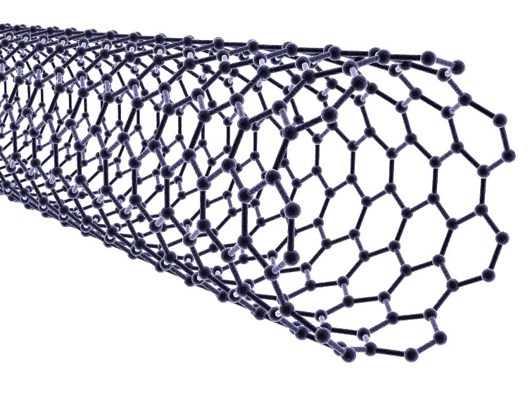
Fullerenes
Fullerenes:
Fullerenes are molecules of carbon with hollow shapes.
The structure is based on hexagonal rings of carbon
atoms, but may have 5 or 7 carbon rings. The first to be
discovered was Buckminsterfullerene (C₆₀)
which is spherical (like a football).
Carbon nanotubes are cylindrical fullerenes with very high length compared to their diameter. This makes them useful for nanotechnology, electronics and materials.

Slide 22
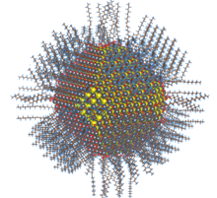
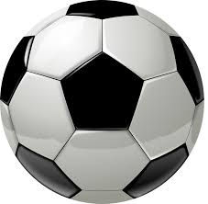
Covalent bonding - PART 3 CHEMISTRY ONLY
Nanoscience is the study of small particles that are between 1 and 100 nanometres in size. Particles consisting of fewer than 100 atoms are often called nanoclusters.
1 nanometre (1 nm) = 1 x 10⁻⁹ metres
(0.000 000 001m or a billionth of a metre).
Nanoparticles are smaller than fine particles (PM_{2.5}) which have diameters between
1 x 10⁻⁷ metres and 2.5 x 10⁻⁶ .
To comprehend how small this is, coarse particles, like dust, have diameters between 1 x 10⁻⁵ and 2.5 x 10⁻⁶ .
The size of a typical nanoparticle is …
… to a football as a
football is …
…to the Earth

Slide 23
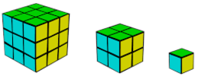
Covalent bonding - PART 3 CHEMISTRY ONLY
Nanoparticles show different properties to the same materials in bulk as they have a high surface area to volume ratio.
The diagram shows this idea:
As particle size gets smaller, the surface area to volume ratio gets larger.
As the side of cube decreases by a factor of 10 the surface area to volume ratio increases by a factor of 10.
Nanoparticles show different properties to the same materials in bulk and have a high surface area to volume ratio. It also means that smaller quantities are needed to be effective than the materials with normal particle sizes.
Surface area (height x width x number of sides) | 3x3x6 =54 | 2x2x6 =24 | 1x1x6 =6
Volume (height x width x length) | 3x3x3 =27 | 2x2x2 =8 | 1x1x1 =1
Surface to volume ratio (surface area / volume) | 54/27 =2 | 24/8 =3 | 6/1 =6

Slide 24
Covalent bonding - PART 3 CHEMISTRY ONLY
Nanoparticles have many applications in medicine, in electronics, in cosmetics and sun creams, as deodorants, and as catalysts.
New developments in nanoscience are very exciting but will need more research into possible issues that might arise from their increased use.
There are some concerns that nanoparticles may be toxic to people. They may be able to enter the brain from the bloodstream and cause harm. Some people think more tests should take place before nanoparticles of a material are used on a wider scale.
Health care
Cosmetics
Clothing
Electronics
Catalysts
Uses of nanoparticles
Food
Paints
Biomedical
Sports equipment
Industrial
Learn three examples for your exam

