Slide 1
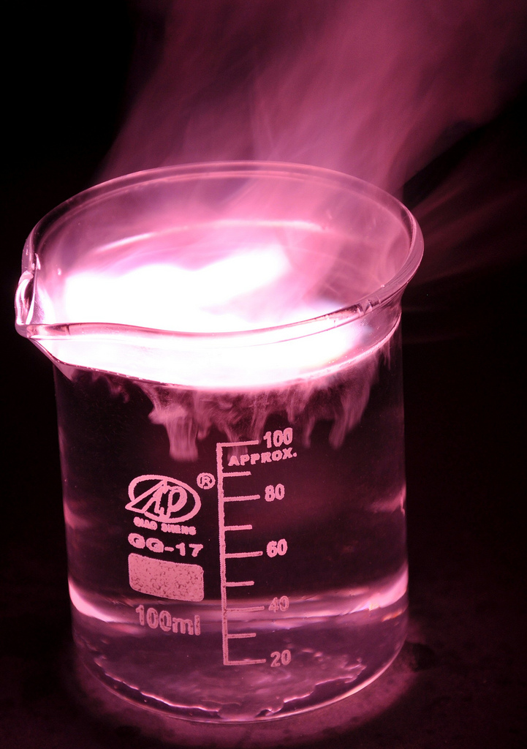
Overview Quantitative chemistry
Chemical measurements
Balanced chemical equations
Conservation of mass
Relative formula mass
Use of amount of substance (HT)
Amounts of substances in equations (HT)
Quantities in equations (HT)
Using moles to balance equations (HT)
Limiting reactants (HT)
Concentrations of solutions
Quantities (chemistry only)
Percentage yield
Atom economy
Moles of solutions and gases (HT)
Notes:
https://c2.staticflickr.com/4/3178/4076380768_03994aed44_b.jpg

Slide 2
Chemical measurements - PART 1
Chemical equations can be very useful.
The law of conservation states that no atoms are lost or made during a chemical reaction so the mass of the product equals the mass of the reactants.
Chemical reactions can be represented by symbol equations which are balanced in terms of the numbers of atoms of each element involved on both sides of the equation.
State symbols s, l, g and aq are used in symbol equations.
When hydrogen molecules react with chlorine molecules, they make hydrogen chloride molecules:
H₂ + Cl₂ → HCl
This equation shows the reactants and products, but it is not balanced.
H₂ + Cl₂ → 2HCl
This balanced equation shows that one hydrogen molecules reacts with one chlorine molecule to form two molecules of hydrochloric acid.

Slide 3
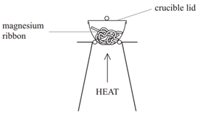
Chemical measurements - PART 1
When magnesium is heated in a crucible it reacts with oxygen and forms magnesium oxide:
2Mg + O₂ → 2MgO
This equation shows that two magnesium atoms react with one oxygen molecule to form two magnesium oxide compounds.
Here are the results from the reaction:
Some reactions may appear to involve a change in mass but this can be explained because a reactant or product is usually a gas and its mass has not been taken into account.
In this example, the mass of the magnesium oxide produced is greater than the mass of the original metal.
 | Mass in g
Mass of crucible at the start of the reaction | 0.23
Mass of crucible at end of reaction | 0.41
Notes:
http://www.tutormyself.com/wp-content/uploads/img_56ad15facc33b.png

Slide 4
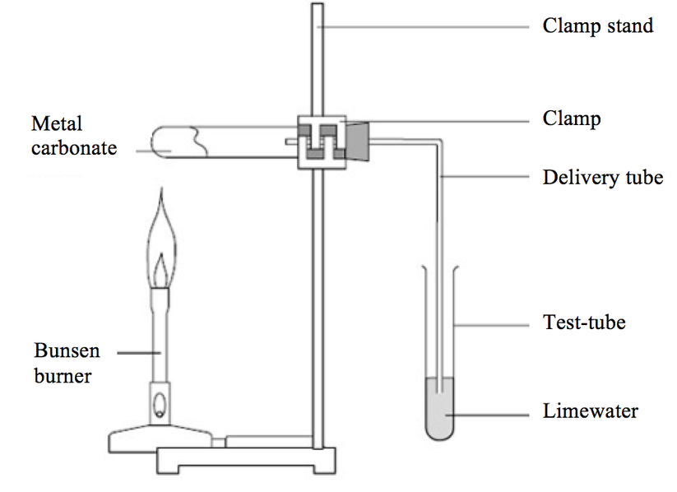
Chemical measurements - PART 1
When calcium carbonate thermally decomposes it forms calcium oxide and carbon dioxide:
CaCO₃ → CaO + CO₂
This equation shows that one calcium carbonate compound (made from one calcium, one carbon and three oxygen atoms) forms one calcium oxide compound and one carbon dioxide molecule.
Here are the results from the reaction:
In thermal decomposition of metal carbonates, carbon dioxide is produced and escapes into the atmosphere leaving the metal oxide as the only solid product.
In this example, the mass of the calcium oxide produced is less than the mass of the metal carbonate formed.
 | Mass in g
Mass of metal carbonate at the start of the reaction | 0.54
Mass of metal carbonate at end of reaction | 0.36
Whenever a measurement is taken, there is always some uncertainty about the result obtained that may have come from a variety of sources within the investigation. It is useful to determine whether the mean value falls within the range of uncertainty of the result.
Notes:
https://www.google.co.uk/url?sa=i&rct=j&q=&esrc=s&source=images&cd=&cad=rja&uact=8&ved=0ahUKEwi29vnf7MLVAhUIzIMKHf0PBCwQjRwIBw&url=http%3A%2F%2Figcsechemistryrevision.weebly.com%2Fthe-periodic-table&psig=AFQjCNHbIyDlYCiPV-LD2cObgR3YO4wosA&ust=1502117113201934

Slide 5
Chemical measurements - PART 1
When calcium carbonate thermally decomposes it forms calcium oxide and carbon dioxide:
CaCO₃ → CaO + CO₂
This equation shows that one calcium carbonate compound (made from one calcium, one carbon and three oxygen atoms) forms one calcium oxide compound and one carbon dioxide molecule.
Here are the results from the reaction:
In thermal decomposition of metal carbonates, carbon dioxide is produced and escapes into the atmosphere leaving the metal oxide as the only solid product.
In this example, the mass of the calcium oxide produced is less than the mass of the metal carbonate formed.
 | Mass in g
Mass of metal carbonate at the start of the reaction | 0.54
Mass of metal carbonate at end of reaction | 0.36
Whenever a measurement is taken, there is always some uncertainty about the result obtained that may have come from a variety of sources within the investigation. It is useful to determine whether the mean value falls within the range of uncertainty of the result.
Notes:
https://www.google.co.uk/url?sa=i&rct=j&q=&esrc=s&source=images&cd=&cad=rja&uact=8&ved=0ahUKEwi29vnf7MLVAhUIzIMKHf0PBCwQjRwIBw&url=http%3A%2F%2Figcsechemistryrevision.weebly.com%2Fthe-periodic-table&psig=AFQjCNHbIyDlYCiPV-LD2cObgR3YO4wosA&ust=1502117113201934

Slide 6
Chemical measurements - PART 2
Relative formula mass (M_{r}) of a compound is the sum of the relative atomic masses of the atoms in the numbers shown in the formula.
The relative atomic masses can be found in the periodic table
In a balanced chemical equation, the sum of the relative formula masses of the reactants equals the sum of the relative formula masses of the products.
For example: 2Mg + O₂ → 2MgO
(2x24) + (2x16) → 2 x (24+16)
80 → 80
NaCl
(1 x Na + 1 x Cl)
A_{r}: Na (23) Cl (35.5)
M_{r} = 23 + 35.5 = 58.5
H₂O
(2 x H + 1 x O)
A_{r}: H (1) O (16)
M_{r} = (1 x 2) + 16 = 18
H₂SO₄
(2 x H + 1 x S + 4 x O)
A_{r}: H (1) S (32) O (16)
M_{r} = (1x2) + 32 + (16x4) = 98
Al₂(SO₄)₃
(2 x Al + 3 x S + 12 x O)
A_{r}: Al (27) S (32) O (16)
M_{r} = (27x2) + (32x3) + (16x12) = 342

Slide 7
Use of amount of substance - PART 1
Chemical amounts are measured in moles. The symbol for the unit mole is mol.
The mass of one mole of a substance in grams is numerically equal to its relative formula mass. One mole of a substance contains the same number of the stated particles, atoms, molecules or ions as one mole of any other substance.
The number of atoms, molecules or ions in a mole of a given substance is the Avogadro constant. The value of the Avogadro constant is 6.02 x 10²³ per mole.
Number of moles = mass (g) or mass (g)
A_{r} M_{r}
Mass (g) = number of moles x A_{r}
or number of moles x M_{r}
How many moles of sulfuric acid molecules are there in 4.7g of sulfuric acid (H₂SO₄)? Give your answer to 1 significant figure.
4.7 = 0.05 mol
98
What is the mass of 7.2 x 10⁻³ moles of aluminium sulfate (Al₂(SO₄)₃)? Give your answer to 1 decimal place.
7.2 x 10⁻³ x 342 = 2.5g

Slide 8
Use of amount of substance - PART 1 HIGHER TIER
The masses of reactants and products can be calculated from balanced symbol equations.
Chemical equations can be interpreted in terms of moles. Example:
H₂ + Cl₂ → 2HCl
This equation shows that one mole of hydrogen reacts with one mole of chlorine to form two moles of hydrochloric acid.
The balanced equation is useful because it can be used to calculate what mass of hydrogen and chlorine react together and how much hydrogen chloride is made.
A_{r}: H (1) so mass of 1 mole of H₂ = 2 x 1 = 2g
A_{r}: Cl (35.5) so mass of 1 mole of Cl₂ = 35.5 x2 = 71g
M_{r} : HCl (1 + 35.5) so mass of 1 mole of HCl = 36.5g
The balanced equation tells us that one mole of hydrogen reacts with one mole of chlorine to give two moles of hydrogen chloride molecules, so turning this to masses:
1 mole of hydrogen = 1 x 2 = 2g
1 mole of chlorine = 1 x 71 = 71g
2 moles of hydrochloric acid = 2 x 36.5 = 73g

Slide 9
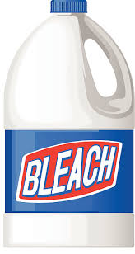
Use of amount of substance - PART 1 HIGHER TIER
Sodium hydroxide reacts with chlorine to make bleach:
2NaOH + Cl₂ → NaOCl + NaCl + H₂O
If you have a solution containing 100.0g of sodium
hydroxide, what mass of chlorine gas do you need to
convert it to bleach?
M_{r} : NaOH (23 + 16 + 1) so mass of 1 mole of NaOH = 40g
M_{r} : Cl₂ (35.5 x 2) so mass of 1 mole of Cl₂ = 71g
So 100.0g of sodium hydroxide is 100/40 = 2.5 moles
The balanced symbol equation tells us that for every two moles of sodium hydroxide, you need one mole of chlorine to react with it.
So you need 2.5/2 = 1.25 moles of chlorine
One mole of chlorine is 71g, so you will need 1.25 x 71g = 88.75g of chlorine to react with 100.0g of sodium hydroxide.
Notes:
https://www.google.co.uk/url?sa=i&rct=j&q=&esrc=s&source=images&cd=&cad=rja&uact=8&ved=0ahUKEwj-vJir4MTVAhXrBsAKHWkWDJ4QjRwIBw&url=http%3A%2F%2Fclipart-library.com%2Fbleach-bottle-cliparts.html&psig=AFQjCNEwZrD7GTPhfnI4-VkcrXeeVO_Fcw&ust=1502182494697836

Slide 10
Use of amount of substance - PART 1 HIGHER TIER
The balancing numbers in a symbol equation can be calculated from the masses of reactants and products by converting the masses in grams to amounts in moles and converting the number of moles to simple whole number ratios.
8.5g of sodium nitrate (NaNO₃) is heated until its mass is constant.
6.9g of sodium nitrite (NaNO₂) and 1.6g of oxygen gas (O₂) is produced.
NaNO₃ → NaNO₂ + O₂
M_{r}: NaNO₃ = 23 + 14 + (16x3) = 85
M_{r}: NaNO₂ = 23 + 14 + (16x2) = 69
M_{r}: O₂ = 16x2 = 32
Then to convert masses to moles use:
Moles of NaNO₃ = 8.5/85 = 0.1 mol
Moles of NaNO₂ = 6.9/69 = 0.1 mol
Moles of O₂ = 1.6/32 = 0.05 mol
Dividing the ratio by the smallest number gives 2:2:1 2NaNO₃ → 2NaNO₂ + O₂
Number of moles = mass (g)
M_{r}
NaNO₃ : NaNO₂ : O₂
0.01 : 0.01 : 0.05

Slide 11
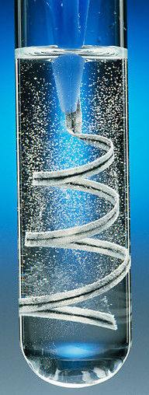
Use of amount of substance - PART 1 HIGHER TIER
In a chemical reaction involving two reactants, it is common to use an excess of one of the reactants to ensure that all the reactant is used up. The reactant that is completely used up is called the limiting reactant because it limits the amount of products.
4.8g of magnesium ribbon reacts with 7.3g of HCl.
Which is the limiting reactant?
Mg(s) + 2HCl(aq) → MgCl₂(aq) + H₂(g)
A_{r}: Mg (24) and A_{r}: Cl (35.5)
4.8g of Mg = 4.8/24 moles = 0.2 mol
7.3g of HCl = 7.3/36.5 moles = 0.2 mol
From the balanced equation:
1 mole of Mg reacts with 2 moles of HCl,
therefore 0.2 mol of Mg will need 0.4 mol of HCl to react completely, there is only 0.2 mol of HCl, so the HCl is the limiting reactant.
Notes:
https://www.google.co.uk/url?sa=i&rct=j&q=&esrc=s&source=images&cd=&cad=rja&uact=8&ved=0ahUKEwipmbLB4MTVAhVMCcAKHRezDfYQjRwIBw&url=http%3A%2F%2Fthaydungdayhoa.com%2Fvideo-clip%2Fmagie-tac-dung-voi-dung-dich-axit-clohydric.html&psig=AFQjCNGLBqWTLdXFIBC5sgzgj1iDJR1bVg&ust=1502182612745360

Slide 12
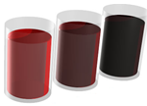
Calculations - PART 2
Chemists quote the amount of substance (solute) dissolved in a certain volume of the solution. The units used to express the concentration can be grams per decimetre cubed (g/dm³). A decimetre (1dm ³) cubed is equal to 1000cm³.
The blackcurrant juice is getting more concentrated – the darker colour indicates more squash is in the same volume of its solution
If you know the mass of the solute dissolved in a certain volume of solution, you can work out the concentration using:
Concentration = amount of solute (g)
(g/dm³ ) Volume of solution (dm³)
Remember if you are using cm³ to multiply the volume by 1000 to covert to dm³
Example 1:
50g of sodium hydroxide is dissolved in water to make up 200cm³ .
What is the concentration in dm³?
50g/200cm³= 0.25g/cm³
0.25g/cm³ x 1000 = 250g/dm³

Slide 13
Calculations - PART 2
Example 2:
A solution of sodium chloride has a concentration of 200g/dm³.
What is the mass of sodium chloride in 700cm³ of solution?
Convert 700cm³ into dm³
700/1000 = 0.7 dm³
Then rearrange the equation
amount of solute = concentration x volume of solution
(g) (g/dm³) (dm³)
200g/dm³ x 0.7 dm³ = 140g
HIGHER:
You can increase the concentration of an aqueous solution by:
Adding more solute and dissolving it in the same volume of its solution.
Evaporating off some of the water from the solution so you have the same mass of solute in a smaller volume of solution.

Slide 14
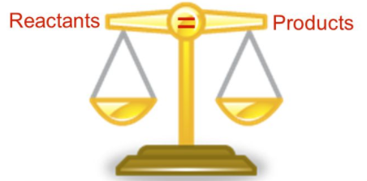
Yield and atom economy - CHEMISTRY ONLY
Even though no atoms are gained or lost in a chemical reaction, it is not always possible to obtain the calculated amount of product because:
The reaction may not go to completion because it is reversible
Some of the product may be lost when it is separated from the reaction mixture
Some of the reactants may react in ways different to the expected reactions
The amount of product obtained is known as the yield.
The theoretical yield is the maximum calculated amount of a product that could be formed from a given amount of reactants.
The actual yield is the actual amount of product obtained from a chemical reaction.
Notes:
https://www.google.co.uk/url?sa=i&rct=j&q=&esrc=s&source=images&cd=&ved=0ahUKEwjSltDYrsPVAhWrKsAKHRnNB70QjRwIBw&url=http%3A%2F%2Fslideplayer.com%2Fslide%2F3592418%2F&psig=AFQjCNHGiju0DEs91_r5gjgI3eDgDsEfaA&ust=1502134825976090

Slide 15
Yield and atom economy - CHEMISTRY ONLY
When compared with the maximum theoretical amount as a percentage, it is called the percentage yield and is calculated as:
Percentage yield = mass of product actually made x 100
maximum theoretical mass of product
A piece of sodium metal is heated in chlorine gas. A maximum theoretical mass of 10g for sodium chloride was calculated, but the actual yield was only 8g.
Calculate the percentage yield.
Percentage yield = 8/10 x 100
= 80%
This means the percentage yield is 80%
HIGHER:
200g of calcium carbonate is heated. It decomposes to make calcium oxide and carbon dioxide. Calculate the theoretical mass of calcium oxide made.
CaCO₃ → CaO + CO₂
M_{r} of CaCO₃ = 40 + 12 + (16x3) = 100
M_{r} of CaO = 40 + 16 = 56
100g of CaCO₃ would make 56 g of CaO
So 200g would make 112g

Slide 16
Yield and atom economy - CHEMISTRY ONLY
The atom economy (atom utilisation) is a measure of the amount of starting materials that end up as useful products. It is important for sustainable development and for economic reasons to use reactions with high atom economy. The percentage atom economy is calculated using a balanced equation for the reaction as follows:
Relative formula mass of desired product from equation x 100
Sum of relative formula mass of all reactants from equation
Example:
Calculate the atom economy for making hydrogen by reacting zinc with hydrochloric acid:
Zn + 2HCl → ZnCl₂ + H₂
M_{r} of H₂ = 1 + 1 = 2
M_{r} of ZnCl₂ = 65 + 35.5 + 35.5 = 136
Atom economy = ²∕₁₃₆ ₊ ₂ × 100
= ²∕₁₃₈ × 100 = 1.45%
This method is unlikely to be chosen as it has a low atom economy.
The less waste there is, the higher the atom economy, the less materials are wasted, less energy used, so making the process more economic, 'greener' and sustainable.

Slide 17
Quantities – CHEMISTRY ONLY Higher
The concentration of a solution is the amount of solute per volume of solution.
Chemists measure concentration in moles per cubic decimetre (mol/dm³).
Concentration = amount (mol)
(mol/dm³) volume (dm³)
Example 1:
Example 2:
What is the concentration of a solution that has 35.0g of solute in 0.5dm³of solution?
35/0.5 = 70 g/dm³
Calculate the mass of magnesium chloride (MgCl₂) if there is 1 dm³ of a 1mol/ dm³ solution.
Mass of 1 mole of magnesium chloride = 24 + (35.5 × 2) = 95 g So there are 95 g of magnesium chloride in 1 dm³ of a 1 mol/dm³ solution.

Slide 18
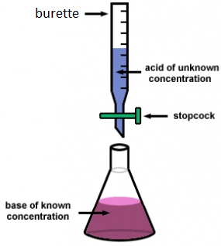
Quantities - CHEMISTRY ONLY Higher
If the volumes of two solutions that react completely are known and the concentrations of one solution is known, the concentration of the other solution can be calculated.
2NaOH(aq) + H₂SO₄(aq)→ Na₂S0₄(aq) + 2H₂O(l)
It takes 12.20cm³ of sulfuric acid to neutralise 24.00cm³ of sodium hydroxide solution, which has a concentration of 0.50mol/dm³.
Calculate the concentration of the sulfuric acid in g/dm³
0.5 mol/dm³ x (24/1000) dm³ = 0.012 mol of NaOH
The equation shows that 2 mol of NaOH reacts with 1 mol of H₂SO₄, so the number of moles in 12.20cm³ of sulfuric acid is (0.012/2) = 0.006 mol of sulfuric acid
Calculate the concentration of sulfuric acid in mol/ dm³
0.006 mol x (1000/12.2) dm³ =0.49mol/dm³
Calculate the concentration of sulfuric acid in g/ dm³
H₂SO₄ = (2x1) + 32 + (4x16) = 98g
0.49 x 98g = 48.2g/dm³
Notes:
https://www.google.co.uk/url?sa=i&rct=j&q=&esrc=s&source=images&cd=&cad=rja&uact=8&ved=0ahUKEwic9fD53sTVAhXXFsAKHSJ7Dr8QjRwIBw&url=https%3A%2F%2Fdashboard.dublinschools.net%2Flessons%2F%3Fid%3De9c698fd6c35d97ff2e23fd627aef61a&psig=AFQjCNEPUZuHN4PUAqRXuixkOonJ1d2CJw&ust=1502182150450095

Slide 19
Quantities - CHEMISTRY ONLY Higher
Equal amounts of moles or gases occupy the same volume under the same conditions of temperature and pressure. The volume of one mole of any gas at room temperature and pressure (rtp) (20°C and 1 atmospheric pressure) is 24 dm³.
You can calculate the volume of a gas at room temperature and pressure from its mass and relative formula mass using the equation:
Number of moles = mass
relative formula mass
Volume of gas at rtp = moles x 24
You can calculate the volumes of gaseous reactants and products from a balanced equation and a given volume of a gaseous reactant or product using the following equation:
Volume of gas at rtp = number of moles x molar mass
volume (24 dm³)

Slide 20
Quantities - CHEMISTRY ONLY Higher
What is the volume of 3.5g of hydrogen?
A_{r} : H (1)
M_{r} : H₂ = 2
1 mole in g = 2g
3.5/2 = 1.75 mol
volume H₂ = 1.75 x 24 = 42 dm³
6g of a hydrocarbon gas had a volume of 4.8 dm³. Calculate its molecular mass.
1 mole = 24 dm³, so 4.8/24 = 0.2 mol
M_{r} = 6 / 0.2 = 30
if 6g = 0.2 mol, 1 mol equals 30 g
What mass of magnesium carbonate is needed to make 6 dm³ of carbon dioxide?
MgCO_{3(s)} + H₂SO_{4(aq)} → MgSO_{4(aq)} + H₂O_{(l)} +CO_{2(g)}
1 mole = 24 dm³, 6 dm³ is equal to 6/24 = 0.25 mol of gas
From the equation, 1 mole of MgCO₃ produces 1 mole of CO₂, which occupies a volume of 24 dm³.
so 0.25 moles of MgCO₃ is needed to make 0.25 mol of CO₂
M_{r} : MgCO₃ = 24 + 12 + (3 x 16) = 84,
Mass of MgCO₃ = 0.25 x 84 = 21g
What is the volume of 11.6 g of
butane (C₄H₁₀) gas at RTP?
M_{r} : (4 x 12) + (10 x 1) = 58
11.6/58 = 0.20 mol
volume = 0.20 x 24 = 4.8 dm³

