Slide 1
Using flashcards for revision

Slide 2
How do flashcards help us to learn?

Slide 3
How do flashcards help us learn?
Flashcards force us to recall information we have already learned.
They help us to store information in our long-term memory through practice and repetition (not just reading words from a card).
You can quickly evaluate which topics you need to spend more revision time on. This means you don’t waste precious study time revising things you already know.

Slide 4
What makes a good flashcard?

Slide 5
What does a good flashcard look like?
Design flashcards that encourage you to recall the answer from memory.
Keep information as short as possible and write clearly. You should be able to read what you wrote at a very quick glance.
Use different coloured pens or card for different topics.

Slide 6
What does a good flashcard look like?
There are several different ways of creating a good flashcard when learning a different language.
Have a look at the next few slides and decide which design you prefer.
Top tip: focus on learning key phrases rather than individual words. This will make it much easier to understand and create sentences in French/Spanish.

Slide 7
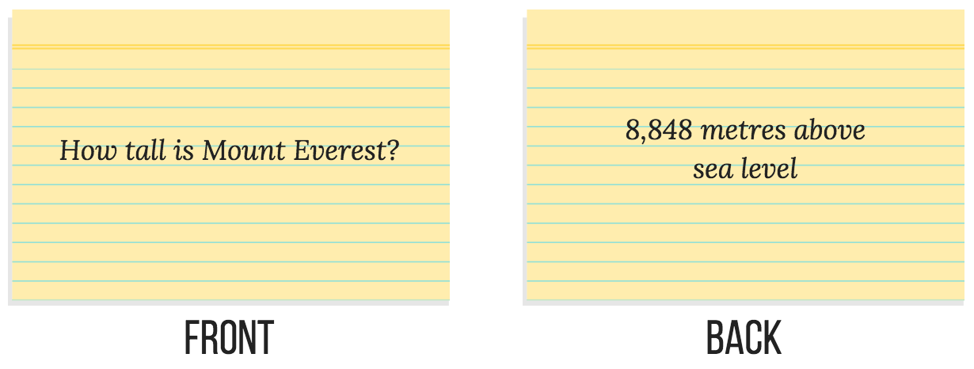
Method 1
Question
How do you say ‘I play football?’
Answer
Je joue au foot

Slide 8
Method 2
English word or phrase
I play football
French translation
Je joue au foot

Slide 9
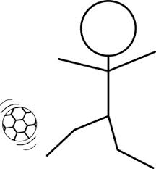
Method 3
Picture
French word or phrase
Je joue au foot

Slide 10
Method 4
English and French with a gap
I play football
Je joue __ _______
English and French with gap filled in
I play football
Je joue au foot

Slide 11
How to revise using your own flashcards
Put the cards into a pile.
Pick up the top card and try to say the answer out loud from memory. If you are translating into French or Spanish, try to spell it. As an extra challenge, try to use it in a sentence.
Turn the card over and look at the answer. If your answer was correct, put the card to one side in a separate, discard pile. If your answer was incorrect, put the card back to the bottom of the stack you’re going through.
Keep going until ALL of the cards are in the discard pile.
Repeat this process on 2 separate days.

Slide 12
Top tips
Colour code the following words on your flashcards to help you with your writing:
Masculine and feminine nouns
Masculine and feminine adjectives.
How do you say ‘Happy?’
Content
Contente

Slide 13
Why can’t I just learn my flashcards all at once?

Slide 14
If you only learn something once, you are more likely to forget it because it is only stored in your short –term memory.
If you revise something lots of times, it will eventually get stored in your long-term memory.
Anything stored here is very difficult to forget!
This is why it is important to revise using your flashcards a few times in short bursts before you take a test.

Slide 15
Top tips
Shuffle the cards at the start of a new revision session. This will help you to focus on memorising the meaning of the words rather than the order they are in.
Learning in short bursts is better than cramming for an hour before a vocabulary test. Try learning your flashcards for 10 minutes a day over 3 days before the test.
Before a mock exam or the real exam, try shuffling cards from different topics together.
Start by translating from French/Spanish into English, but then try translating from English into French/Spanish, too.

Slide 16
Can I create flashcards online instead?

Slide 17
Using flashcards on Quizlet
Quizlet is a free online flashcard creator.
You could use this instead of handwritten flashcards – it’s entirely up to you.
Flashcards have already been created on Quizlet to help you revise vocabulary for your weekly vocabulary tests. You can also hear the correct pronunciation of words.
You can also revise vocabulary through a variety of games.

Slide 18
How do I sign up for Quizlet?

Slide 19
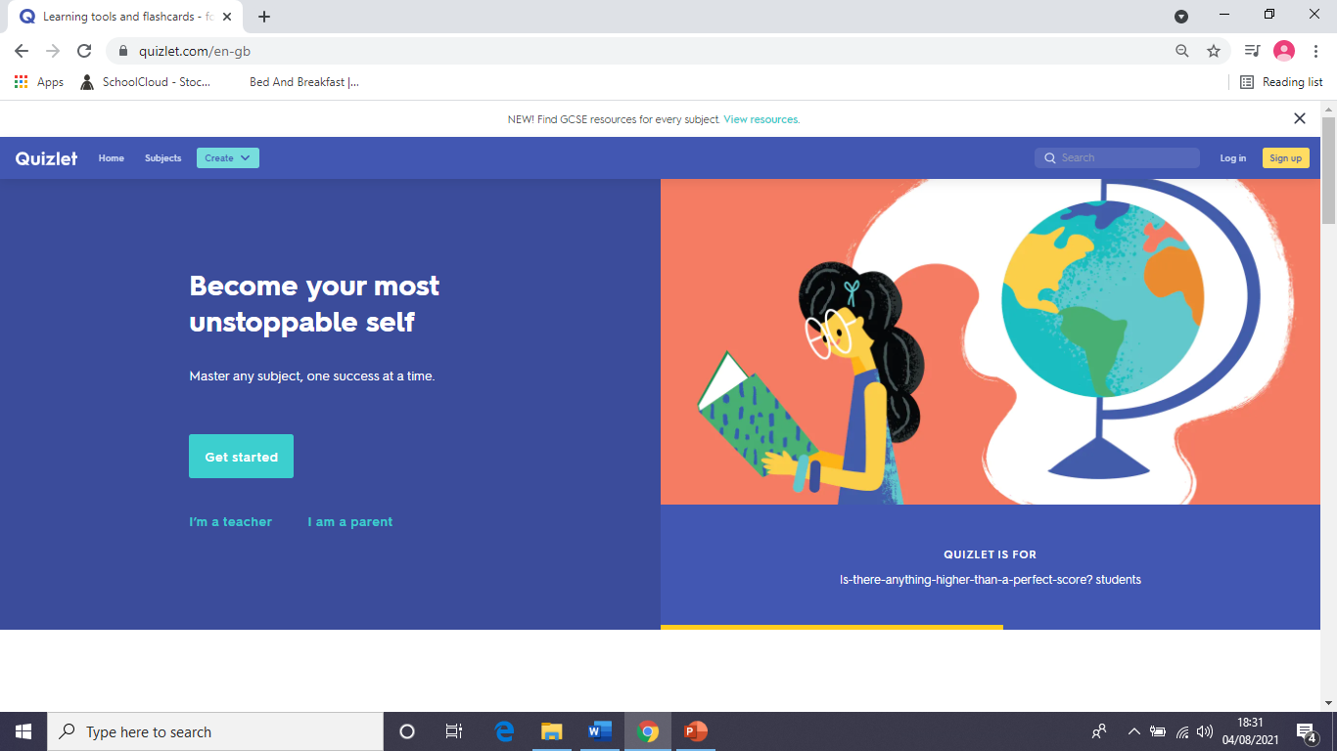
Creating a free account on Quizlet using a computer
Go to quizlet.com and click on ‘Sign Up’

Slide 20
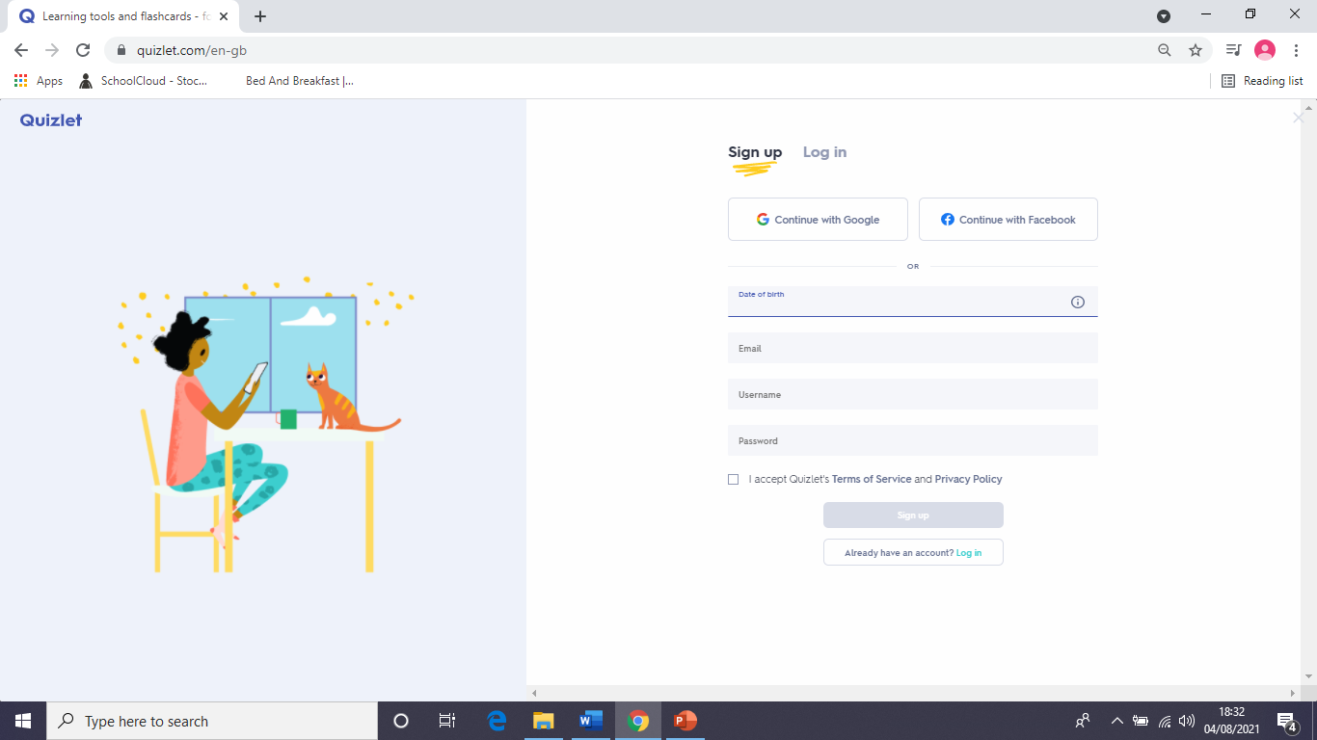
Creating a free account on Quizlet using a computer
Fill in your date of birth.
Give an email address that you frequently use.
Think of a memorable username and password.
Click the box next to ‘I agree’ and ‘Sign Up.’

Slide 21
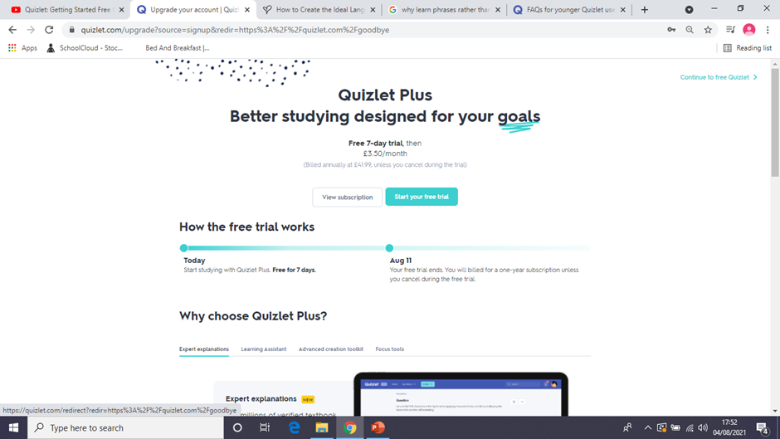
Creating a free account on Quizlet using a computer.
If this page appears, click on ‘continue to free Quizlet’ in the top right hand corner.
You do NOT need to pay anything to join Quizlet.

Slide 22
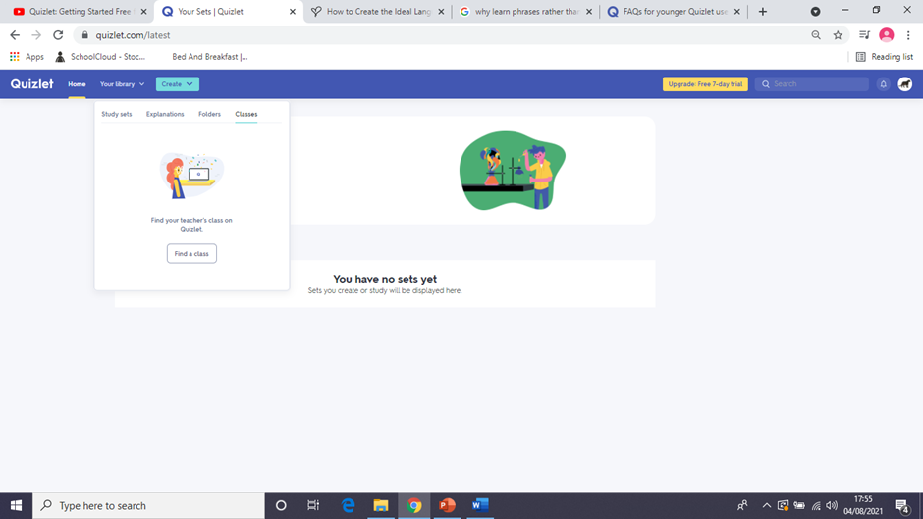
Joining our class on Quizlet on a computer
After signing up, you should see this page.
Click on ‘Your library’, then ‘Classes.’
Click on the button that says ‘Find a class’ and search for stocklandgreenmfl

Slide 23
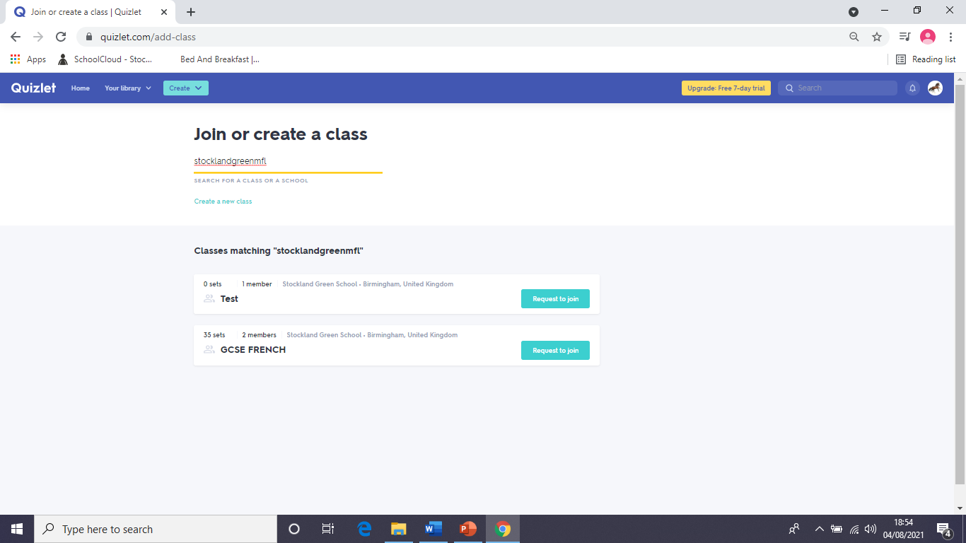
Joining our class on Quizlet using a computer
Find ‘GCSE French’ and click ‘Request to join.’

Slide 24
Finding our class from your homepage
Click on ‘Your library’ at the top of the screen and ‘Classes’. Then click on ‘GCSE French’.

Slide 25
Signing up for Quizlet and joining our class on your phone
Search for ‘Quizlet’ in the app store.
Download the app and click on ‘Sign up for free.’
Enter your date of birth, an email address you regularly use and a memorable username and password. Click ‘No’ to ‘Are you a teacher’? and skip the page about upgrading your account.
Enter the name of your school. Skip the page that asks you to add courses to your library and click on ‘begin studying.’
Click on ‘search for study sets’ and then ‘Classes’ at the top of the screen. Type in stocklandgreenmfl in the search box at the top of the screen.
Click on GCSE FRENCH.

Slide 26
How do I learn vocabulary on Quizlet?

Slide 27
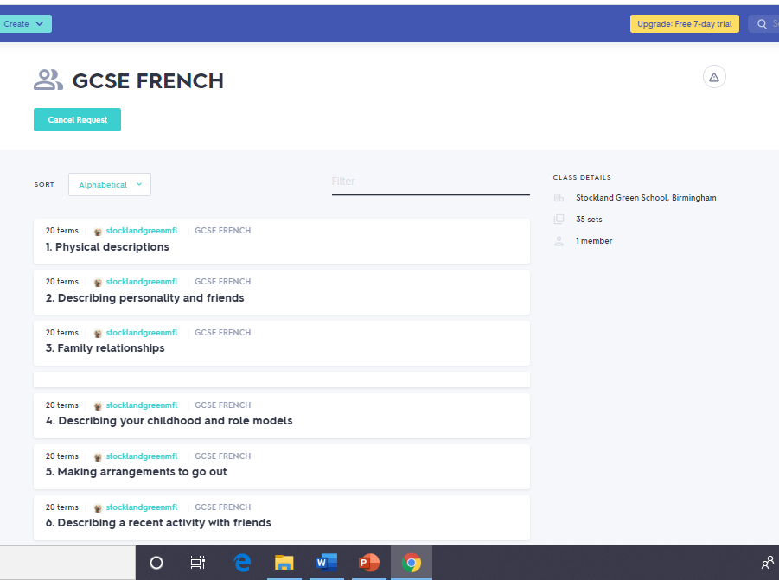
Learning vocabulary on Quizlet
Choose on a topic to start learning and click on it
(check with your teacher if you are not sure where to start.)

Slide 28
Learning vocabulary on Quizlet
If you want to use the online flashcards, click on this icon to make them full screen.

Slide 29
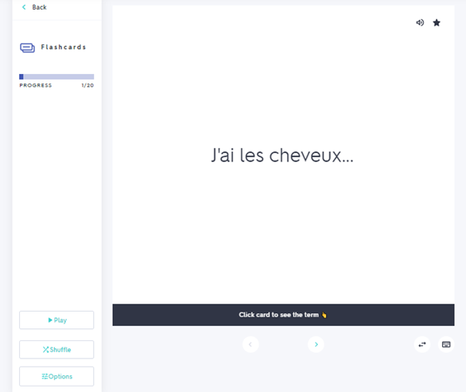
Learning vocabulary on Quizlet
Click on the flashcard to flip it over.
Click ‘back’ when you have finished studying the flashcards.

Slide 30
Learning vocabulary on Quizlet
Click on volume icon to hear the phrase.
If you are struggling to remember the phrase, press the star button.

Slide 31
Learning vocabulary on Quizlet
Click on ‘Shuffle’ to rearrange the order of the flashcards.
Click on ‘Options’ and you can change which side of the flashcard you see first.
You can also choose to only study the flashcards you marked with a star.

Slide 32
Learning vocabulary on Quizlet
There are lots of other ways you can learn the vocabulary apart from flashcards.
‘Learn,’ ‘Write’, ‘Spell’ and ‘Test’ help you to recognise and spell the words.
‘Match’ and ‘Gravity’ are games.

Slide 33
How can I create my own flashcards on Quizlet?

Slide 34
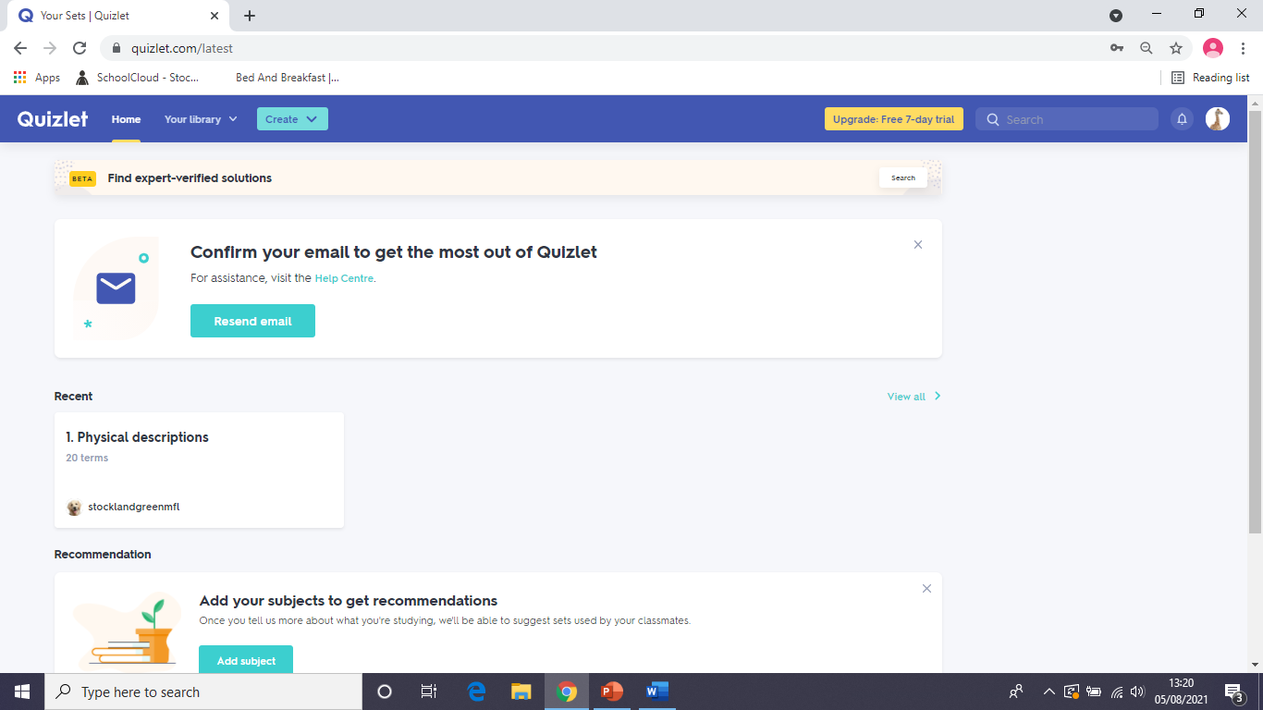
Creating flashcards on Quizlet on a computer
Click on ‘Create’ at the top of the screen and ‘study set.’
If you are using a phone, click the plus symbol at the bottom of the screen and ‘Create study set.’

Slide 35
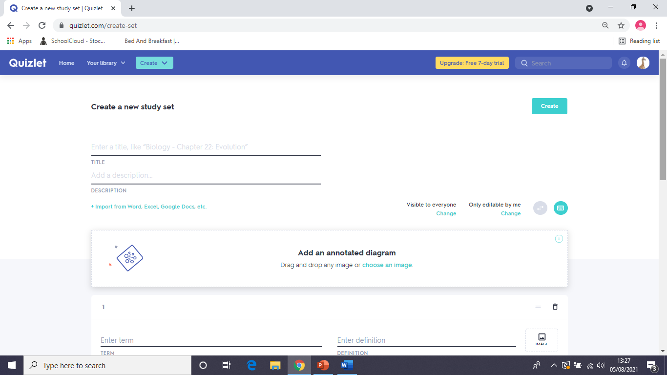
Creating flashcards on Quizlet
Give your set of flashcards a title.
There is no need to put anything in the description.

Slide 36
Creating flashcards on Quizlet
Create your flashcards by typing information here.
You can delete a flashcard by clicking on the bin or upload pictures by clicking on the ‘Image’ icon.
Front
Back

Slide 37
Creating flashcards on Quizlet
Click on ‘choose language’ before you type in the French/Spanish.
Click on ‘Create’ at the top of the screen to save your flashcards after you have made them.

Slide 38
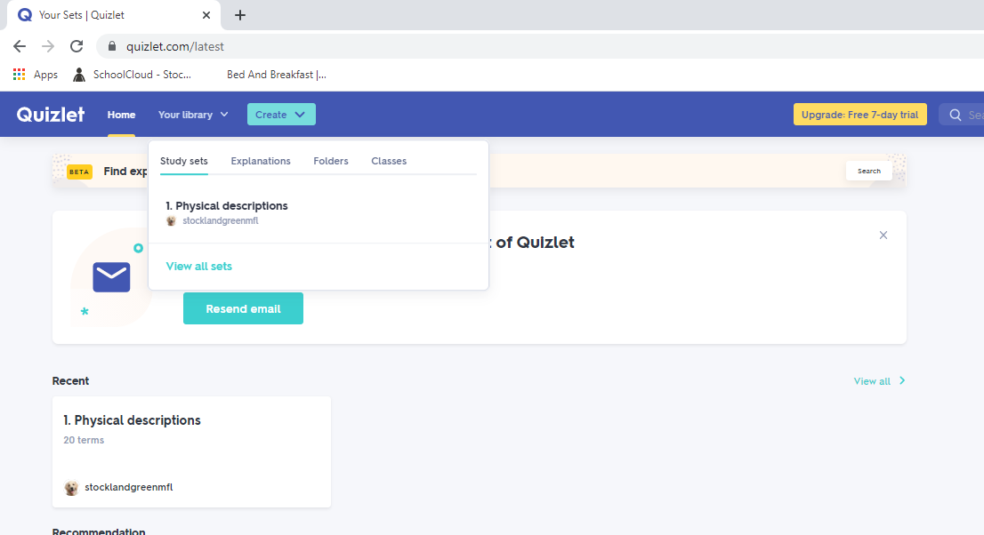
Finding your flashcards on your homepage
Click on ‘Your library,’ ‘Study Sets’ and ‘View all sets’ to see all the flashcards you have created.

Slide 39
Who can I contact if I have any questions about flashcards?

Slide 40
Who can I contact if I have any other questions?
If you have any questions, or need extra support, you can talk to your teacher in class, or email them:
Mrs Bourne: h.bourne@stockgrn.bham.sch.uk
Miss Clough: F.Clough@stockgrn.bham.sch.uk
Miss Hamilton: E.hamilton@stockgrn.bham.sch.uk

