Slide 1
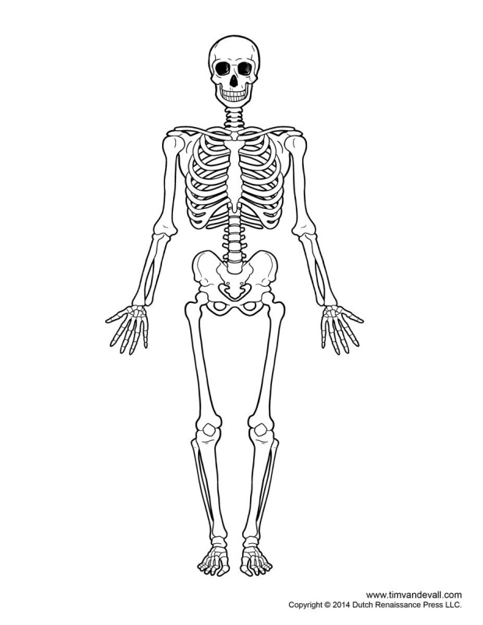
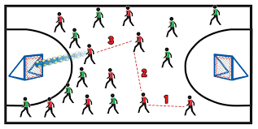
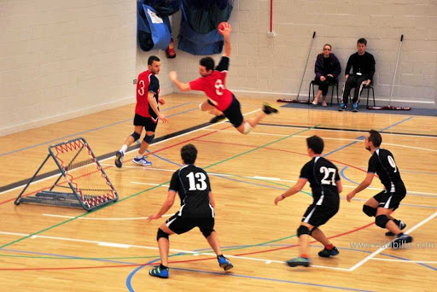
Skull
Clavicle
Humerus
Scapula
Ribs
Sternum
Ulna
Spine
Radius
Pelvis
Patella
Femur
Tibia
Fibula
Year 9 PE- Tchoukball
Rules of Tchoukball Players are allowed to move with the ball for a maximum of 3 steps and then must pass to another teammate or attempt a shot on goal. Players are only allowed to hold the ball for 5 seconds without moving Players may use their hands (open or closed) to catch Players can throw the ball at one rebounder a maximum of 3 times. A player may not touch the ball more than once in any one attack The ball must be passed twice before a shot on goal can be attempted. No one is allowed in the No contact is allowed No intercepting the ball | Tchoukball Lessons Shooting - Shotting at the target and rebound catching skills 2. Move to move effectively - 3 step rule leading to a shooting opportunity 3. How to pass effectively link 3 steps to 3 passes to create a shooting opportunity 4. Advanced shooting - Jump Shot, power and accuracy 5. Student leadership Students to create team tactics 6. Rules Student play games and learn all the rules for umpiring next lesson 6. Student umpiring - Students to umpire a game for 5 minutes 7. Student umpiring - Students to umpire a game for 5 minutes 8. Assessment
Scoring In order to score a point the ball must be thrown from outside of the crease, bounce off of the frame and land on the ground outside of the crease. If the ball is bounced off of the frame and then caught by the opposing team, no point is scored and the opposing team can attack immediately. If the ball is bounced off of the frame and then caught by the opposing team, no point is scored and the opposing team can attack immediately. | Skill/tactic When to use them:
 | Passing – Pass at speed to beat the defensive line, pass into space
 | Creating space – Sprint into space, call for the ball. Have an attacking team unit and a defensive team unit
 | Scoring - Throw the ball at the frame with power to score a point, when the ball lands outside the D or a team mate catches it If the opposition catch the ball then can attack the same frame, so aim into space.

Slide 2
Skull
Clavicle
Humerus
Scapula
Ribs
Sternum
Ulna
Spine
Radius
Pelvis
Patella
Femur
Tibia
Fibula
Self-Quiz Questions | Self-Quiz Questions
How many steps can you take with the ball? | 1. What is the benefit of the steps rule?
2. How many seconds can you hold the ball for? | 2. What is the benefit of the seconds rule?
3. What is the maximum number of rebounds allow from one player? | 3. Why does the rebounds rule make the game more exciting?
4. Is contact allowed? | 4. What are the benefits of having a no contact game?
5. Are you allowed to shoot in the D? | 5. Why must you shoot from outside the D?
6. Can you intercept the ball? | 6. Why does the no interception rules allow for a fast paced game?
7. What are the team units called? | 7. What are the benefits of 2 units?
8. Give one teaching point of the jump shot | 8. What is the benefit of the jump shot over a standing shot?
9. How to generate power in a shot? | 9. What is the benefit of power in the shot?
10. How many times can a player touch the ball in each attack? | 10. How does only allowing a player to touch the ball, make Tchoukball more inclusive?
Total score | Total score

Slide 3
Skull
Clavicle
Humerus
Scapula
Ribs
Sternum
Ulna
Spine
Radius
Pelvis
Patella
Femur
Tibia
Fibula
Self-Quiz Questions | Self-Quiz Questions
How many steps can you take with the ball? 3 | What is the benefit of the steps rule? Inclusive game for all, enjoyment, physical active
2. How many seconds can you hold the ball for? 5 | What is the benefit of the seconds rule? Inclusive game for all, enjoyment, physical active, stop one player taking over
What is the maximum number of rebounds allow from one player? 3 | Why does the rebounds rule make the game more exciting? Inclusive game for all, enjoyment, physical active, stop one player taking over, faster game
4. Is contact allowed? No | What are the benefits of having a no contact game? Less injuries, more inclusive
Are you allowed to shoot in the D? No | Why must you shoot from outside the D? Game harder, add skill, develops power, fun
6. Can you intercept the ball? No | Why does the no interception rules allow for a fast paced game? Inclusive game for all, enjoyment, physical active
What are the team units called? Attacking and defensive | What are the benefits of 2 units? Inclusive game for all, enjoyment, physical active, add leadership, play to people strengths
8. Give one teaching point of the jump shot Jump high, bend knee, hand by ear, follow through, side on, eyes on frame, non throwing hand aiming | 8. What is the benefit of the jump shot over a standing shot? More power to get the ball outside the D, helps miss the defenders, reduces reaction time
9. How to generate power in a shot? Jump high, side on, hand by ear, follow through | 9. What is the benefit of power in the shot? More power to get the ball outside the D, helps miss the defenders, reduces reaction time
How many times can a player touch the ball in each attack? Once | 10. How does only allowing a player to touch the ball, make Tchoukball more inclusive? Inclusive game for all, enjoyment, physical active, stop one player taking over
Total score | Total score

