Slide 1
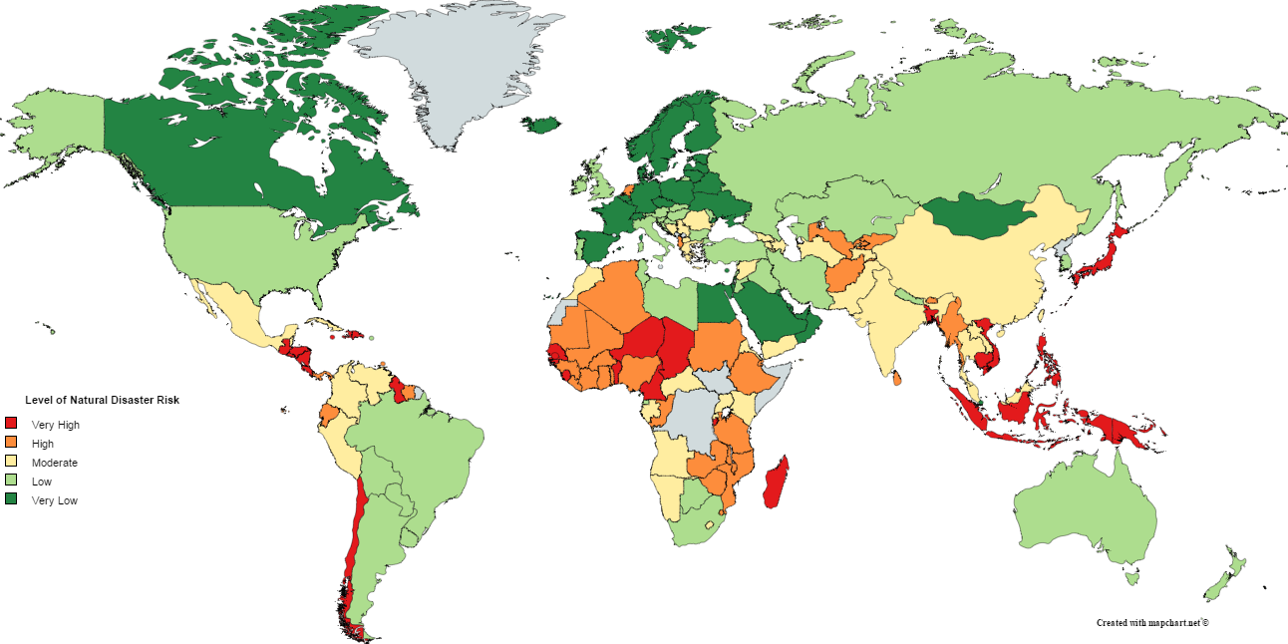
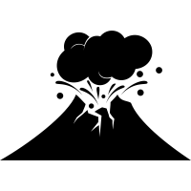
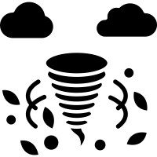
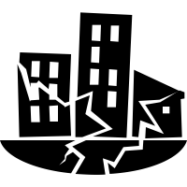
Hazardous world – natural hazards
Natural hazards and climate change
Where are the most dangerous places to live?
Japan, Indonesia and the Philippines are three of many countries that have multiple hazards. The map below shows some of the worst affected countries from natural disasters; red (very high), orange (high), yellow (moderate), light green (low) and dark green (very low).
When natural events have the potential to impact human lives, we call it them ‘natural hazards’. If a natural hazard does directly impact people and a place, we call it a ‘natural disaster’.
We can categorise natural hazards into three different ways depending on where they originate from. These are atmospheric hazards (above the ground), terrestrial hazards (on the ground) and tectonic hazards (below the ground).
Climate change has caused the temperature to increase by roughly 1°C over the last 100 years. This could have an impact on the magnitude (strength) and frequency (the amount) of atmospheric hazards.
Over the last 20-25 years there has been a recent increase in the frequency and magnitude of tropical storms. Some people think this is due to Climate Change but we need more data to be sure. It could be a natural cycle.
Why do people live in hazardous areas?
Some people have no choice but to live in hazardous areas because they are too poor to move away
Some people are attracted by the opportunities tourism can bring through these areas
Some people take advantage of the fertile land to grow crops
Some people are attracted to cheap geothermal energy
Some people are willing to take the risk for well paid jobs e.g. California, USA
Some people want to live in successful major cities which often like on flat land next to rivers
What factors can make natural hazards worse?
WOW Words
Human
Physical
Duration (length of time they last)
Speed of onset (how quickly they occur)
Size of the area they effect
Their randomness (regular of random)
Natural hazards = extreme events that can cause loss of life, extreme damage to property and disruption
Climate change = the global increase (or decrease) in temperature and its affect on the world’s climate.
Magnitude = the size or power of something
Human factors = manmade changes or parts of human behavior than impact on something
Physical factors = naturally occurring factors that impact on our world and environment
Population density
Poor emergency services
Poor quality buildings
Lack of defences
Lack of warning/preparation
Notes:
Autumn 2

Slide 2
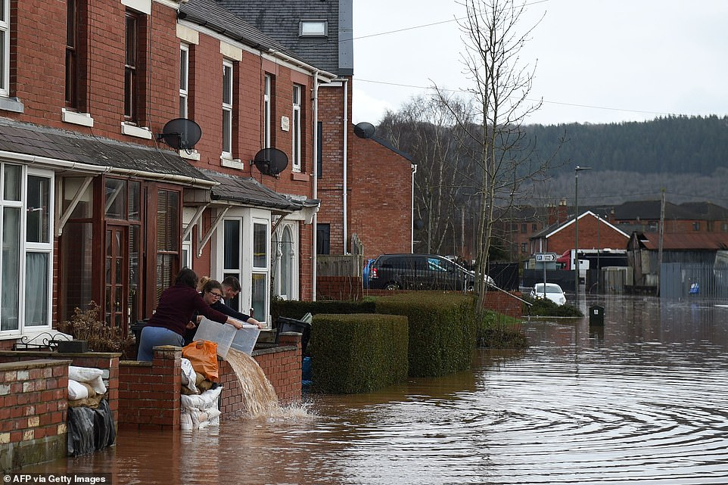
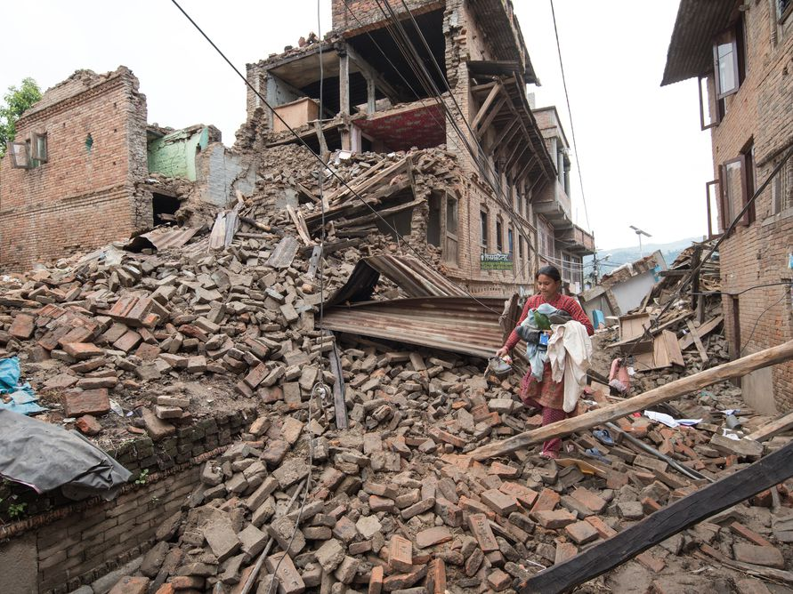
Know it
think it
What is a natural hazard?
What is a natural disaster?
Define the term terrestrial.
Give 2 examples of tectonic hazards.
Give one example of a human factor that can make hazards worse.
Explain (give reasons why) how one human factor can make hazards worse.
Name a country that has multiple hazards.
What does magnitude mean?
How much has global temperature increased in the last 100 years?
State 2 reasons that someone might want to live in a hazardous area and explain why.
Grasp it
What natural hazards do you think have caused the images above? Where in the world do you think they might have occurred?
Study the pictures above. What impacts from natural disasters can you see? Categorise these into social (people), economic (money) and environmental (land and atmosphere).
Do you think people should be allowed to live in hazardous locations? Explain your reasons why.
Which of the factors do you think impact natural hazards more? Rank all (both human and physical) the factors order from 1 (most) to 9 (least).
How do humans contribute to climate change? Research how we can all individually reduce our contribution to climate change.
Which areas in the world are most at risk from natural hazards? Are there any specific patterns to this risk?

Slide 3
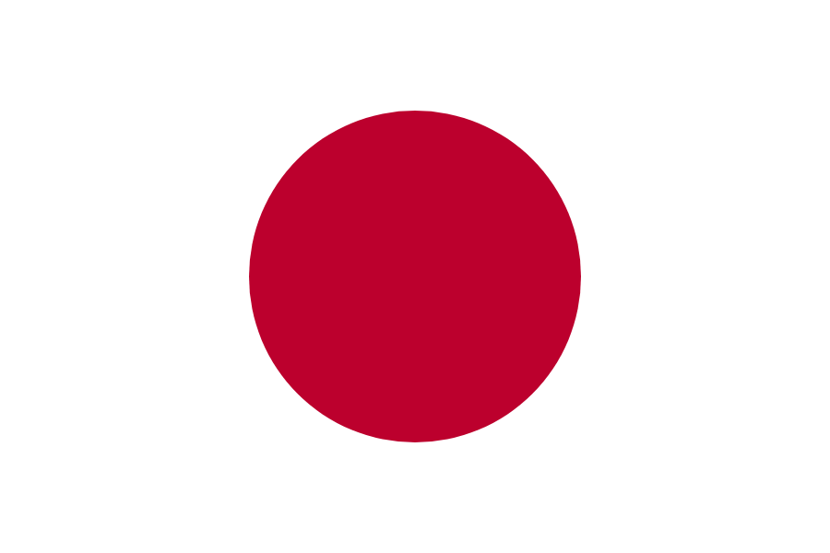
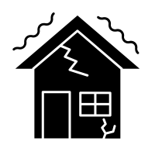
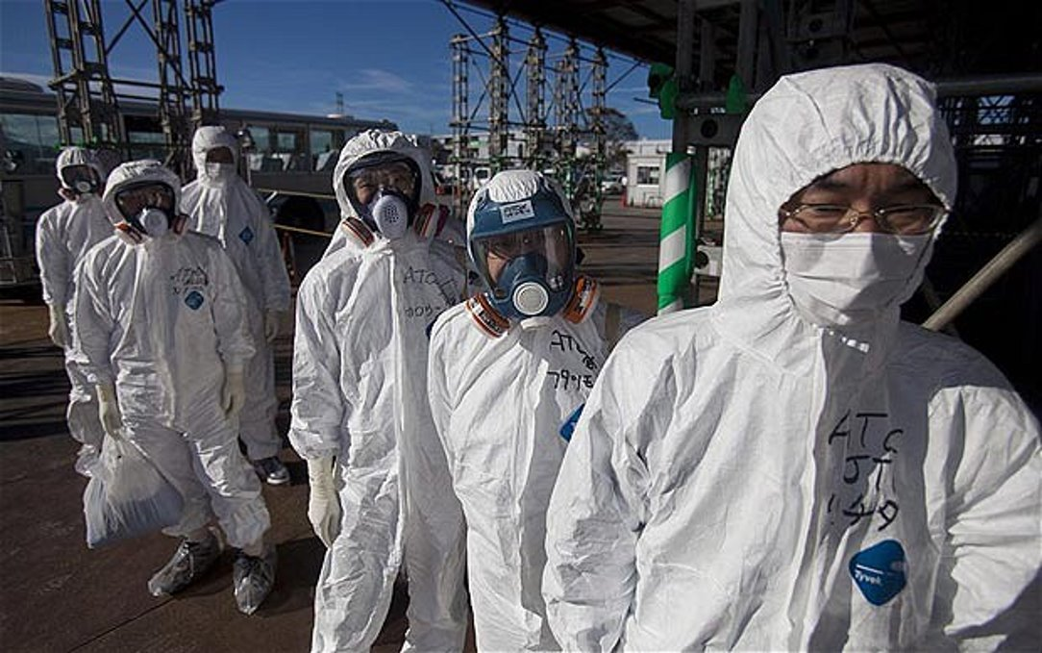
Hazardous world – Japan
Earthquakes
Why is Fukishima deserted?
The 2011 tsunami toppled sea defences at Tohoku protecting Fukushima nuclear power station and the flooding caused a power outage which initiated a nuclear disaster.
An earthquake happens when tectonic plates move. It is the sudden release of energy that creates seismic waves that are felt as vibrations.
There are 3 ways that earthquakes can be measured:
The Richter scale measures the magnitude of a tremor using a seismograph.
Moment magnitude scale is a measure of an earthquake's magnitude based on its seismic moment.
The Mercalli scale measures how much damage is caused by earthquakes based on observations.
Where is Japan?
Japan is in Asia and is made up of 4 main islands; Honshu, Hokkaido, Kyushu and Shikoku. The capital city is Tokyo. Japan is home to many major global companies including Honda, Nissan and Toshiba.
Why is Tokyo important to Japan?
Local – there are 15 hospitals in Tokyo.
National – Tokyo is at the centre of Japan’s
transport system with the busiest metro system
in the world.
International – over 2000 international companies
have their headquarters located in Tokyo.
Tsunamis
A tsunami is a very large ocean wave that is caused by an underwater earthquake. The Tohoku earthquake in Japan happened on 11th March 2011 causing a devastating tsunami which reached heights of 135 ft. There were many impacts and responses to this natural disaster which can be categorized into social, economic and environmental.
How can we respond to natural disasters?
Plate boundaries
Emergency relief – gives immediate help by providing rescue, safety and emergency food/water/medical supplies.
Constructive – plates move away from each other causing earthquakes and volcanoes.
Destructive – oceanic plate descends underneath continental plate causing earthquakes and volcanoes.
Conservative – plates move past each other causing earthquakes.
Collision – two continental plates move towards each other causing earthquakes.
WOW Words
Social = effects on people
Economic = effects on money/jobs
Environmental = effects on land/atmosphere/animals
Nuclear power plant = a thermal power station in which the heat source is a nuclear reactor.
Aid = providing help to another country
Short-term relief – helps give support in the first few weeks and months. Provides shelter, food, clothes, water and medical care.
Long-term aid – helps get people back to normal. It involves repairing roads, providing jobs and preparing disaster plans for the future.
Notes:
Autumn 2

Slide 4
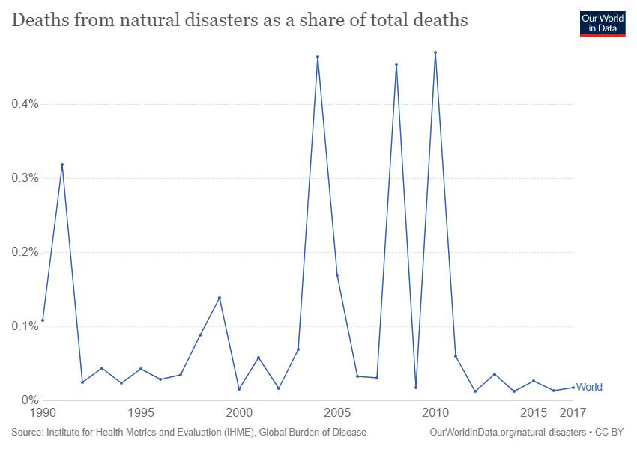
Know it
think it
What continent is Japan on?
Give one reason why Tokyo is important internationally.
How many plate boundaries are there?
Which plate boundaries will you find volcanoes?
Which plate boundaries will you find earthquakes?
Name the 3 ways that you can measure an earthquake.
When did the tsunami in Tohoku happen?
Why is Fukishima deserted?
What is the difference between short-term and long-term relief?
Give an example of emergency relief.
Grasp it
1. Are natural disasters getting worse? Or are we just getting better at recording them? Use the graph above and your own research to support your answer.
2. Does a countries wealth have an impact on how it can deal with natural disasters? Explain your answer and use real life examples to support.
3. Do you think Fukishima will ever be able to re-open? Think like a geographer and support your answer with evidence.
Which responses to the 2011 tsunami do you think were the most effective? Explain you reasons why.
Research the boxing day tsunami that hit Thailand in 2002. What were the differences in that natural disaster to Tohoku in 2011?
Write a newspaper article reporting on the Fukishima nuclear disaster. Include the causes, impacts and responses.

