Slide 1
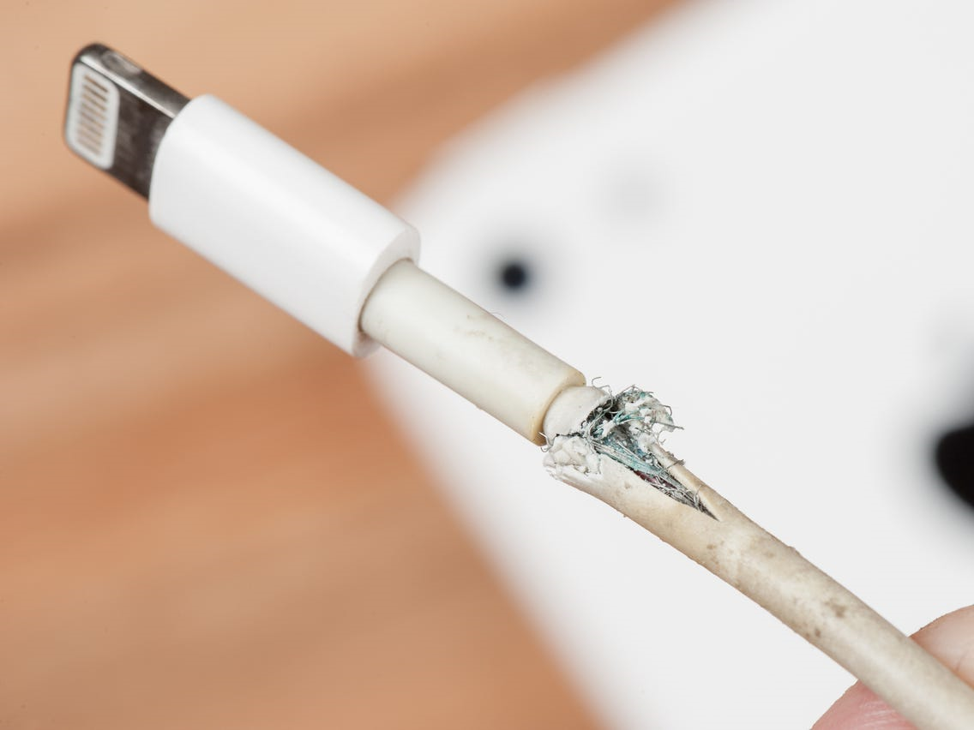
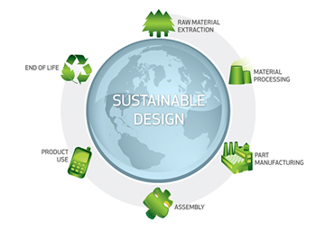
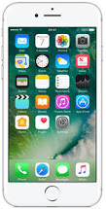
Stockland Green Knowledge Organiser - DT- Year 8 – Sustainability
SUSTAINABILITY
In Design and Technology, understanding about sustainability is important in the world today. It is important as we wish to try and combat issues that will harm our plant. To prevent this designers try to incorporate sustainable design.
Sustainability
Sustainable design seeks to reduce negative impacts on the environment, and the health and comfort of building occupants, thereby improving building performance. The basic objectives of sustainability are to reduce consumption of non-renewable resources, minimize waste, and create healthy, productive environments.
The 6R’s
Refuse what you don’t need - Is your product really needed? Have you thought about the people who might be making your product - are they treated fairly (pay, living and working conditions etc)?
Reduce what you do need - Are there any parts in your product that are not needed? How can the amount of material be reduced? How could you simplify your product?
Reuse anything you can think of - Which parts of the product could be used again? Has the product got another use without having to process it?
Recycle what you cannot refuse, reduce or reuse - Which parts of the product can be recycled? Is this information clear on the packaging?
Repair what you can fix - Which parts might need to be replaced? Which parts might fail with use or over time? How easy would it be to replace parts?
Rethink if you really need it - How can the product do the job better? Is the product energy efficient? Has the product been designed for disassembly?
Carbon footprint
A carbon footprint is the measure of the carbon dioxide produced by something or someone.
Planned Obsolescence
Planned obsolescence is when a product is designed and made with parts that are known to fail after a specific time. This means a new part or a new product will have to be bought to replace it. e.g iphone charger
Product Life Cycle
Products life cycle is the time from a product’s manufacture, to its recycling or disposal, at the end of its useful life. Customers often expect products to be designed and manufactured, so that they do as little damage to the environment as possible, throughout their entire lifetime. Products should:
Be manufactured, from sustainable / recyclable materials,
produce as little pollution as possible, during manufacture and use.
Use as little energy / fuel as possible
Perceived Obsolescence
Perceived obsolescence is when the client/user is convinced, that he / she needs an updated product, even though his /her existing product is working well. This is often based on style rather than functionality. E.g a new iphone

Slide 2
Stockland Green Knowledge Organiser - DT- Year 8 - Sustainability
Know it
Think it
What is sustainability?
What is a life cycle?
What is meant by a carbon footprint
What is the environment?
What is meant by the term ‘rethink’?
What is meant by the term ‘reuse’?
What is meant by the term ‘refuse’?
What is meant by the term ‘repair’?
What is meant by the term ‘reduce’?
What is meant by the term ‘recycle’?
Explain the life cycle of any product.
Grasp it
Explain how obsolescence affects the environment

