Slide 1
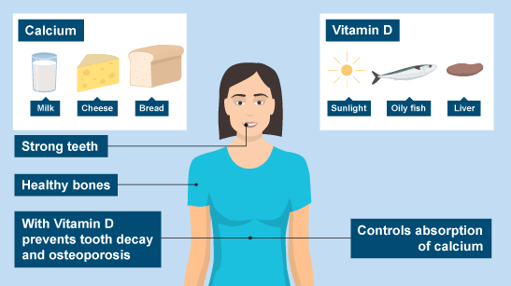
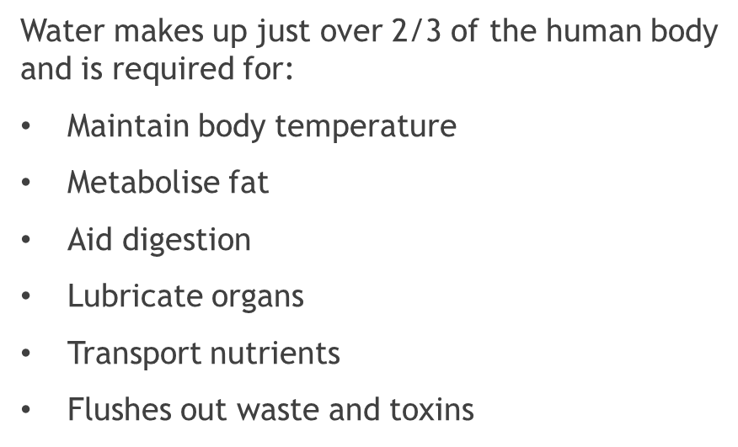
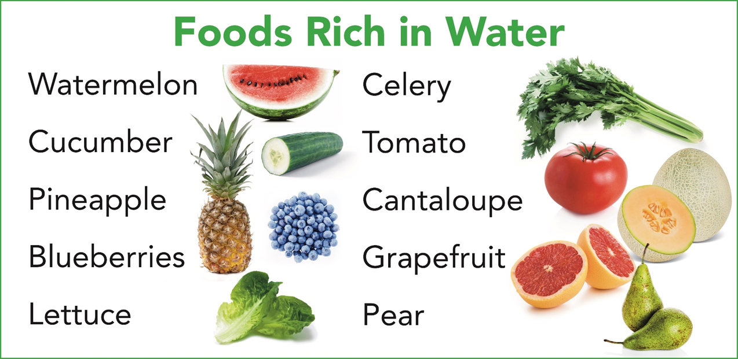
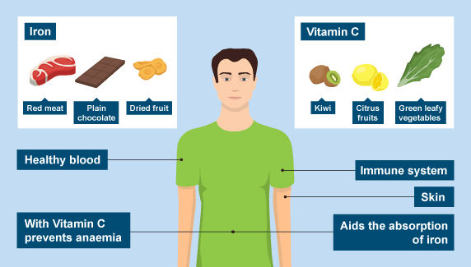
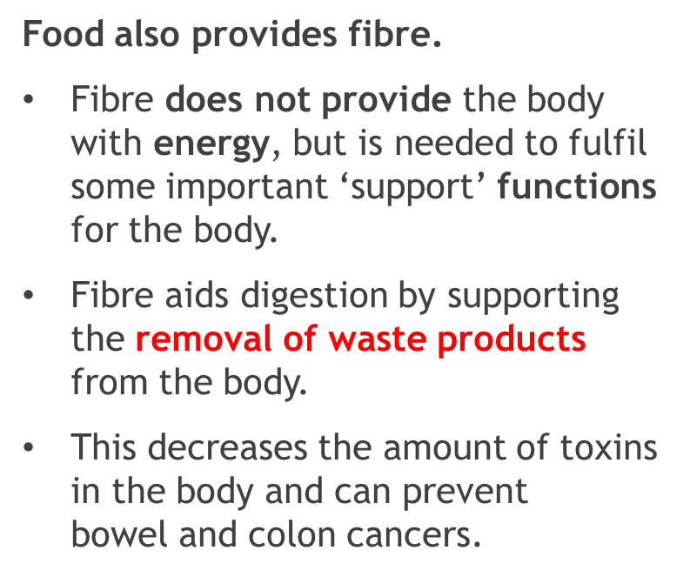
Stockland Green Knowledge Organiser - DT- Year 8 – Nutrients
Nutrients
Nutrients are compounds in foods essential to life and health, providing us with energy, the building blocks for repair and growth and substances necessary to regulate chemical processes.
Macro Nutrients are required in the body in large amounts as they are the main source of energy.
Micro Nutrients are only needed in small amounts as some of them the body can produce itself. They are needed to maintain normal cell function on a smaller scale.
Carbohydrate is the body’s main source of energy. Muscle relies on carbohydrate during any physical movement, especially during exercise. Carbohydrate breaks down to glucose, which is more easily used in the body.
Proteins are needed in the body for growth and repair of tissue and cells. Proteins are made up of ‘building blocks’ called amino acids.
The body needs fats for insulation/warmth, temperature control, protection of vital organs and essential fatty acids (Omega3 and 6).
9 essential | 12 non-essential
Body cannot make these | Can be made by the body
Must be provided by our diet, by the food we eat
High Biological Value | Low Biological Value
Animal sources such as meat, poultry, fish, eggs, milk, cheese and yoghurt | Plants, legumes, grains, nuts, seeds and vegetables
Saturated Fat:
Solid at room temperature
Mainly from animal sources
Causes high blood cholesterol
Unsaturated Fat:
Liquid at room temperature
Mainly from non-animal sources
Can lower blood cholesterol

Slide 2
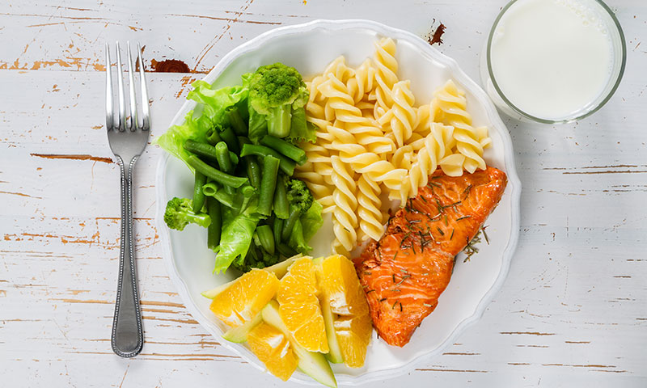
Stockland Green Knowledge Organiser - DT- Year 8 – Nutients
Know it
Think it
What are the three macro-nutrients?
What is the main function of carbohydrates?
Proteins are made up of building blocks – but what are these called?
Give two functions of fat in the diet.
What are cheese, eggs and beans all sources of?
What does vitamin D prevent?
What is calcium needed for in our diet?
List four foods which are rich in water.
What vitamin can be absorbed from sunlight?
What is dietary fibre needed for?
Discuss the nutrition provided by the meal below. Make at least 4 detailed points; giving the name of the nutrient, the source and what it provides for the body.
Broccoli
Salmon
Pasta
Orange slices
Remember to write in full, detailed sentences and give reasons for your ideas.
Grasp it
Create a chart outlining the foods you ate yesterday. For each food, identify the main nutrient it provides.
Then summarise by highlighting the nutrient you are the most and the least of.

