Slide 1
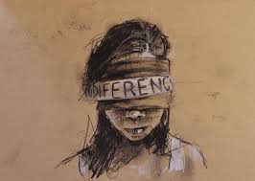
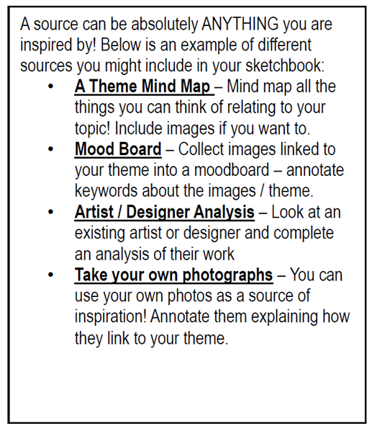
Stockland Green Knowledge Organiser – Art – 10 – Autumn Term– Fears & Phobias (A01:Develop)

Slide 2
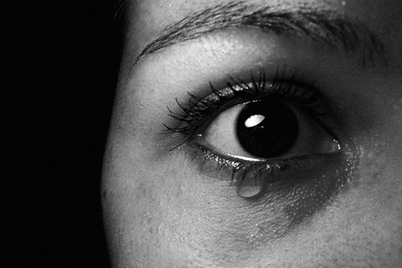
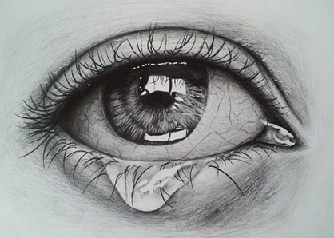
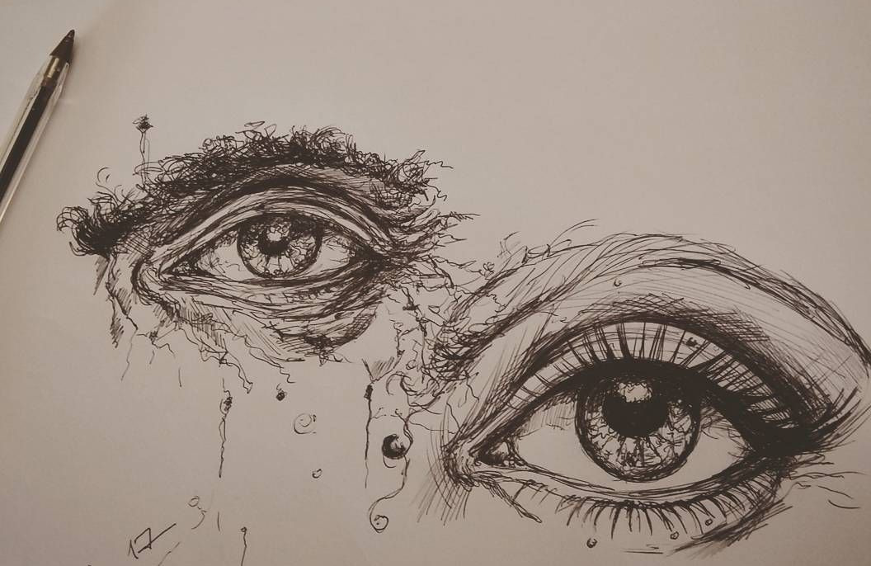
Stockland Green Knowledge Organiser – Art – 10 – Autumn Term – Fears & Phobias (AO3:Record)

Slide 3
Stockland Green Knowledge Organiser – Art – 10 – Autumn Term
Self-Quiz Questions | Self-Quiz Questions | Challenge Self-Quiz Quizzing
1.What is Assessment Objective 1? | 1.Explain what tasks you need to complete for AO1? | 1.What do you think is required to gain a grade 9 in Fine Art? Be as descriptive as possible.
2.What is Assessment Objective 2? | 2.Explain what tasks you need to complete for AO2? | 2.What makes a successful drawing?
3. What is Assessment Objective 3? | 3.Explain what tasks you need to complete for AO3? | 3.What makes a successful piece of artist analysis?
4. What is Assessment Objective 4? | 4.Explain what tasks you need to complete for A04? | 4.What makes a final piece successful?
5.What percentage is your set task towards your final grade? | 5.What are annotations? | 5.What makes experimental project work successful?
6.What is a portfolio of work? | 6.When would you be expected to write annotations to support your work? | 6.
7.What is a set task? | 7. What is artist analysis? | 7.
8. What percentage is your coursework portfolio towards your final grade? | 8. | 8.
9.How do you show an understanding of your selected artist’s work? | 9. | 9.
10.How long do you feel a final piece should take to create? | 10. | 10.
Total score | Total score | Total score

Slide 4
Stockland Green Knowledge Organiser – Art – 10 – Spring Term– Fears & Phobias (A01:Develop)

Slide 5
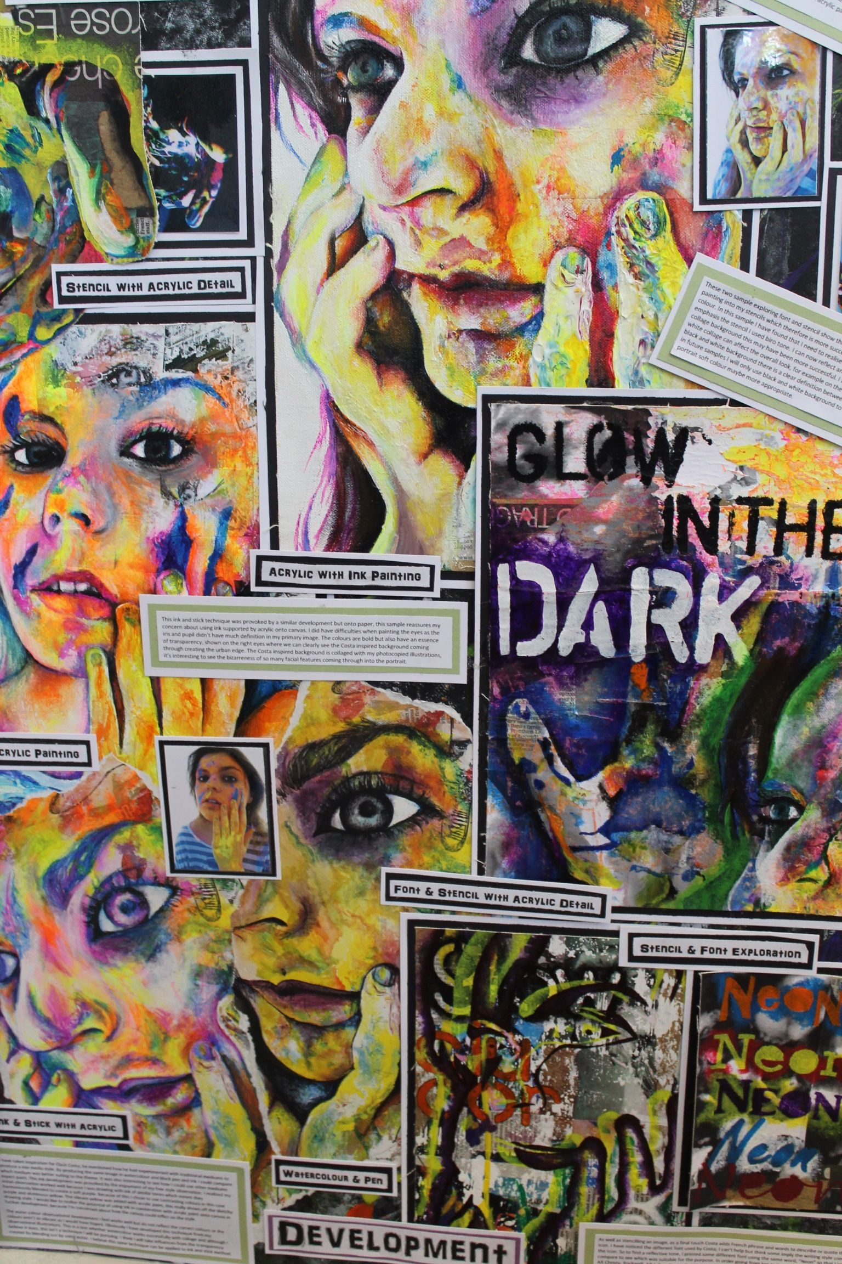
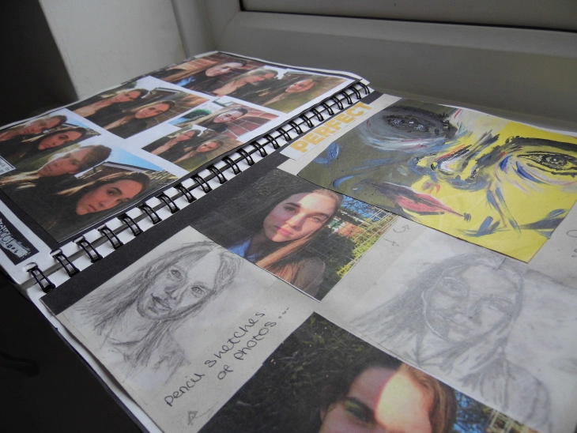
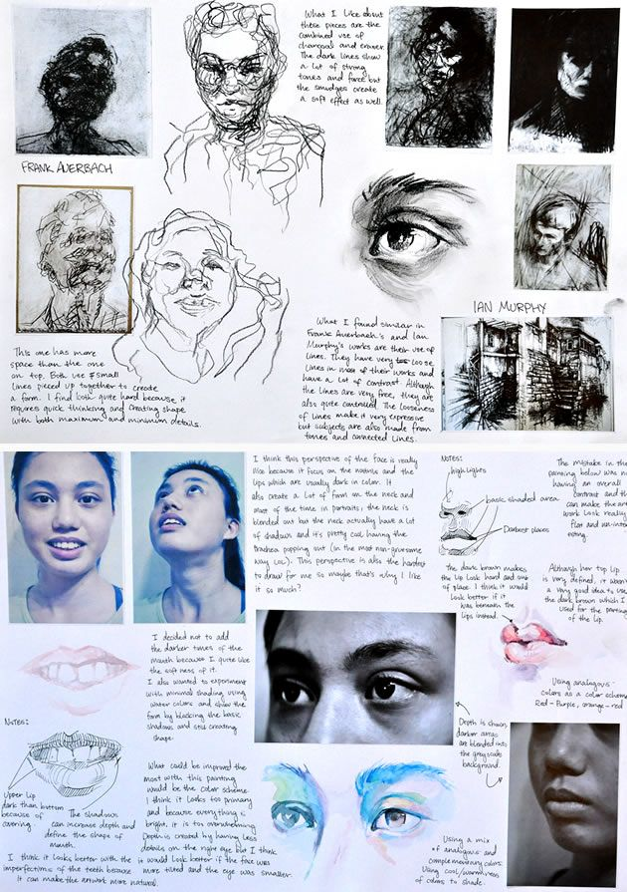
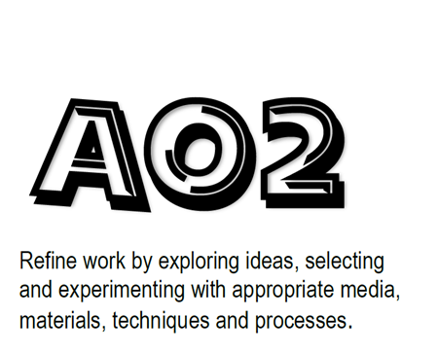
Stockland Green Knowledge Organiser – Art – 10 – Spring Term – Fears & Phobias (AO3:Refine)

Slide 6
Stockland Green Knowledge Organiser – Art – 10 – Autumn Term
Self-Quiz Questions | Self-Quiz Questions | Challenge Self-Quiz Quizzing
1.What is Assessment Objective 1? | 1.Explain what tasks you need to complete for AO1? | 1.What do you think is required to gain a grade 9 in Fine Art? Be as descriptive as possible.
2.What is Assessment Objective 2? | 2.Explain what tasks you need to complete for AO2? | 2.What makes a successful drawing?
3. What is Assessment Objective 3? | 3.Explain what tasks you need to complete for AO3? | 3.What makes a successful piece of artist analysis?
4. What is Assessment Objective 4? | 4.Explain what tasks you need to complete for A04? | 4.What makes a final piece successful?
5.What percentage is your set task towards your final grade? | 5.What are annotations? | 5.What makes experimental project work successful?
6.What is a portfolio of work? | 6.When would you be expected to write annotations to support your work? | 6.
7.What is a set task? | 7. What is artist analysis? | 7.
8. What percentage is your coursework portfolio towards your final grade? | 8. | 8.
9.How do you show an understanding of your selected artist’s work? | 9. | 9.
10.How long do you feel a final piece should take to create? | 10. | 10.
Total score | Total score | Total score

Slide 7
Stockland Green Knowledge Organiser – Art – 10 – Summer Term– Fears & Phobias (A01:Develop)

Slide 8
Stockland Green Knowledge Organiser – Art – 10 – Summer Term – Fears & Phobias (AO3:Refine)

Slide 9
Stockland Green Knowledge Organiser – Art – 10 – Autumn Term
Self-Quiz Questions | Self-Quiz Questions | Challenge Self-Quiz Quizzing
1.What is Assessment Objective 1? | 1.Explain what tasks you need to complete for AO1? | 1.What do you think is required to gain a grade 9 in Fine Art? Be as descriptive as possible.
2.What is Assessment Objective 2? | 2.Explain what tasks you need to complete for AO2? | 2.What makes a successful drawing?
3. What is Assessment Objective 3? | 3.Explain what tasks you need to complete for AO3? | 3.What makes a successful piece of artist analysis?
4. What is Assessment Objective 4? | 4.Explain what tasks you need to complete for A04? | 4.What makes a final piece successful?
5.What percentage is your set task towards your final grade? | 5.What are annotations? | 5.What makes experimental project work successful?
6.What is a portfolio of work? | 6.When would you be expected to write annotations to support your work? | 6.
7.What is a set task? | 7. What is artist analysis? | 7.
8. What percentage is your coursework portfolio towards your final grade? | 8. | 8.
9.How do you show an understanding of your selected artist’s work? | 9. | 9.
10.How long do you feel a final piece should take to create? | 10. | 10.
Total score | Total score | Total score

Slide 10
Stockland Green Knowledge Organiser – Art – 11 – Autumn Term – Portfolio task (AO3:Refine)

Slide 11
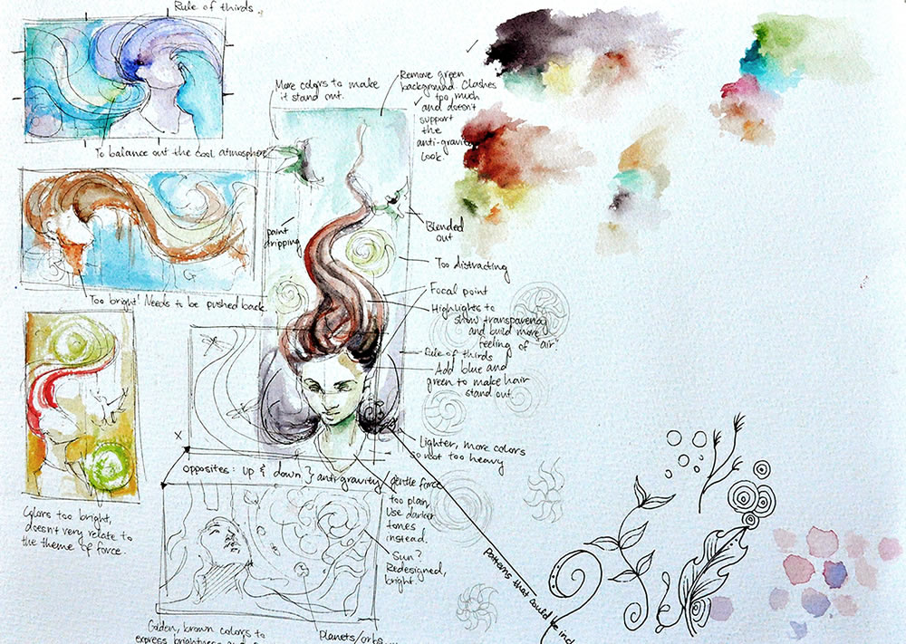
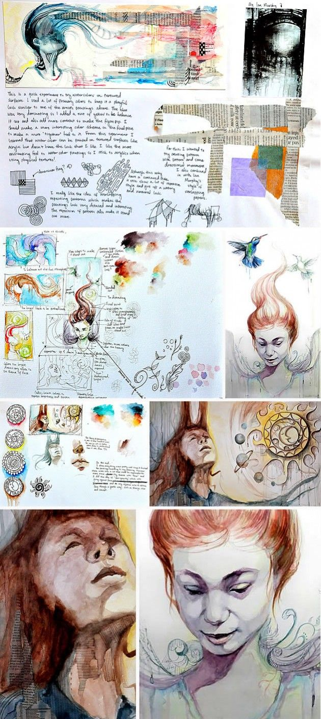
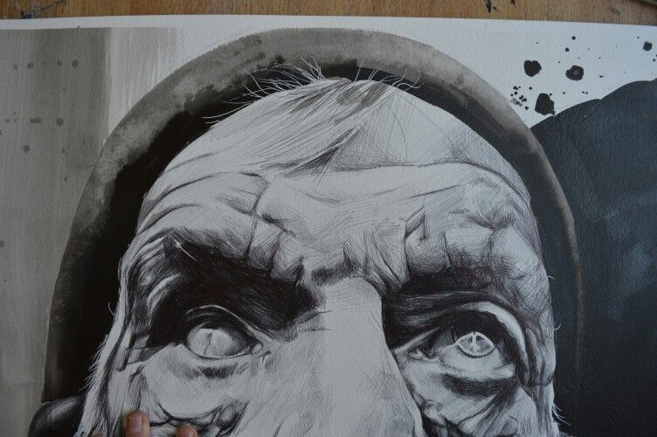
Stockland Green Knowledge Organiser – Art – 11 – Autumn – Portfolio task (Record/Develop

Slide 12
Stockland Green Knowledge Organiser – Art – 10 – Autumn Term
Self-Quiz Questions | Self-Quiz Questions | Challenge Self-Quiz Quizzing
1.What is Assessment Objective 1? | 1.Explain what tasks you need to complete for AO1? | 1.What do you think is required to gain a grade 9 in Fine Art? Be as descriptive as possible.
2.What is Assessment Objective 2? | 2.Explain what tasks you need to complete for AO2? | 2.What makes a successful drawing?
3. What is Assessment Objective 3? | 3.Explain what tasks you need to complete for AO3? | 3.What makes a successful piece of artist analysis?
4. What is Assessment Objective 4? | 4.Explain what tasks you need to complete for A04? | 4.What makes a final piece successful?
5.What percentage is your set task towards your final grade? | 5.What are annotations? | 5.What makes experimental project work successful?
6.What is a portfolio of work? | 6.When would you be expected to write annotations to support your work? | 6.
7.What is a set task? | 7. What is artist analysis? | 7.
8. What percentage is your coursework portfolio towards your final grade? | 8. | 8.
9.How do you show an understanding of your selected artist’s work? | 9. | 9.
10.How long do you feel a final piece should take to create? | 10. | 10.
Total score | Total score | Total score

Slide 13
Stockland Green Knowledge Organiser – Art – 11 – Spring Term– Set Task (A01:Develop)

Slide 14
Stockland Green Knowledge Organiser – Art – 11 – Spring Term– Set task(AO3:Record)

Slide 15
Stockland Green Knowledge Organiser – Art – 10 – Autumn Term
Self-Quiz Questions | Self-Quiz Questions | Challenge Self-Quiz Quizzing
1.What is Assessment Objective 1? | 1.Explain what tasks you need to complete for AO1? | 1.What do you think is required to gain a grade 9 in Fine Art? Be as descriptive as possible.
2.What is Assessment Objective 2? | 2.Explain what tasks you need to complete for AO2? | 2.What makes a successful drawing?
3. What is Assessment Objective 3? | 3.Explain what tasks you need to complete for AO3? | 3.What makes a successful piece of artist analysis?
4. What is Assessment Objective 4? | 4.Explain what tasks you need to complete for A04? | 4.What makes a final piece successful?
5.What percentage is your set task towards your final grade? | 5.What are annotations? | 5.What makes experimental project work successful?
6.What is a portfolio of work? | 6.When would you be expected to write annotations to support your work? | 6.
7.What is a set task? | 7. What is artist analysis? | 7.
8. What percentage is your coursework portfolio towards your final grade? | 8. | 8.
9.How do you show an understanding of your selected artist’s work? | 9. | 9.
10.How long do you feel a final piece should take to create? | 10. | 10.
Total score | Total score | Total score

Slide 16
Stockland Green Knowledge Organiser – Art – 11 – Summer Term – Portfolio task (AO3:Refine)

Slide 17
Stockland Green Knowledge Organiser – Art – 11 – Autumn – Portfolio task (Record/Develop

Slide 18
Stockland Green Knowledge Organiser – Art – 10 – Autumn Term
Self-Quiz Questions | Self-Quiz Questions | Challenge Self-Quiz Quizzing
1.What is Assessment Objective 1? | 1.Explain what tasks you need to complete for AO1? | 1.What do you think is required to gain a grade 9 in Fine Art? Be as descriptive as possible.
2.What is Assessment Objective 2? | 2.Explain what tasks you need to complete for AO2? | 2.What makes a successful drawing?
3. What is Assessment Objective 3? | 3.Explain what tasks you need to complete for AO3? | 3.What makes a successful piece of artist analysis?
4. What is Assessment Objective 4? | 4.Explain what tasks you need to complete for A04? | 4.What makes a final piece successful?
5.What percentage is your set task towards your final grade? | 5.What are annotations? | 5.What makes experimental project work successful?
6.What is a portfolio of work? | 6.When would you be expected to write annotations to support your work? | 6.
7.What is a set task? | 7. What is artist analysis? | 7.
8. What percentage is your coursework portfolio towards your final grade? | 8. | 8.
9.How do you show an understanding of your selected artist’s work? | 9. | 9.
10.How long do you feel a final piece should take to create? | 10. | 10.
Total score | Total score | Total score

