Slide 1
Anxiety, stress, depression
List 5 ways we can help ourselves to stay mentally healthy Ways to stay healthy: 1. 2. 3. 4. 5. | Why might it become difficult to remain mentally healthy? Difficulties remaining mentally healthy: 1. 2. 3. | List 5 warning signs that someone may be experiencing poor mental health. Warning signs of poor mental health: 1. 2. 3. 4. 5.

Slide 2
Prior Learning
Positive thinking
Today’s Lesson:
To know the signs of anxiety, depression and stress.
To know how to protect your mental health.
To know how to support someone in need.
Thinking Ahead:
Self-harm, Eating Disorders
KEYWORDS
Anxiety
Depression
Stress

Slide 3
GLOBAL CITIZENSHIP
Subject Links
Science
Psychology
PE
Rights Respecting
&
PRIDE
Responsibility
Integrity
Empathy
Careers Links
Psychologist
Counsellor
Parent
Teacher
Good friend!

Slide 4
Last lesson we looked at positive thinking and how to turn negative thoughts into positive ones

Slide 5
Sometimes it can be easy to turn our negative thoughts into positive ones.
But sometimes that can be very difficult and those negative thoughts can have a negative affect on us.

Slide 6
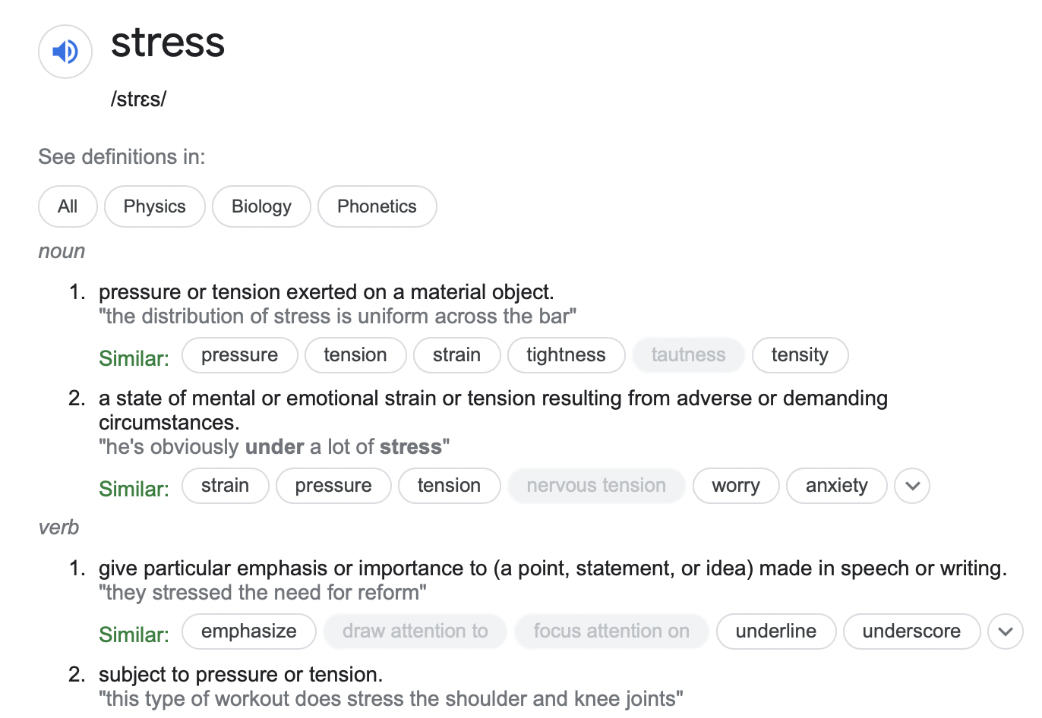
What is stress?

Slide 7
What is stress?
https://www.youtube.com/watch?v=zsFd84C9-vA
Stress can be both positive and negative.

Slide 8
Progress Check
In what way can stress be positive?
What are the 4 main types of stress?
What does GAS stand for?
What are the 3 phases of responses to stress?

Slide 9
What do you think might be common stressors for the following age groups…
Children ages 1-5 | Children aged 8-11 | Young people aged 12-18 | Adults aged 25-35 | Adults aged 45-55 | Elderly people aged 60+

Slide 10
At any age you may also have feelings of anxiety.
But what is anxiety?

Slide 11
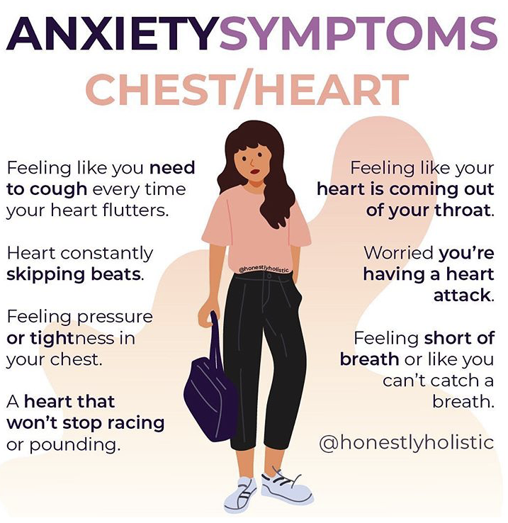

Slide 12
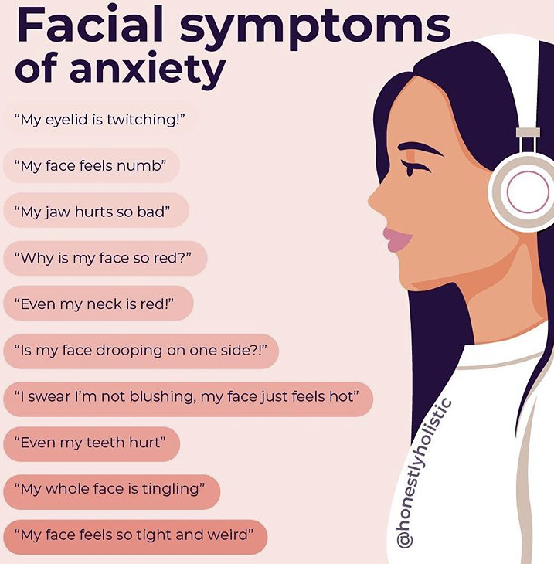

Slide 13
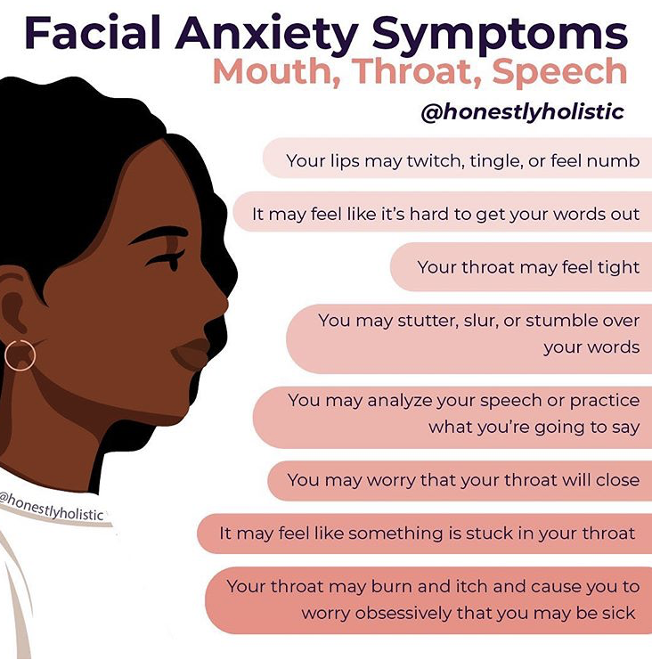

Slide 14
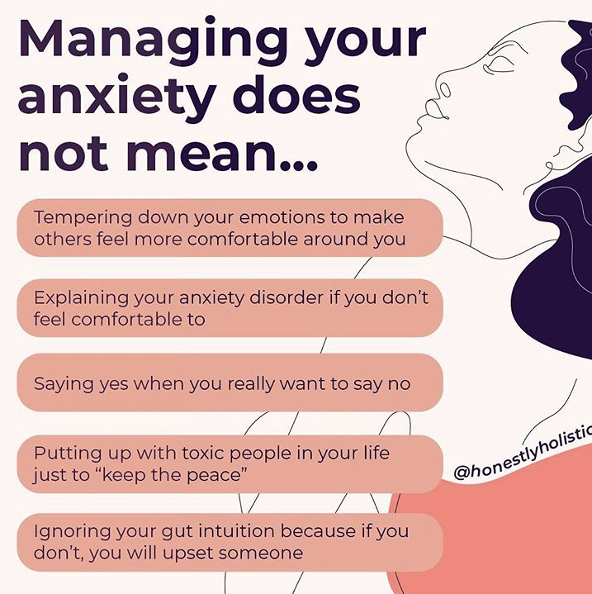

Slide 16
Prolonged stress can develop into depression…
What does a stereotypical person with depression look like? | Why might depression be difficult to recognise? | Why might some people find it difficult to take depression seriously and understand?

Slide 17
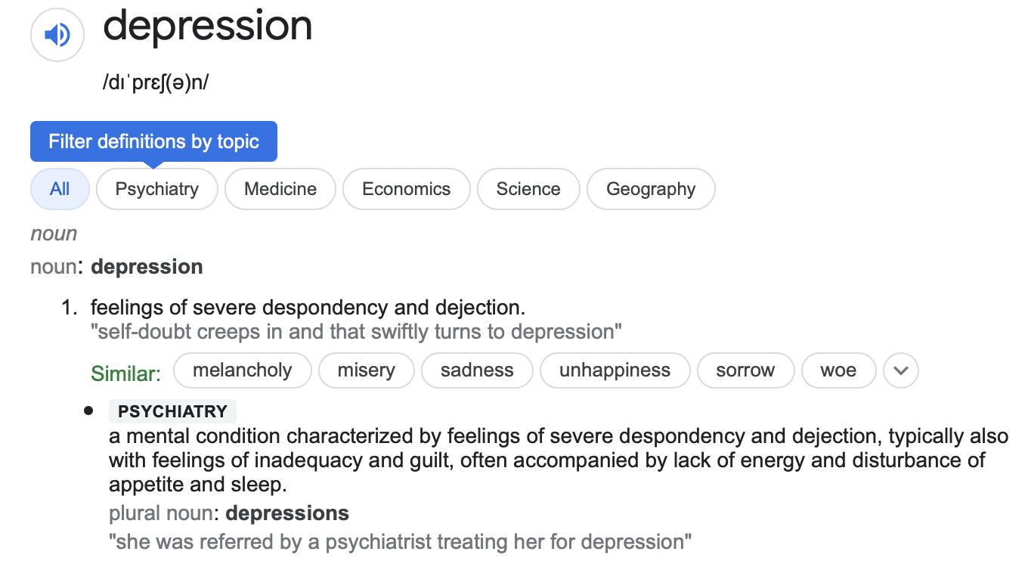
Prolonged stress can develop into depression.
But what is depression?

Slide 18
So what is depression exactly?
AND
Why is it often misunderstood?
https://www.youtube.com/watch?v=fWFuQR_Wt4M

Slide 19
Depression warning signs and when to worry from Dr Pooky Knightsmith
PROGRESS CHECK
What are the 6 warning signs to look out for?
https://www.youtube.com/watch?v=eNCNfalmSpY

Slide 20
Listen to Dr Pooky talk you through the box breathing technique and try it along with her.
PROGRESS CHECK
Create a step by step set of instructions about how to carry out the box breathing technique
https://www.youtube.com/watch?v=JYytiS0ymZg

Slide 21
So what can you do if you feel as though you or someone you know might be experiencing stress, anxiety or depression?
Speak to someone!
Mental Health Foundation
Provides information and support for anyone with mental health problems or learning disabilities.
Website: www.mentalhealth.org.uk

Slide 22
How can you support your mental health?
What will do you do?
To protect my mental health, I am going to....

