Slide 1
No shouting out
Respect others’ point of view
Listen carefully to others
Do not put others down
Never use the discussion to start or spread rumours.
Don’t reveal personal information in discussion.
Never reveal sensitive information about another named person, however it is okay to talk hypothetically
Always be mature and sensitive when discussing issues in Enrichment
If you want to talk about something personal, you are very welcome to talk to a teacher or Mrs L Wootton, Mrs J Samuels.

Slide 2
Your friend posts a comment on social media:
Feeling sad…why won’t people just leave me alone??
What would your first action be after reading this? What other words would you use to describe your friend’s emotions? | Why do you think your friend has posted this? | How would you support your friend?

Slide 3
Prior Learning
Mental Health through Social Media- increased risk of developing anxiety, depression, stress, effects on sleep, ability to concentrate etc.
Today’s Lesson:
Describe the meaning of bullying and cyberbullying and the impact it can have
Explore challenging scenarios and their appropriate responses
Explain where to seek support and advice on bullying/cyberbullying.
Thinking Ahead:
KEYWORDS
Social media, discrimination, blackmail, sexting, harassment, race, culture, ethnicity, sex, gender, sexual orientation, prejudice, physical, verbal, cyberbullying

Slide 4
ASPIRE BELIEVE ACHIEVE
ALL subjects!
ILT
Select one of these careers and create a career profile page in your booklet.
All headings completed
Best presentation only
Keep a record of your sources (where you found this information)
Ask for help if you need to
Qualifications
Careers
Youth worker
Social worker
Psychologist
Teacher
Counsellor
Plan your future
Rights Respecting
&
PRIDE
Integrity
Determination
Empathy
Skills & Qualities

Slide 6
What is bullying?

Slide 7
What bullying is
Making comments about
Your weight
Your appearance
Your abilities
Your religion
Your background
Your disability
Your health
Your family
Your accent
Name calling
Hitting, pinching, biting, pushing and shoving
Damaging your belongings
Stealing your money
Making things up to get you into trouble
Taking things away from you
Taking your friends away from you
Posting insulting messages on the internet or by IM (cyberbullying)
Spreading rumours
Threats and intimidation
Making silent or abusive phone calls
Sending you offensive phone texts

Slide 8
What bullying is
Name calling
Hitting, pinching, biting, pushing and shoving
Damaging your belongings
Stealing your money
Making things up to get you into trouble
Taking things away from you
Taking your friends away from you
Posting insulting messages on the internet or by IM (cyberbullying)
Spreading rumours
Threats and intimidation
Making silent or abusive phone calls
Sending you offensive phone texts
TASK:
Rank order these examples from the worst form of bullying at the top down to the least worst
Be ready to explain why one form of bullying is worse than another, in your opinion.
We may perceive some of these to be not as bad as others, but they are all still forms of bullying. It is not good enough to say that something was a “joke” or that it was “teasing”.
If it is something negative about another person, it is bullying!

Slide 9
What are the consequences of bullying?
Discuss the statements below.
Which consequence will have the greatest impact on the victim?
Feeling unable to trust others.
Feeling suicidal.
Having low self esteem.
Lacking confidence.
The effects and feeling last until adulthood.
Feeling lonely.
Truanting school
Having a lack of friends.
Feeling scared for their safety.
TASK:
Divide these into what you think could be short or long term consequences. Be prepared to explain why.
Short term- during schools years
Long term- long into adulthood

Slide 10
Did You Know
69% of children in the UK report being bullied
87% of parents report that their child had been bullied in the past 12 months
20% report bullying others
85% had witnessed bullying
1 in 5 child deaths in the UK is caused by suicide. Could this be due to bullying?
It is estimated that at least 20 children and adolescents a year commit suicide because of being bullied
More than half of those who reported being bullied had been physically hurt
34% of those physically hurt required attention from a doctor or hospital.
3% of the attacks involved a weapon.
1 in 3 young people who experience bullying truant from school
How do these statistics make you feel?
Why?

Slide 11
‘Most conflicts start online’ - Do you agree or disagree? Explain your reasons.
What stressful situations occur online?
What causes online arguments?
What are the effects of online arguments?
How can we avoid or get out of conflict online?
How does cyberbullying differ from other types of bullying? Why do you think this is?
Why can stopping bullying be so difficult? How is this made even harder when the bullying is online?
Notes:
Q2. To keep the peace
To maintain public order
To prevent bad behaviour resolve disputes
To make everyday situations more fair.

Slide 12
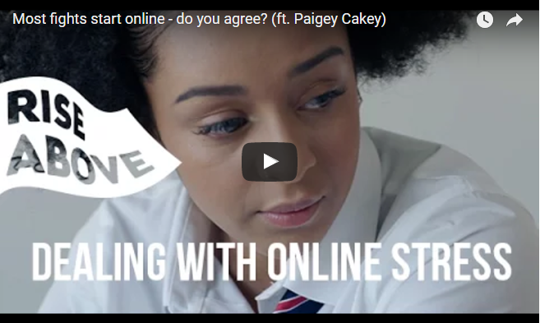
How did this situation start?
Who was in the wrong?
Who was to blame for the situation escalating?
What causes situations like this to escalate so quickly?
How could this situation have been resolved before it became physically violent?
https://riseabove.org.uk/article/do-most-fights-start-online/
Use a different colour pen to add to your previous answers.

Slide 13
We all have a role to play to resolve conflict
How could each of these groups respond to and support in resolving one of the conflicts below?
Individual
Friends
School
Other e.g. family, police, youth clubs, websites
Malik has just joined the school. He sees his teacher struggling with some books and goes to help him. A group of students see this and mutter ‘freak’ under their breath at him. Every time they see him around school they shove him when they pass him.
Jade overhears her friends talking about a party they are going to at the weekend. She asks them where it is and they change the conversation and pretend to ignore her question. That weekend she sees them posting snapchats from the party saying ‘best friends forever’.
In every English lesson, students get into groups with each other for group-work. Every week, all the other students refuse to work with James, saying that he smells and is dirty. Sometimes they pass him notes with picture of a shower and tell him to ‘have a wash’.
Rhea has been friends with Martha for two years. Rhea checked her phone at break time and saw that Martha has put up a social media status about how she hates hanging out with snitches and has tagged her in it. Later that day she finds that Martha has blocked her on all the social media sites and won’t pick up her calls.
Notes:
Direct students to the Rise Above website for ideas. If devices are not available for students to use, they can discuss in groups using their own knowledge.
Students can create their own diagram or complete in groups. You can direct each pair/group to a scenario or allow students to choose their own.

Slide 14
Based on the scenario you’ve just read, consider the following questions…
Which actions would be the most supportive and why?
Which circle of support is the most important in your scenario?
What may be the barriers to accessing these circles of support and how could they be overcome?
Why might some types of bullying be more serious and require more support than others?
Notes:
Q2. To keep the peace
To maintain public order
To prevent bad behaviour resolve disputes
To make everyday situations more fair.

Slide 15
School anti-bullying policy
What should be included? Think about everything you discussed.
Don’t forget about cyberbullying!
_________________________________________________________________________
_________________________________________________________________________
_________________________________________________________________________
_________________________________________________________________________
_________________________________________________________________________
Notes:
All students write suggestions on sticky notes or in groups as a list on sheets of paper.
You (or the students themselves) can review the collection of post-its and turn them into a wall display.
Remember to reinforce the message that students must reach out to trusted adults or friends if they are experiencing bullying or suspect that someone they know is being bullied – either in person or online.

Slide 16
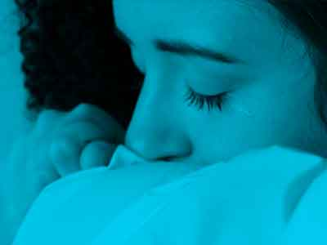
Reach out for support
If you, or anyone you know needs support in this area, speak to a trusted adult, a teacher, form tutor, house leader.
You can also get support from Childline at: https://www.childline.org.uk/
Notes:
Remember to reinforce the message that students must reach out to trusted adults or friends if they are experiencing bullying or suspect that someone they know is being bullied – either in person or online.
Signpost students to Childline (https://www.childline.org.uk/) and their pastoral system in school, such as their form tutor, head of year or school nurse.

Slide 18
Your Pledge. How are you going to play a role in eliminating bullying?
https://www.youtube.com/watch?v=mBwf-VPZqDs
How have you learnt to keep yourself and others safe in your lesson today?
Notes:
Play the video before students write their pledge for a final message and inspiration.

