Slide 1
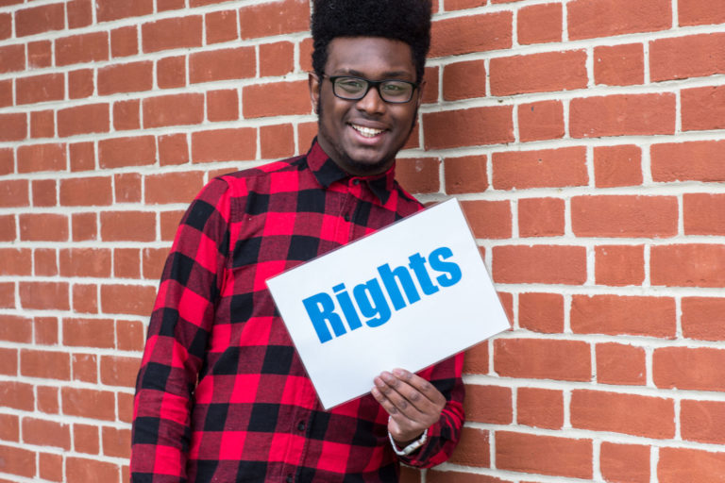
Who are the DUTY BEARERS and who are the RIGHTS HOLDERS?
What are the 4 GENERAL PRINCIPLES of the UNCRC?
Complete- Children's rights are I, I, I, U, U

Slide 2
Prior Learning
Social media
Today’s Lesson:
To recall the meaning of a duty bearers and rights holders
To know how rights are upheld
To reflect on the rights we feel are most important to us
Thinking Ahead:
Living in the wider world
KEYWORDS
Duty Bearers
Rights Holders
UNCRC
Rights
CC: geography, history, science
Careers: aid work, social work, medicine, nursing, law

Slide 3
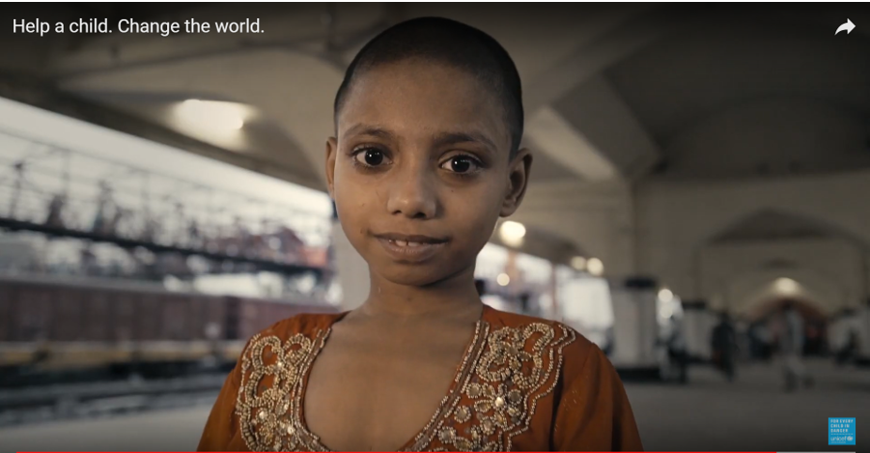
WHAT DO UNICEF DO?
Watch video
Notes:
https://www.youtube.com/watch?v=pz0ca4gD2Es

Slide 4
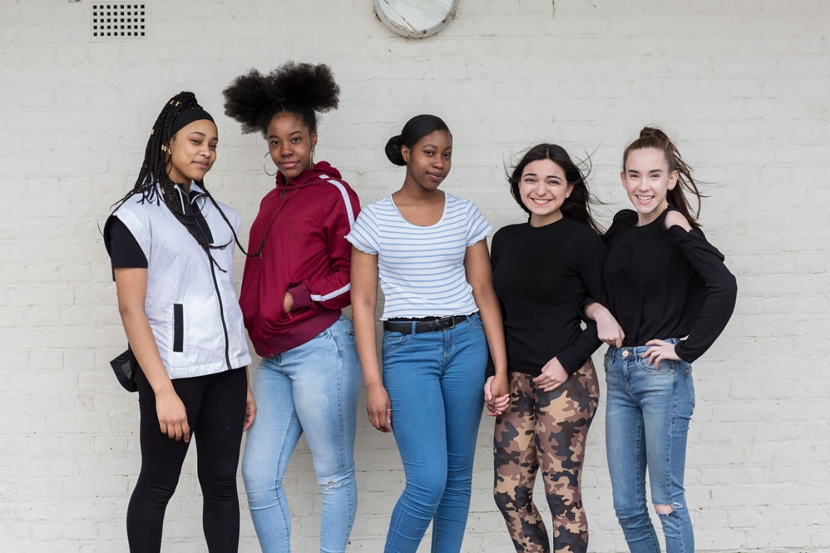
the United nations convention on the rights of the child
© Unicef/Dawe
The most widely ratified (approved) treaty (international agreement) in the world.
It applies to everyone under 18.

Slide 5
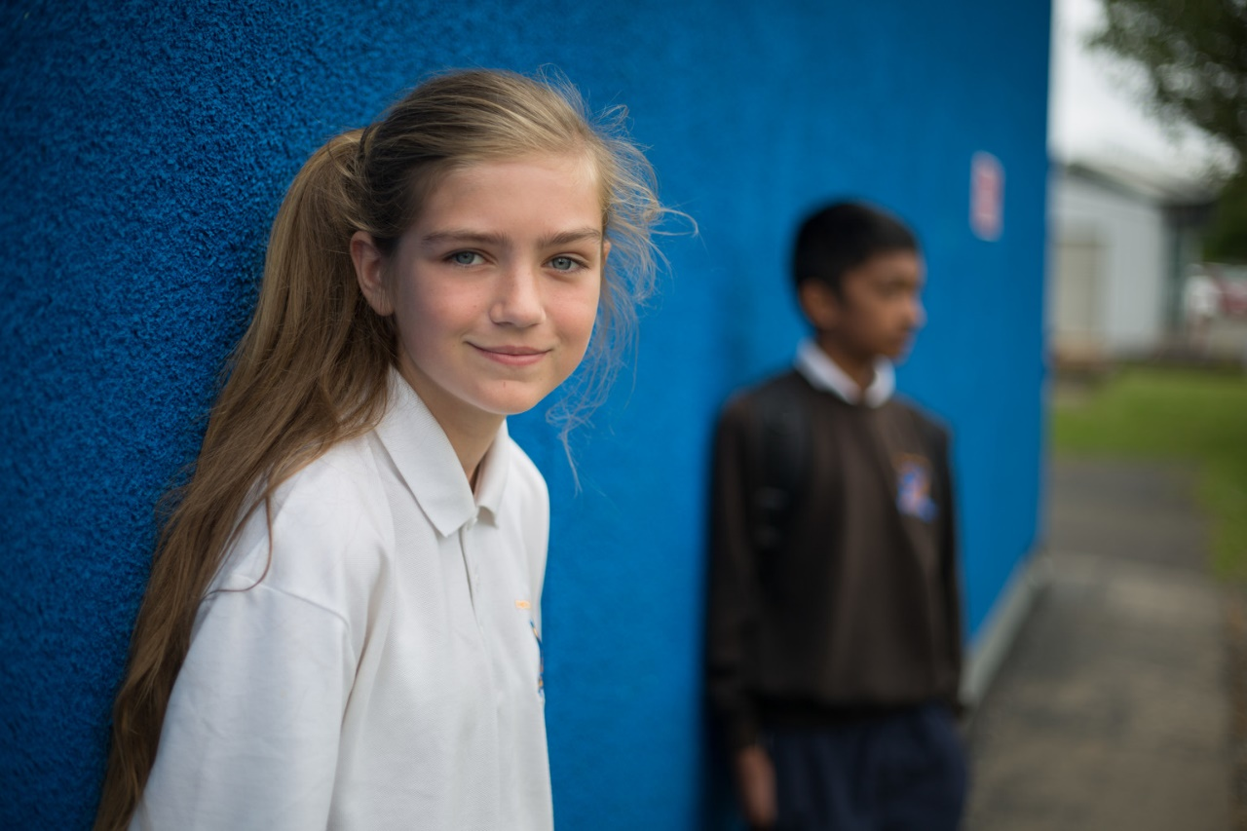
Rights like…
The right to life. Governments must do all they can to ensure that children survive and develop to their full potential
© Unicef/Sutton-Hibbert

Slide 6
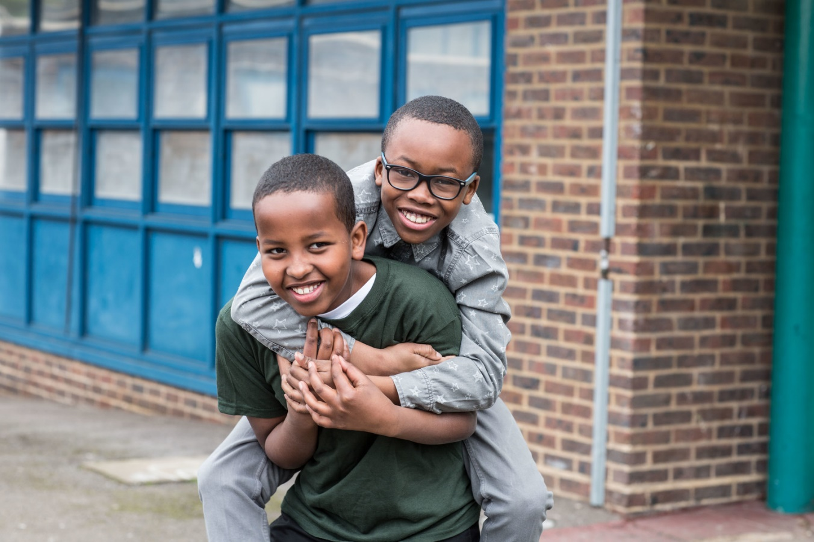
Rights like…
The right to the best possible health.
Every child should have access to good quality health care, clean water, nutritious food, and a clean environment.
© Unicef/Dawe

Slide 7
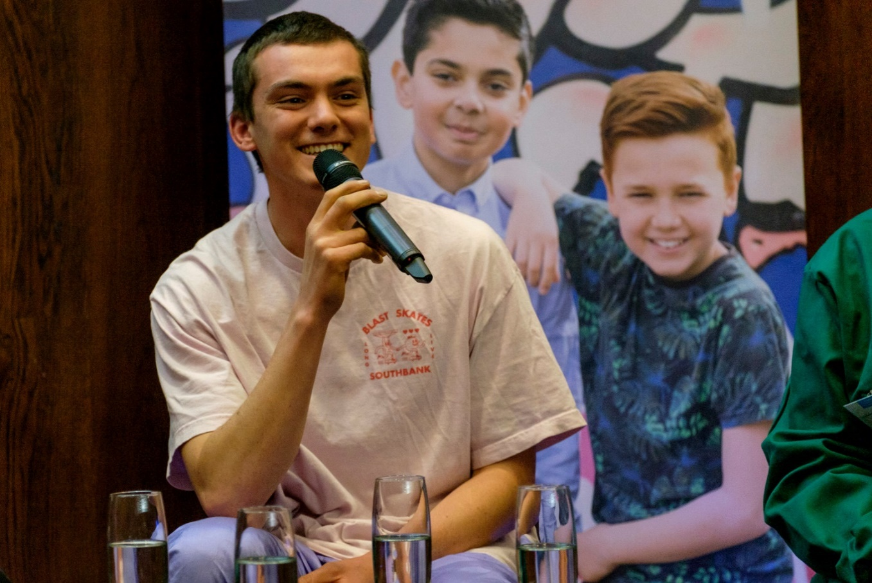
Rights like…
The right to have their views respected
Every child has the right to express their views, feelings and wishes about anything that affects them, and have these taken seriously
© Unicef/Bye19

Slide 8
So, what’s the problem?
Last year the UN Convention on the Rights of the Child had its 30th birthday.
But despite the UN agreeing to the rights of every child in the Convention over 30 years ago, there is still a lot of work to be done for children in the UK and all over the world.
Every year, 5.4 million children die before age five. The majority of these deaths are from preventable causes.
Children face many challenges now that didn’t exist before – such as online bullying, childhood obesity and climate change.
More countries are in conflict than at any time since the Convention was written and many children are among the millions of refugees from these conflicts.

Slide 9
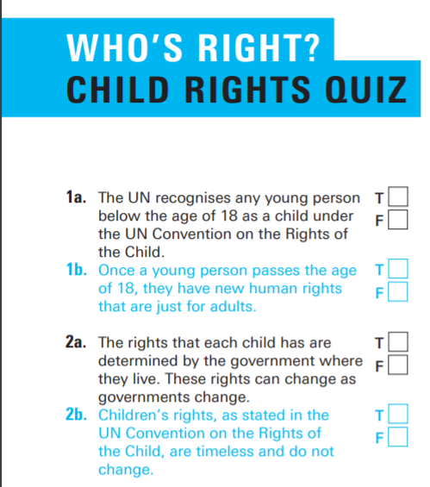
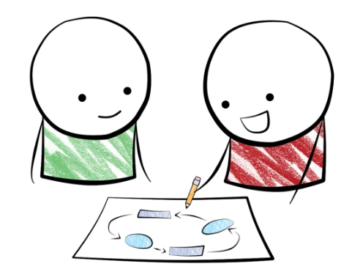
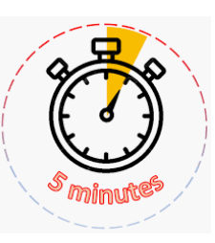
In pairs, you are going to complete the
Who’s Right? Children's Rights Quiz.
You have 5 minutes to complete this.
Notes:
Resource pack pages 12-19 required.
Quiz page 15 requires printing. Page 16 gives you the answers to work through as a class.

Slide 10
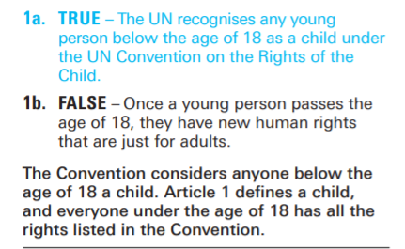
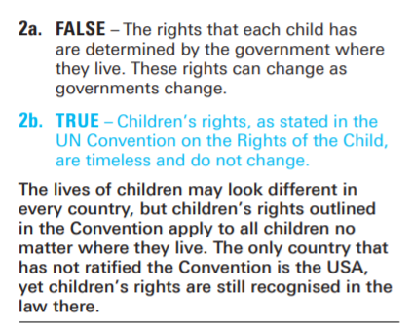
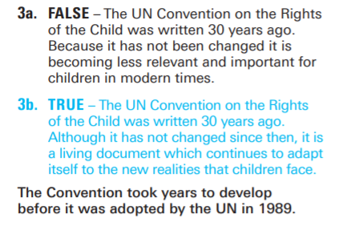

Slide 11
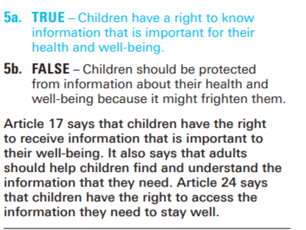
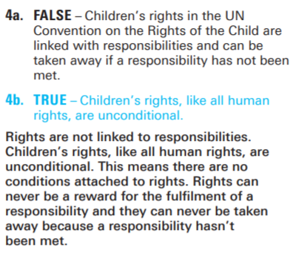
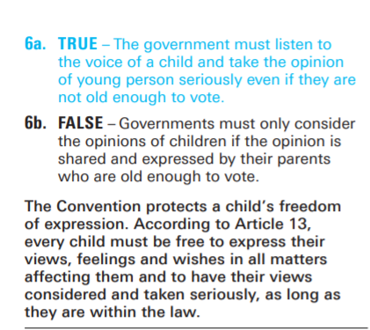

Slide 12
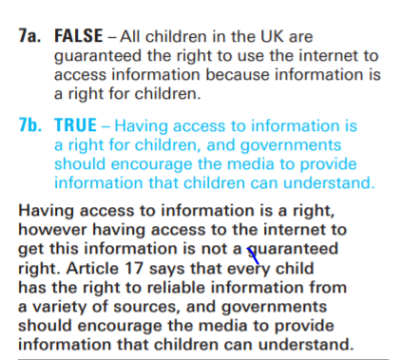
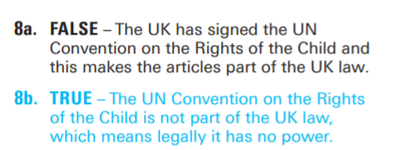
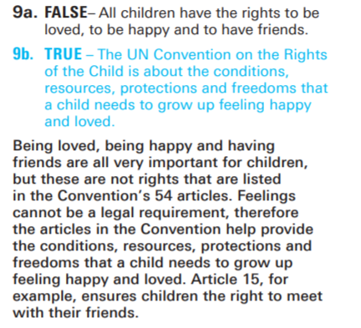

Slide 13
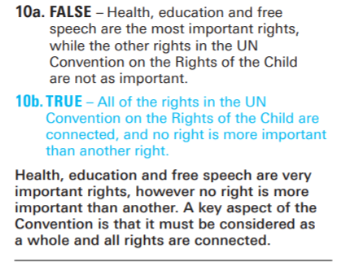
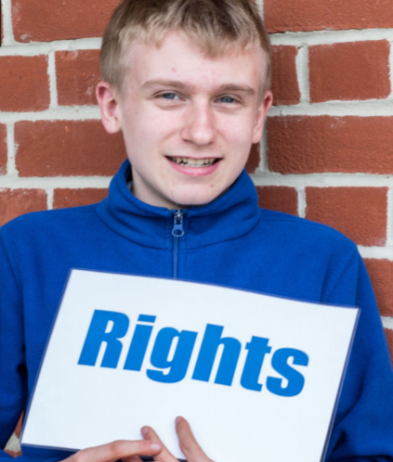

Slide 14
1. How does this link to our SGS Standard?
2. Why do we have a Stockland Green Standard?
3. How does the Stockland Green Standard support our rights?

