Slide 1
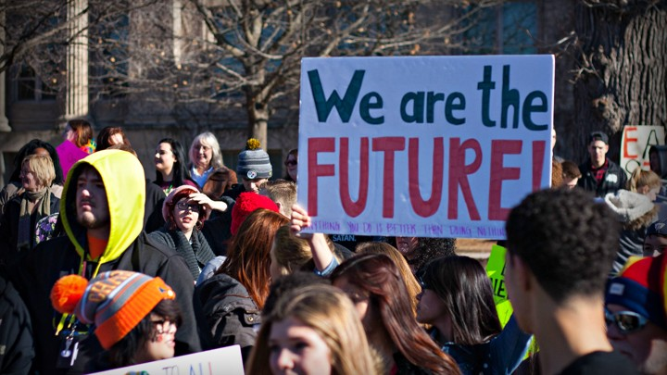
What is an activist?
Name any youth activists you can think of, and what they are campaigning for?
List the qualities that you think an activist would need.
Notes:
Watch the video Just a Kid

Slide 2
Prior Learning
LGBTQ+
UNCRC
The Rights of the Child
Today’s Lesson:
To know the meaning of activism
To explore different youth activists
To consider how we can play a positive role in our community
Thinking Ahead:
Living in the wider world
KEYWORDS
Activism
Community
Climate change
LGBTQ+
advocacy.
involvement.
militancy.
logrolling.
striking.
boycotting.
championing.
effecting change.
CC: sociology, psychology, English
Careers: journalism, law, politics

Slide 3
Word:
Activism
Define it:
the policy or action of using vigorous campaigning to bring about political or social change.
Write a sentence of your own that uses the word activism.
Write your own definition of the word activism.
Which subjects or topics will this word be relevant to?
Digging Deeper:
Link it:
Advocacy, involvement, militancy, logrolling, striking, boycotting, championing, effecting change.
Deconstruct it:
The Online Etymology Dictionary traces the roots of the word back to 1915 when Swedish 'activists' petitioned for the end of that country's neutrality in World War I (WWI).
Use it:
Youth activism is the topic of our lesson today!

Slide 4
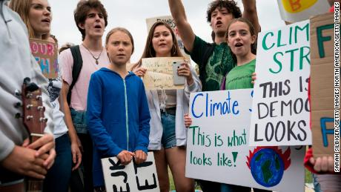
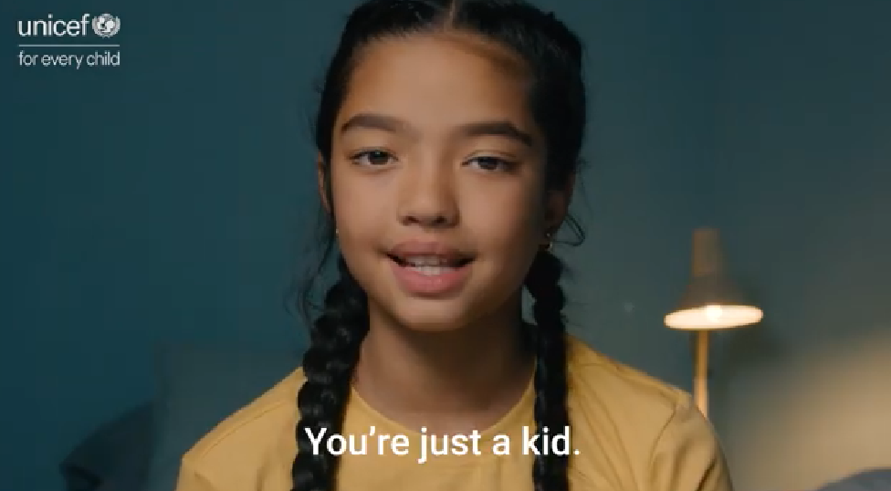
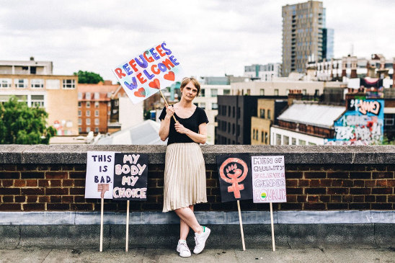
Youth Activists
https://www.youtube.com/watch?v=y4udqAY2Bqc
What examples of activism where referenced in the video? | What inspired these young people to advocate for things they believed in? | What examples of activism could you see?
Notes:
Watch the video ‘Just a kid’
Split the class into 6 or 12 small groups, and distribute the 6 Youth Activist profiles.

Slide 5
Take a look at the 10 youth activists on the next slides

Slide 6
Youth Activists
Describe this activist in 3 words | Summarise in one sentence what she is advocating for? | What qualities and strengths do you think she posses that makes her successful?

Slide 7
Youth Activists
Describe this activist in 3 words | Summarise in one sentence what she is advocating for? | What qualities and strengths do you think she posses that makes her successful?

Slide 8
Youth Activists
Describe this activist in 3 words | Summarise in one sentence what she is advocating for? | What qualities and strengths do you think she posses that makes her successful?

Slide 9
Youth Activists
Describe this activist in 3 words | Summarise in one sentence what she is advocating for? | What qualities and strengths do you think she posses that makes her successful?

Slide 10
Youth Activists
Describe this activist in 3 words | Summarise in one sentence what she is advocating for? | What qualities and strengths do you think she posses that makes her successful?

Slide 11
Youth Activists
Describe this activist in 3 words | Summarise in one sentence what she is advocating for? | What qualities and strengths do you think she posses that makes her successful?

Slide 12
Youth Activists
Describe this activist in 3 words | Summarise in one sentence what she is advocating for? | What qualities and strengths do you think she posses that makes her successful?

Slide 13
Youth Activists
Describe this activist in 3 words | Summarise in one sentence what she is advocating for? | What qualities and strengths do you think she posses that makes her successful?

Slide 14
Youth Activists
Describe this activist in 3 words | Summarise in one sentence what she is advocating for? | What qualities and strengths do you think she posses that makes her successful?

Slide 15
Youth Activists
Describe this activist in 3 words | Summarise in one sentence what she is advocating for? | What qualities and strengths do you think she posses that makes her successful?

Slide 16
Youth Activists
Select one and design a placard that they may use to show their cause. What message would they want to give?
Share with the class what you have learnt about the young person you were given, and explain what is on your placard and why.
#myvoicematters

Slide 17
Youth Activists
How can we advocate for change appropriately and without violence?

Slide 18
TASK: Create a 1 minute talk about the activist you feel most inspired by.
What is the issue or right that this young activist is working towards
Why is the change and/or right this person is advocating for important? What have they achieved?
What ways could we as fellow young people help tell their story or support their movement?
Notes:
For quiet reflection class discussion.

Slide 19
Share your talks with the class. Whether you are the speaker or the listener, you all have a role to play. Use the oracy ladder to make sure you are all successful

