Slide 1
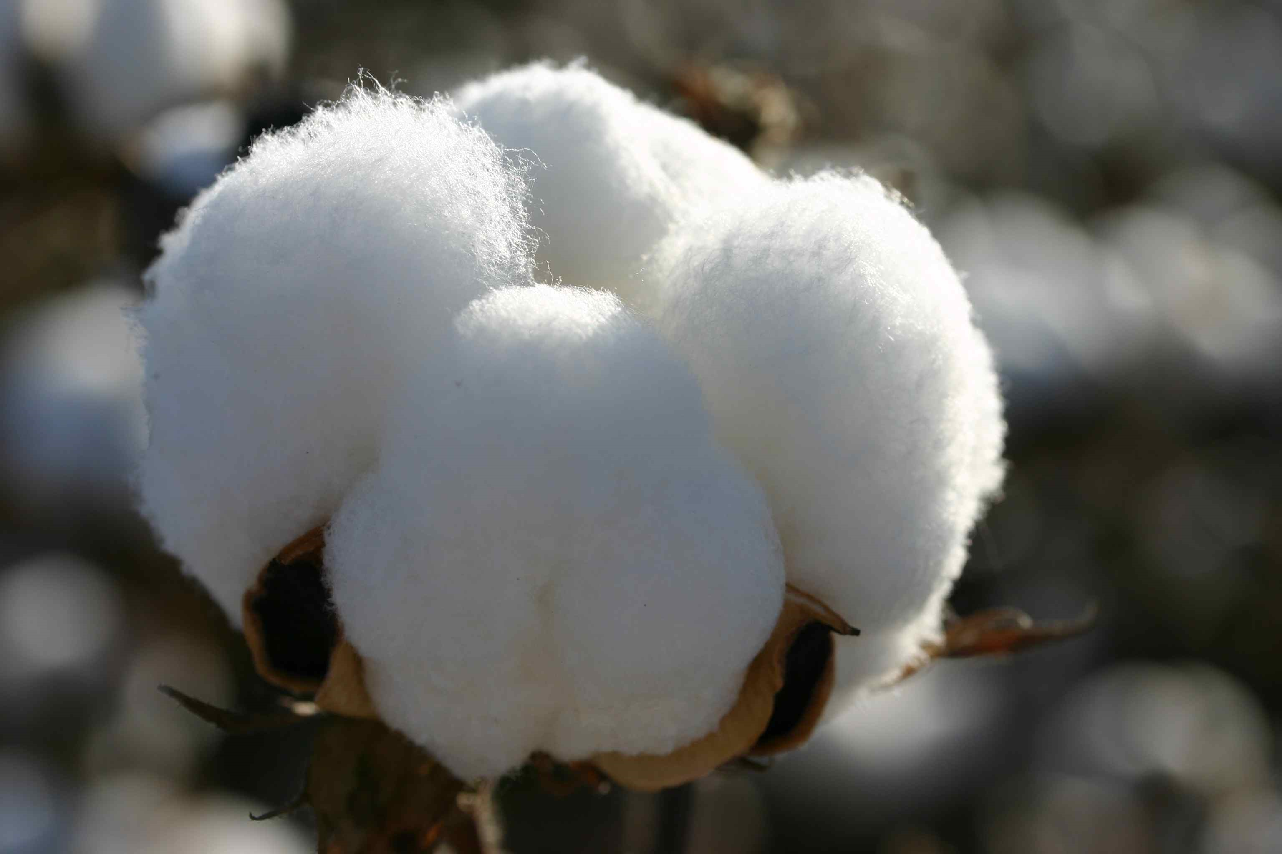
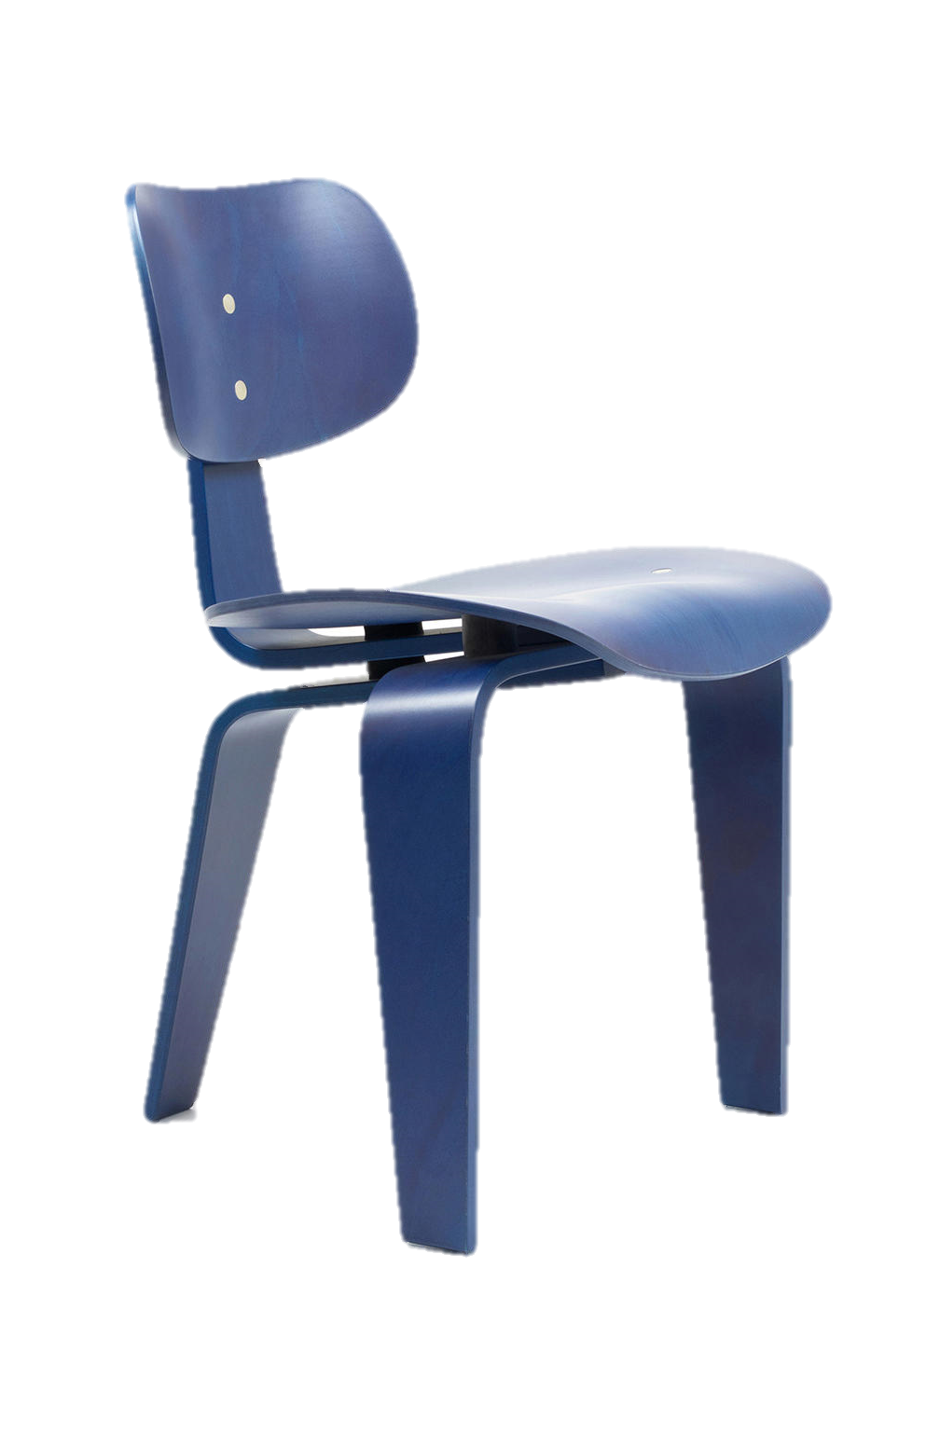
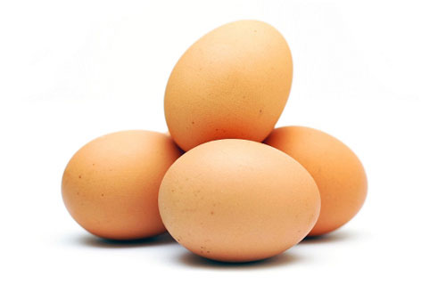
Stockland Green Knowledge Organiser - DT- Year 7 - Investigation
Investigating
In Design and Technology, recording key information is essential to ensure that we design and create a suitable product for our user. Key information can include:- a design brief, specification, materials and their properties and measurements.
What is a Design Brief?
A design brief is a detailed statement describing what you are to design and make, who for and why.
Materials
Materials come in different forms. A material can be anything used to make a product. There are different materials or ingredients used in Technology such a wood, cotton and eggs.
What is a property?
The way to describe a materials is called a property. It is like the characteristics of the material.
This can be used to describe appearance, behaviour, structure, colour and composition.
What is a specification?
A specification is a list of criteria which your design must meet (A little bit like a list of rules you must follow when designing). Because it is like rules, sentences can start with: ‘My design must’ or ‘My design should’.
 | Oak wood is hard and heavy, but nonetheless elastic. The heartwood is very resilient, and durable even under water.
 | Cotton is a natural, cellulosic fibre, which absorbs water and “breathes” well. .
 | Eggs add structure to baked good.
Cotton
My chair must only have 3 legs.
Eggs
Measurements
In Design and technology it is important that we ensure that we record measurements accurately. In Design and Technology we often use centimetres (cm) and millimetres (mm).
Centimetres (cm)
Millimetres (mm)

Slide 2
Stockland Green Knowledge Organiser - DT- Year 7 - Investigation
Know it
Grasp it
What is a design brief?
Give an example of a design brief
What is a design specification?
Name a product and give an example of a specification point for that product
What is a material?
Name 3 types of materials that can be used in Design and technology
What is a property?
Give an example of a property of a material or ingredient.
What units of measure do we mainly use in Design and Technology?
Why is it important to measure accurately in Design and Technology?
Create a mind map of the possible materials that could be used for the children’s product or dish. Include the names and the properties of the materials.
Identity a property of that material
What material could you use?
Possible materials and their properties
Think it
Young children between 3 and 5 years are bored during the summer holidays and need something to occupy them while they are outside. Write a design brief and a specification for this new product.

